Slide 1
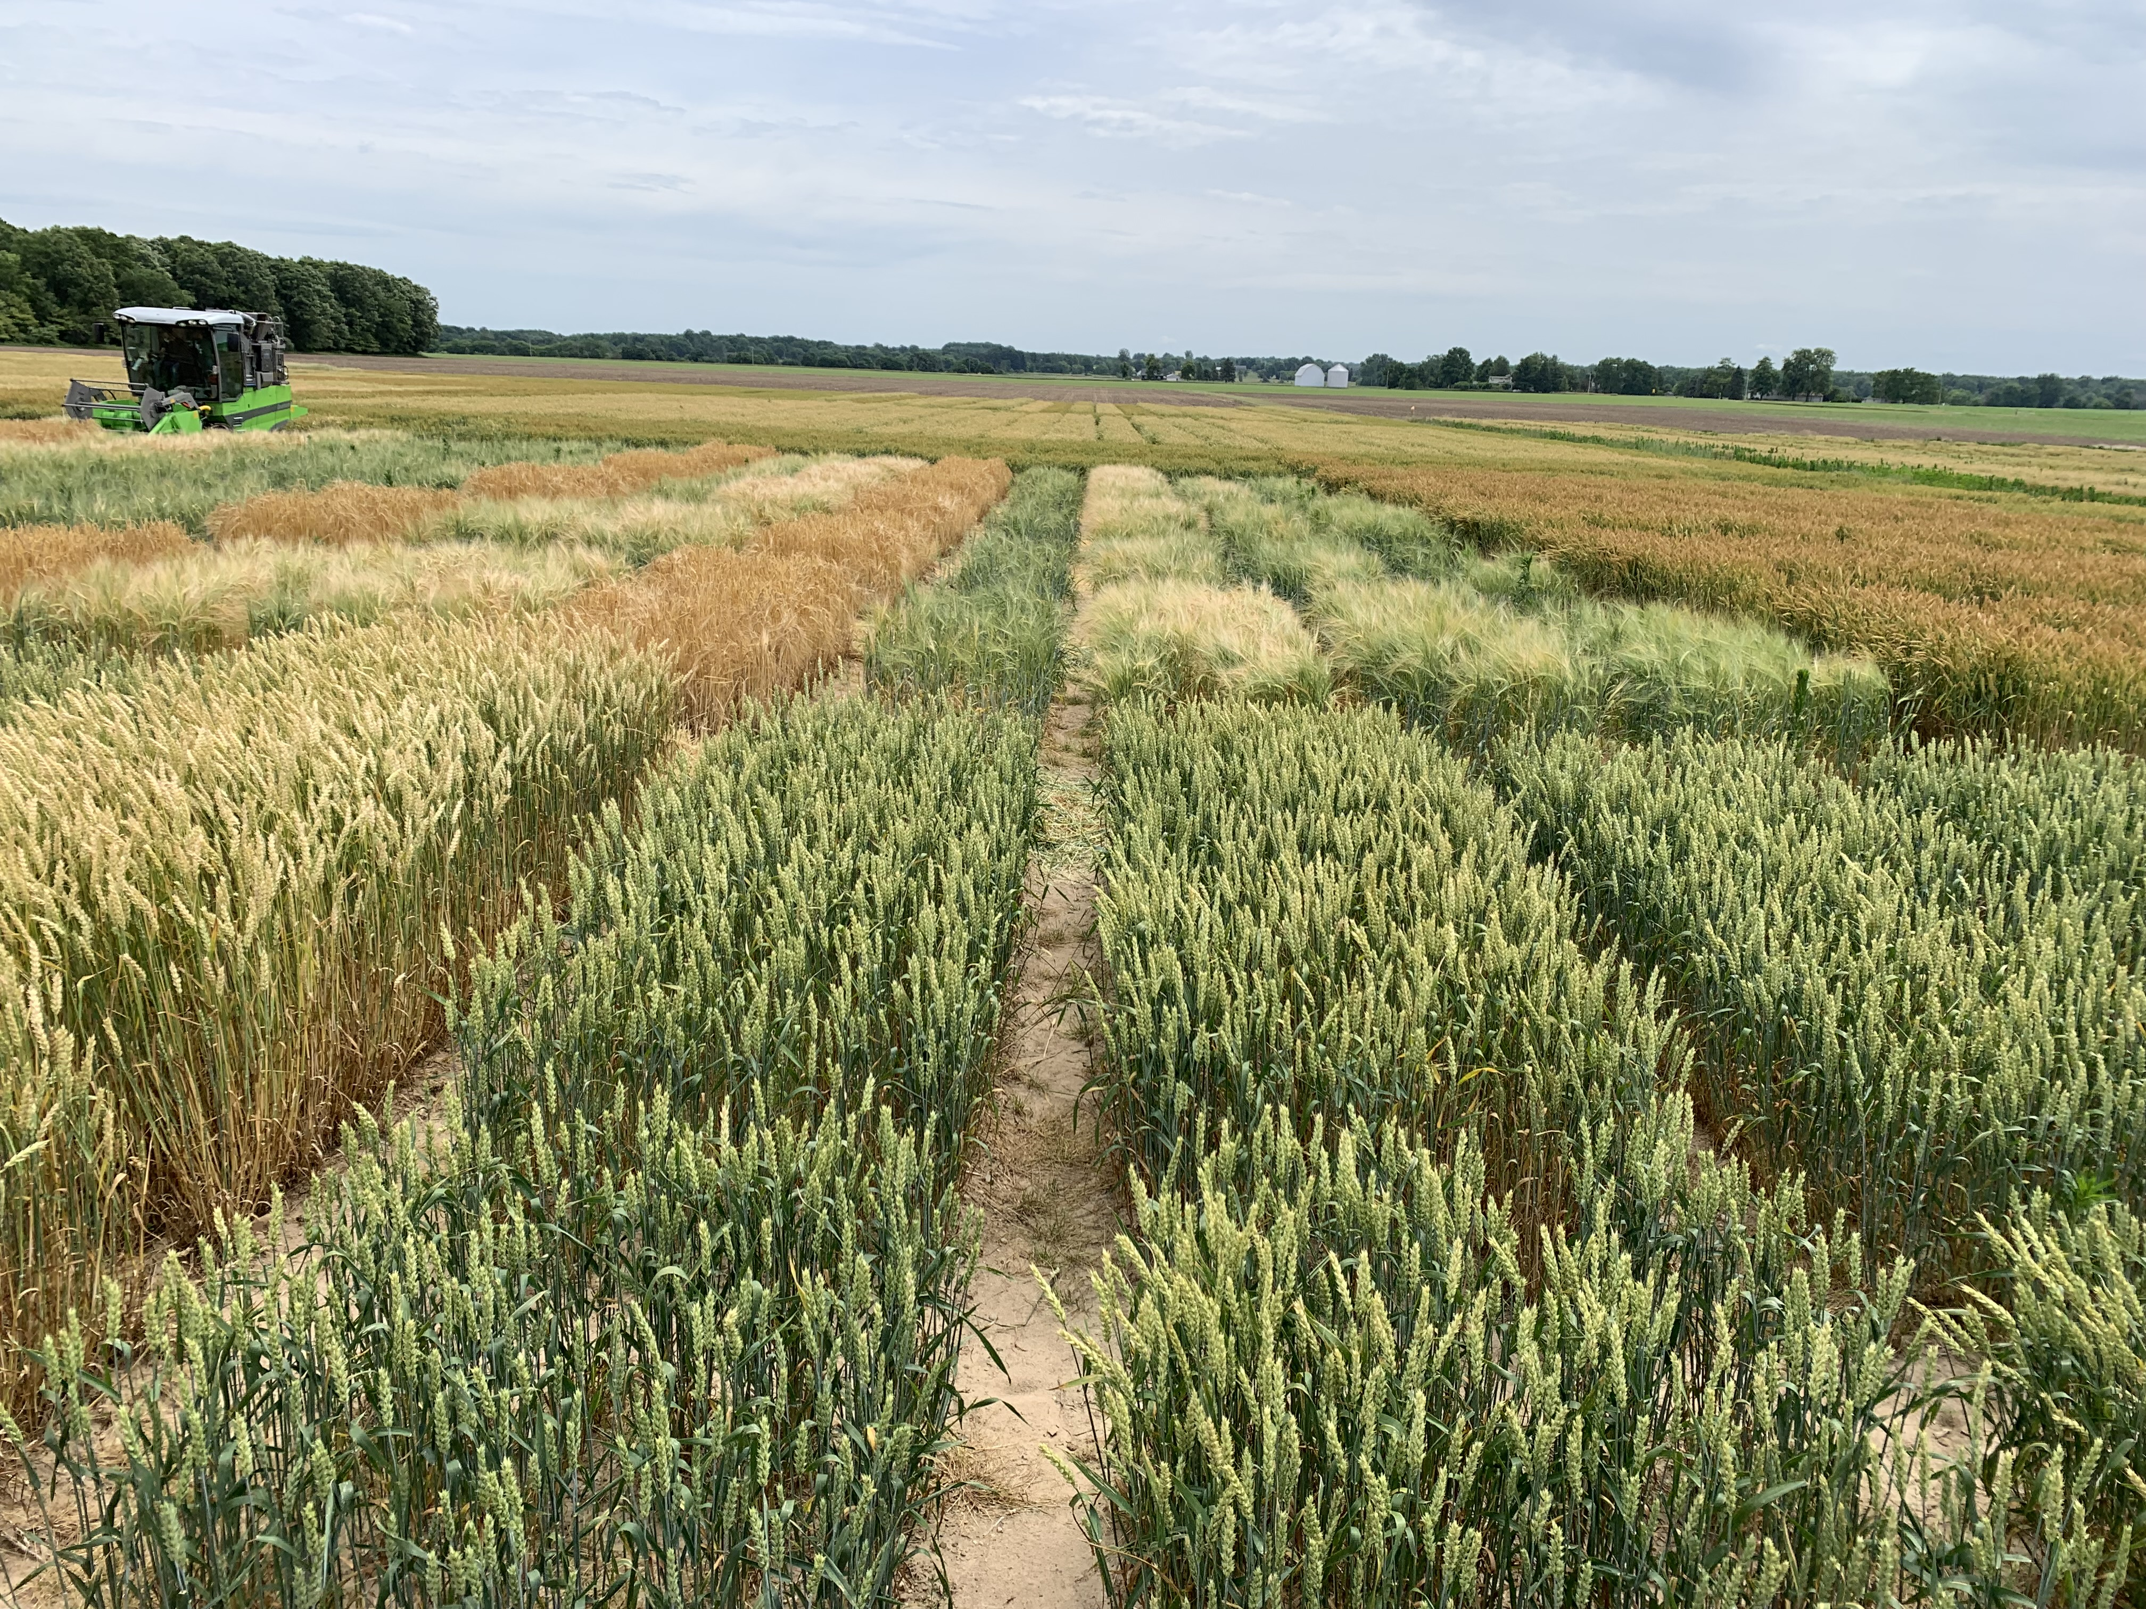
Management Practices to Optimize Winter Barley Yield and Quality
Patrick Copeland and Manni Singh
agronomy.msu.edu
copel113@msu.edu (513) 280-7885
msingh@msu.edu (517) 353-0226
January 13, 2022. Michigan’s Great Beer State Conference & Trade Show
Notes:
Work with Dennis Pennington…

Slide 2
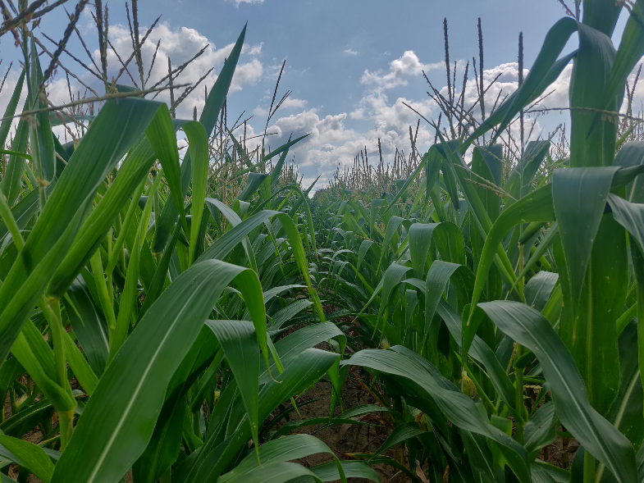
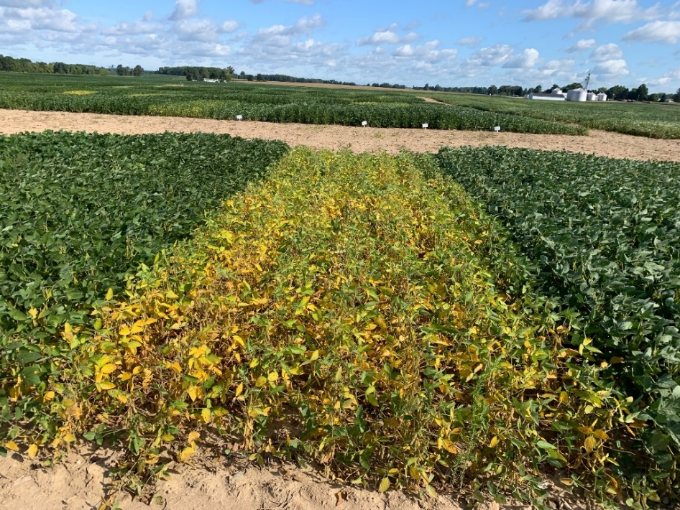
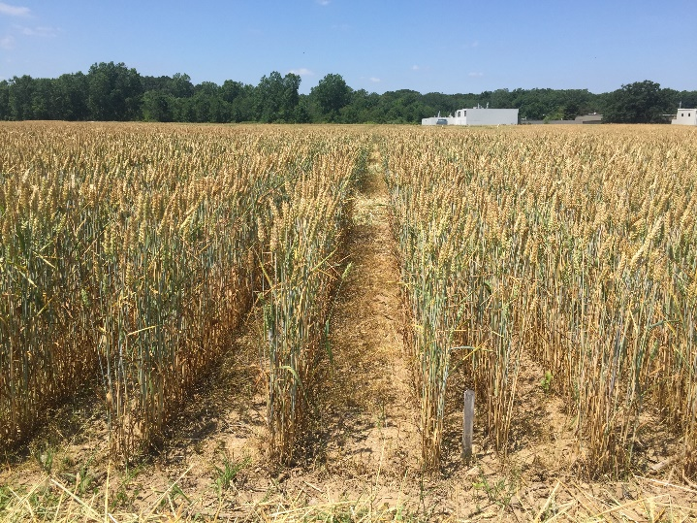
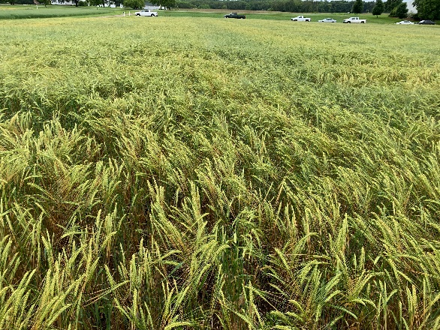
MSU Agronomy Program
Identify current and emerging issues in cropping systems of Michigan with an overall goal to improve the productivity, profitability, and resiliency of these systems
Corn Grain & Silage
Soybean
Winter Wheat
Winter Barley
Notes:
- What our lab does
- My work

Slide 3
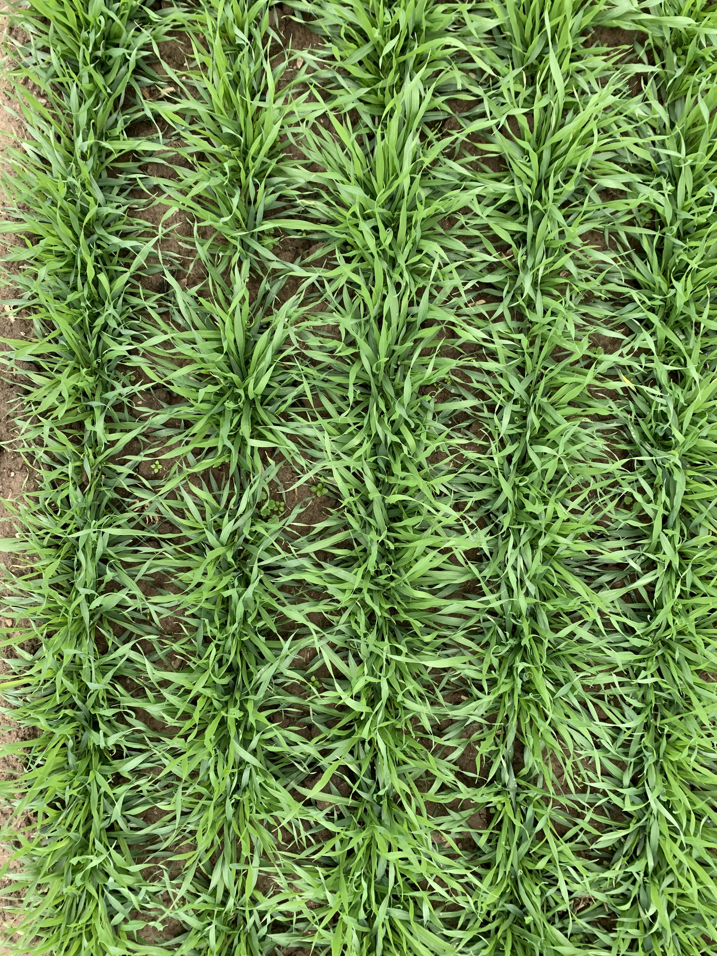
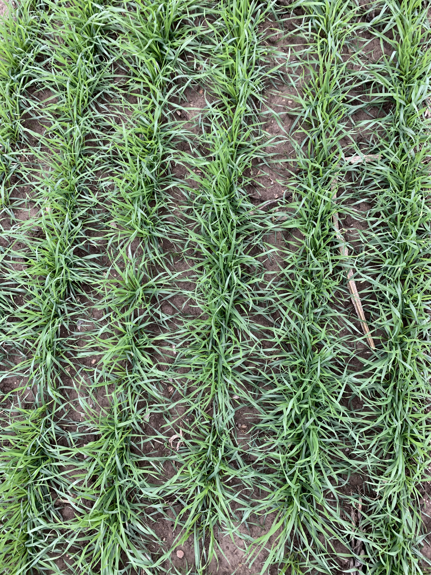
Integrated Crop Management: Yield vs Quality
Crop rotation
Variety Selection
Planting Date
Plant Population
Row Spacing
Fertility management
Pest management
Harvest timing
Winter Barley
Winter Wheat

Slide 4
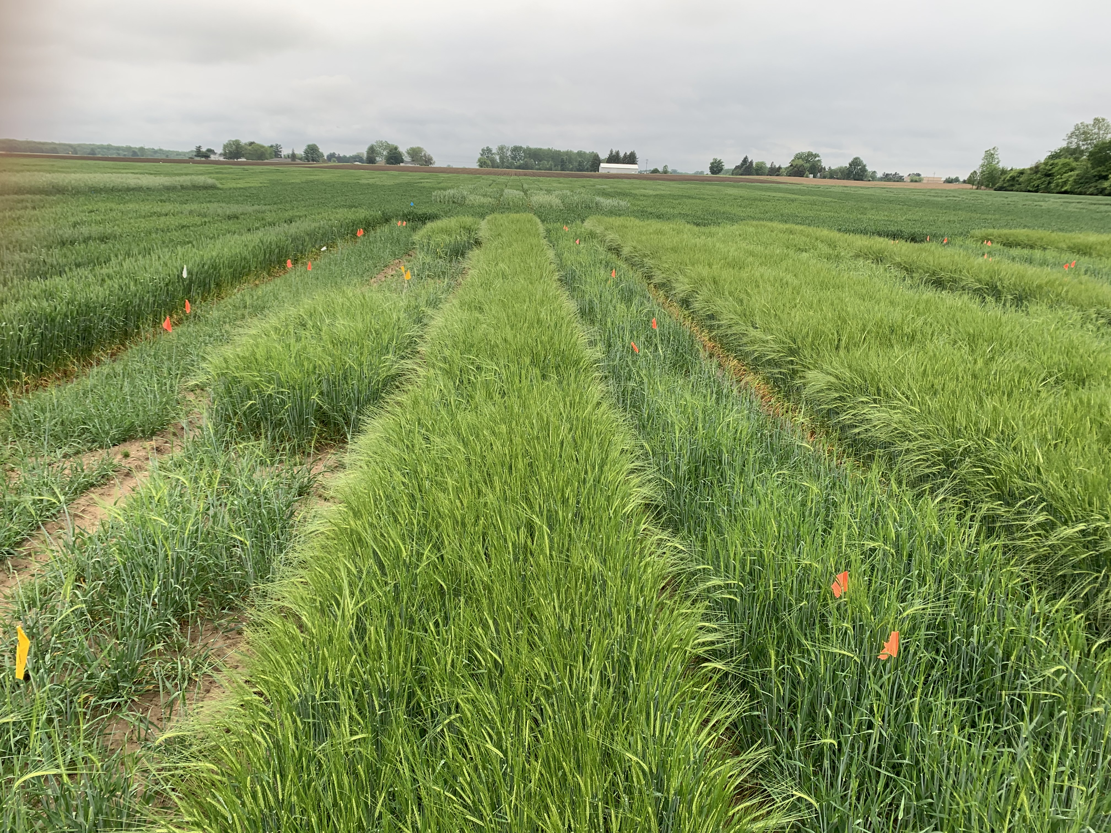
Mason, MI
Variety: Teepee
N Application
2019–20 Growing Season: 30 lbs fall 75 lbs spring
2020–21 Growing Season: 36 lbs fall 65 lbs spring
Plant dates (PD):
2019–20 growing season:
PD1: Sept 19
PD2: Oct 7
PD3: Oct 18
PD4: Oct 29
PD5: Nov 15
2020–21 growing season:
PD1: Sept 17
PD2: Sept. 29
PD3: Oct 14
PD4: Oct 29
PD5: Nov 12
PD5
PD1
PD3
PD4
PD2
Seed rates (SR):
SR1: 0.8 m/ac
SR2: 1.2 m/ac
SR3: 1.6 m/ac
SR4: 2.0 m/ac
SR5: 2.4 m/ac

Slide 5
Hessian Fly Free Dates
Source: Pioneer

Slide 6
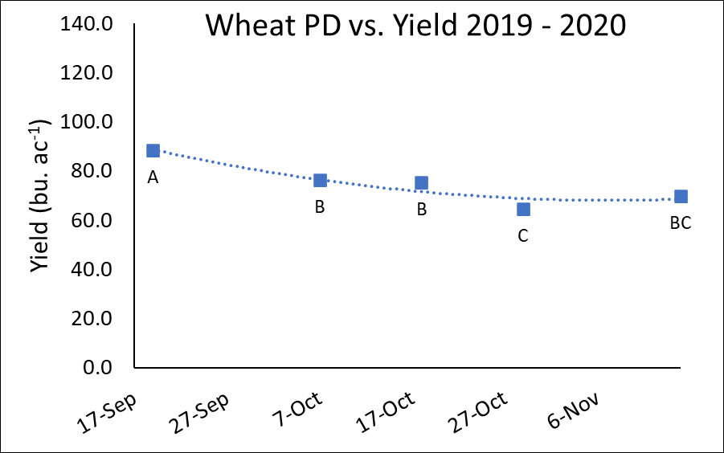
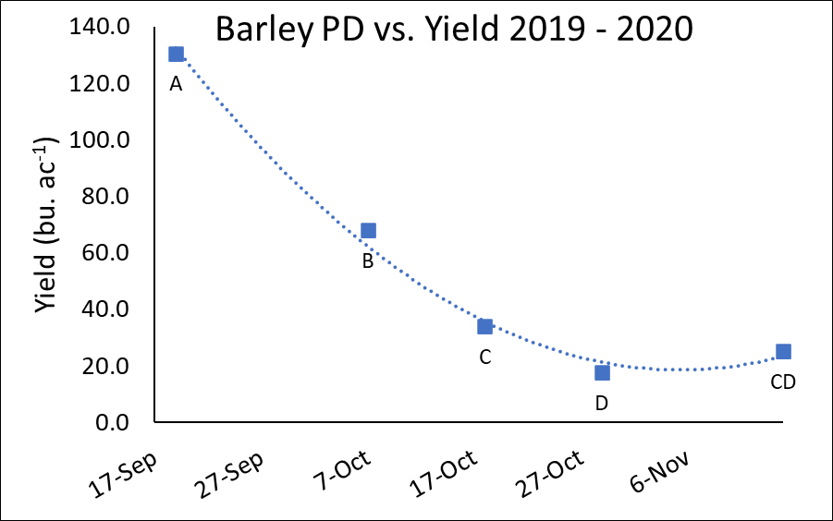
Yield by Planting Date 2019–2020
Yield declined with later planting, but eventually levelled out
Yield response was more significant in barley

Slide 7
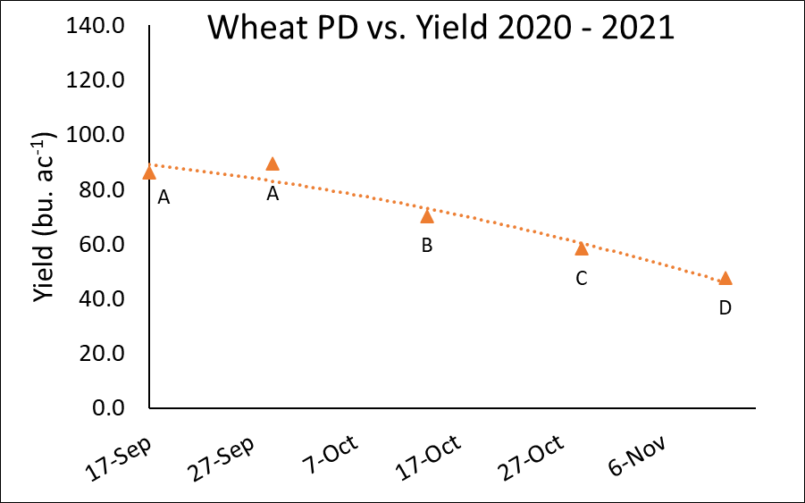
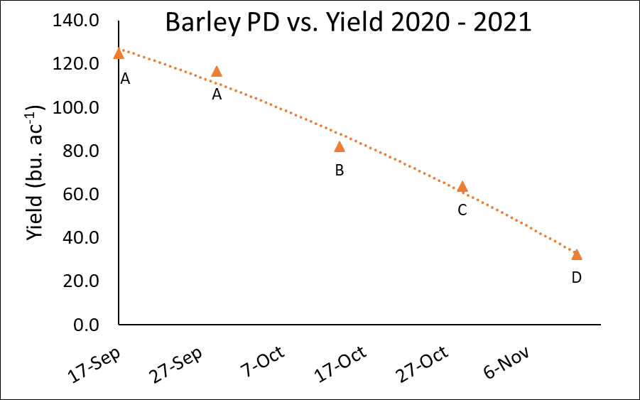
Yield by Planting Date 2020–2021
Yield declined with later planting, and response became greater with later planting
Response was again greater in barley than in wheat

Slide 8
Yield Decline From Late Planting
2019 - 2020
Plant date | % decline (from 19-Sep)
 | Wheat | Barley
19-Sep | - | -
7-Oct | 14% | 48%
18-Oct | 15% | 74%
29-Oct | 27% | 86%
15-Nov | 21% | 81%
p-value | <0.0001
2020 - 2021
Plant date | % decline (from 17-Sep)
 | Wheat | Barley
17-Sep | - | -
29-Sep | -4% | 6%
14-Oct | 18% | 34%
29-Oct | 32% | 49%
12-Nov | 45% | 74%
p-value | <0.0001

Slide 9
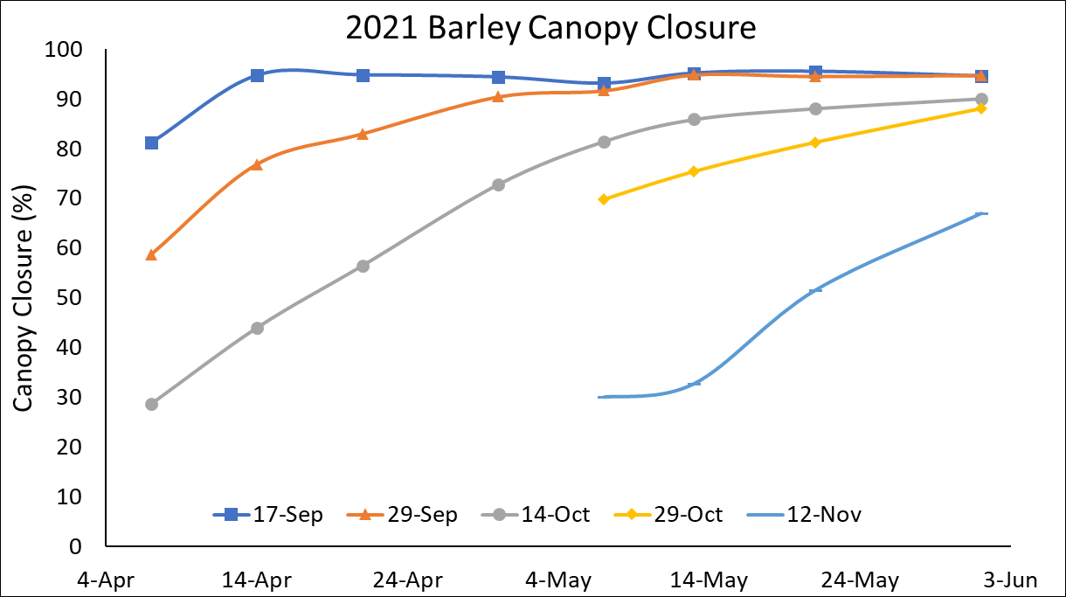
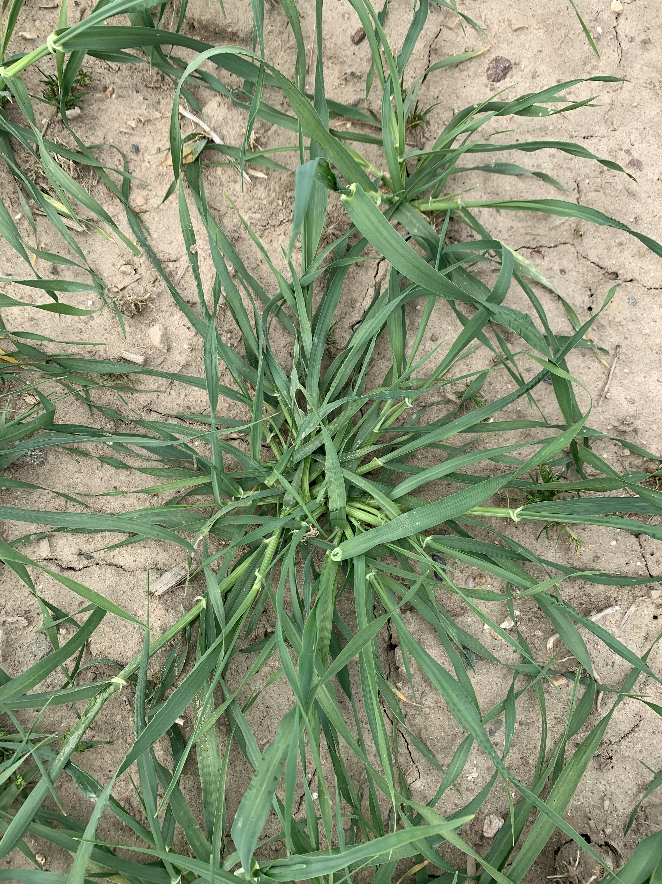
Canopy Closure
First four planting dates all reached canopy closure by beginning of June, yet yield response was still observed

Slide 10
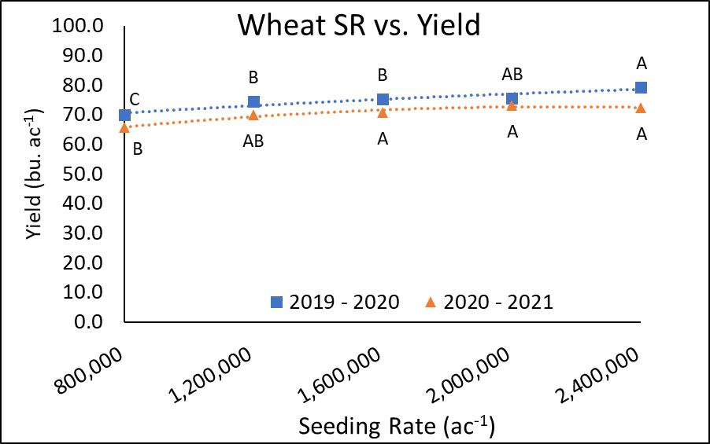
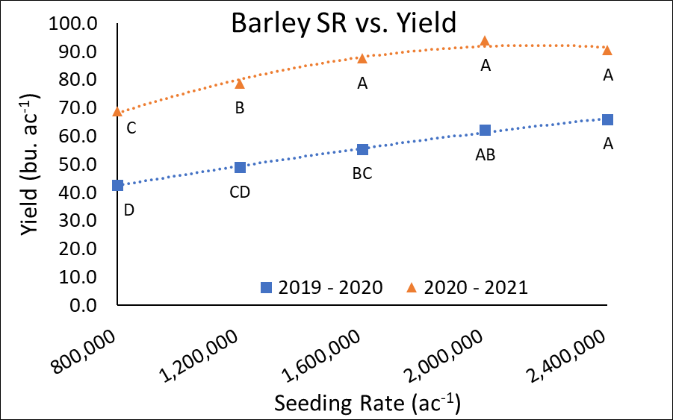
Yield by Seeding rate
Barley more responsive to seeding rate than wheat
Optimal seeding rate ~1.6–2 million seeds acre⁻¹

Slide 11
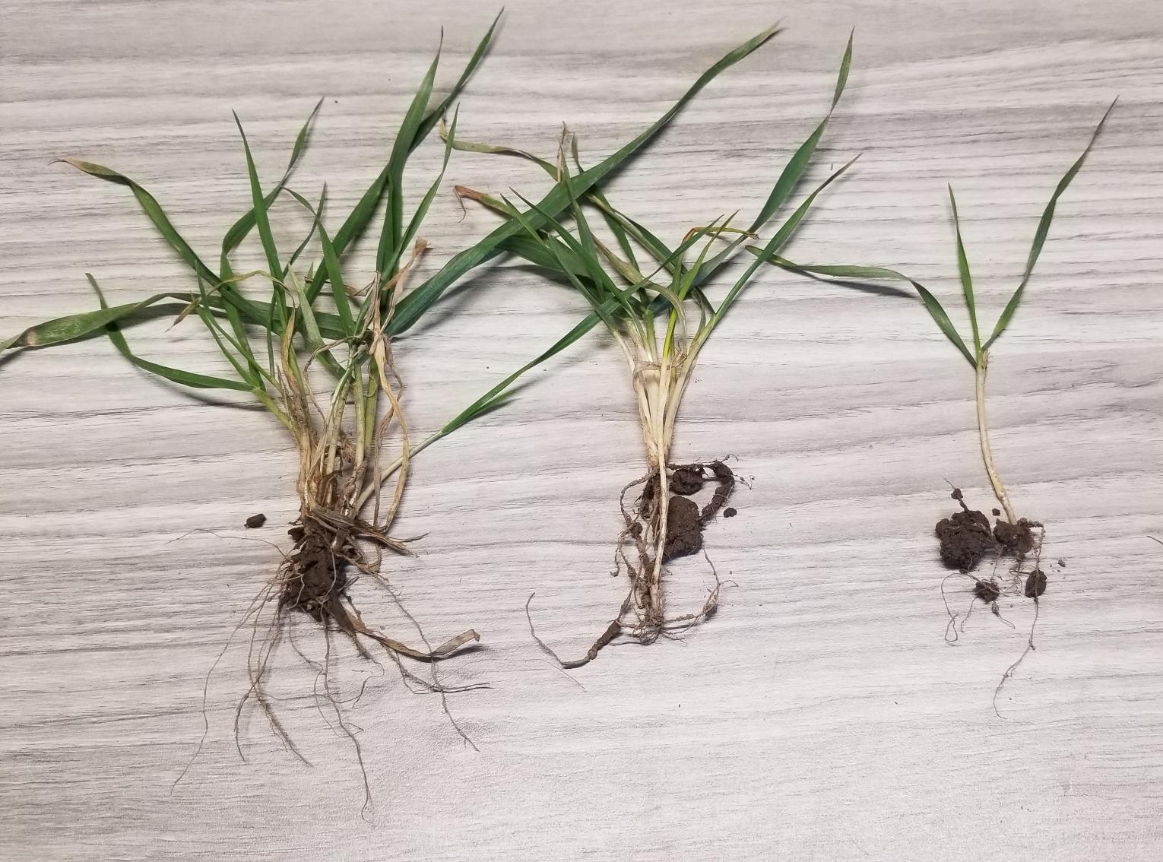
Tillering
Wheat
Barley
More tillering in barley and lower populations
Does not necessarily equal higher yield
More prostrate growth habit with lower populations
Variability in tiller development: can lead to quality issues

Slide 12
Maturity Date
Earlier maturity for barley than for wheat
Maturity heavily influenced by planting date and seeding rate

Slide 13
Winter Malting Barley- 2020 Trial
Plant date | Protein (%) | Plump kernels (%) | Thin kernels (%) | Germination (4ml 72 hr GE)
Criteria | ≤12% | >90% | <3% | >98%
19-Sep | 10.3 C | 84.4 C | 2.2 A | 99.2 A
7-Oct | 12.6 B | 96.1 A | 0.2 B | 98.4 AB
18-Oct | 14.7 A | 95.7 A | 0.4 B | 93.2 C
29-Oct | 16.4 A | 90.8 B | 1.7 A | 95.5 BC
15-Nov | 15.6 A | 92.4 AB | 1.4 A | 95.9 BC
P value | <0.001 | <0.001 | <0.001 | <0.001
Data from 3 higher seed rates (1.6, 2.0, 2.4 m seeds/ac)
RVA (for PHS): <120 only for PD 5
DON (vomitoxin) <0.15 ppm for all samples (low head scab year)

Slide 14
Take Home Messages
Early planting more important in winter barley than in wheat
Barley more responsive to planting date and seeding rate than wheat
Responsiveness to planting date and seeding rate is weather-dependent
Data from our study has not shown an effect of planting date on optimal seeding rate for yield
Conditions for higher yield may not result in best quality
Third year of trials in progress with additional data collection to better understand interaction between planting date, seeding rate, and weather
Notes:
YP = LI x RUE x HI

Slide 15
Dennis Pennington
Kalvin Canfield
Tom Siler
Micalah Blohm
Sam Martin
Harkirat Kaur
Lillian Wierenga
Eric Olson
Kelly Ish
Madeline Yaek
Cole Mallory
Braden Heimbaugh
Lucas Para
Brook Wilke
Chris Kapp
Patrick Copeland
copel113@msu.edu
(513) 280-7885
Manni Singh
msingh@msu.edu
(517) 353-0226
agronomy.msu.edu
Thanks!

