Slide 1
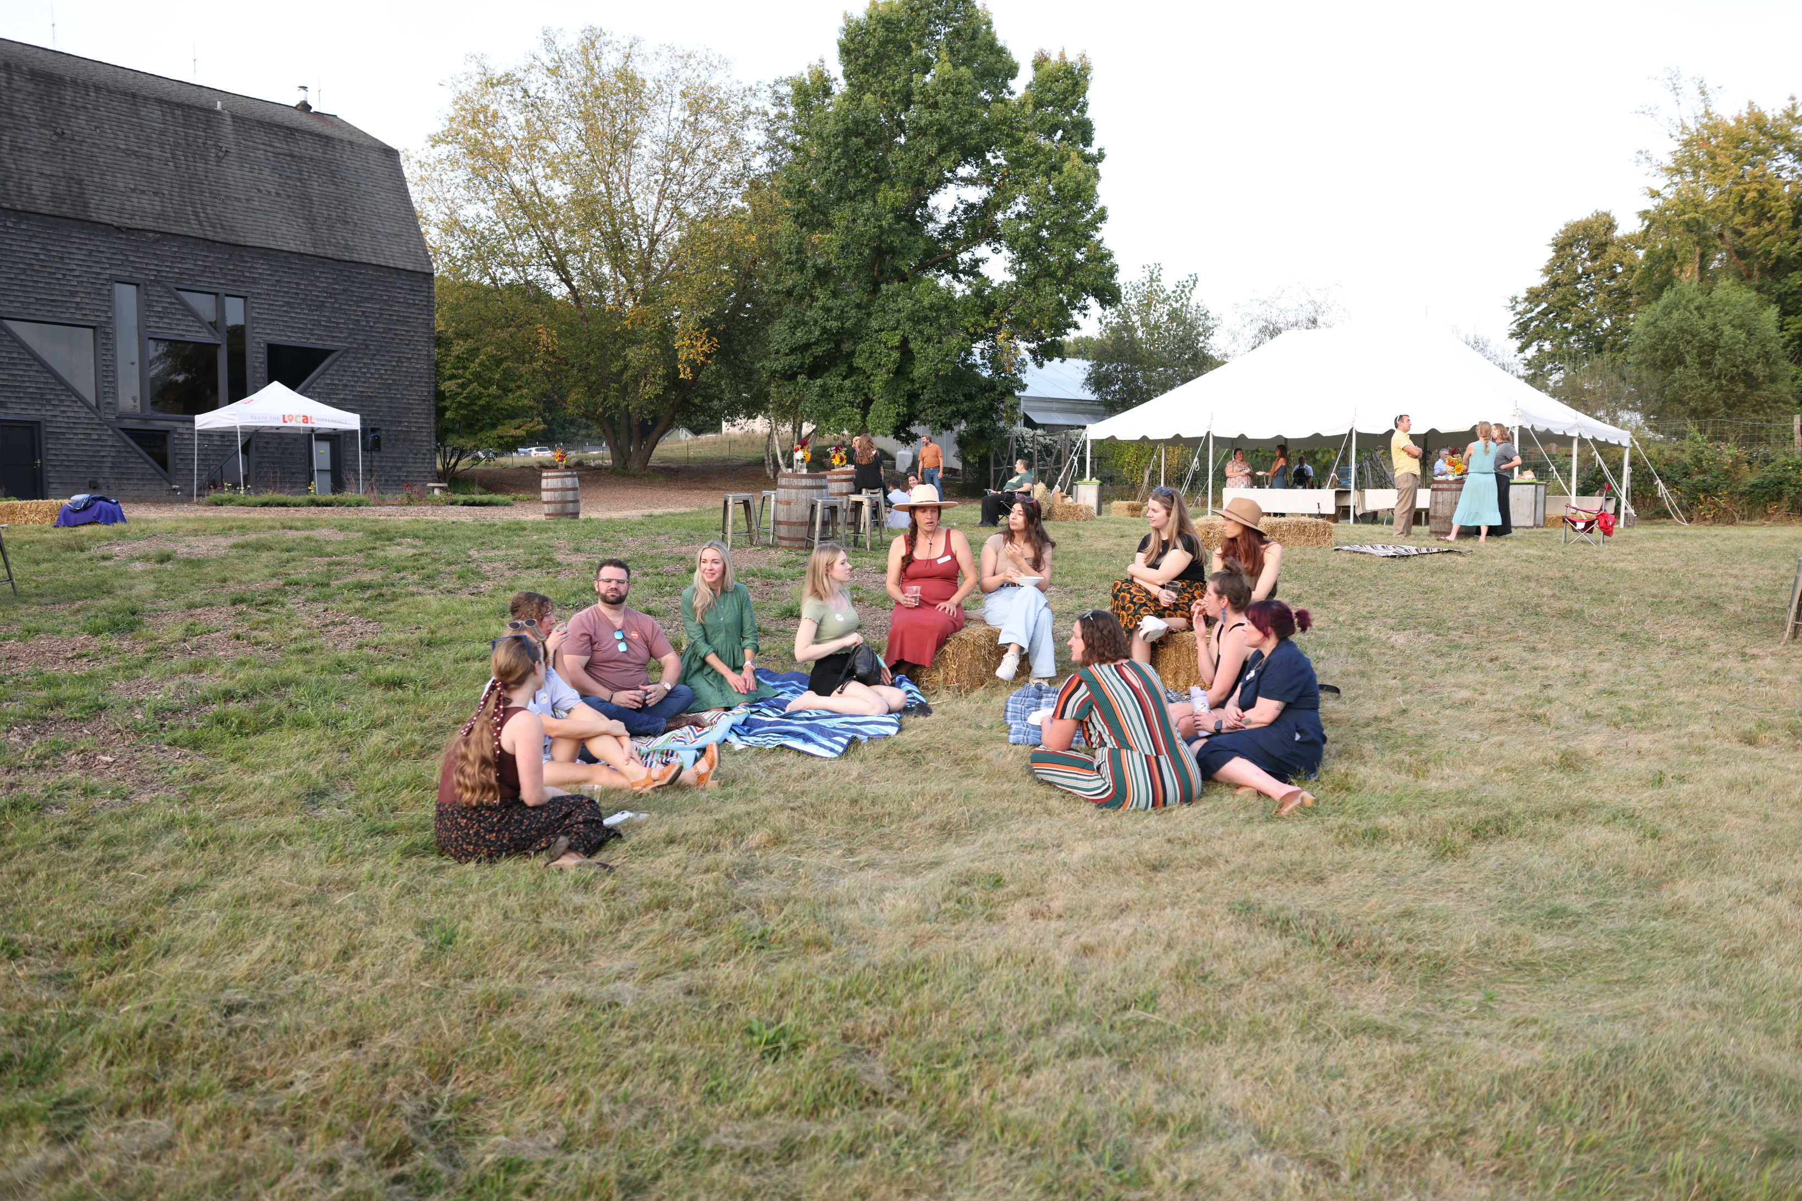

AGRITOURISM MaRKETING ESSENTIaLS
STRATEGIES TO REACH A WIDER AUDIENCE
ERIKA TEBBENS, DIRECTOR OF IMPACT
Notes:
Welcome Everyone!
This topic is a popular one, and its actually something that was directly requested from farmers in our Peer Learning Network along lakeshore of northern lower michigan.
We've open it up to a larger audience, but I want to encourage as much farmer participation in the chat and throughout our discussion as possible. I'm happy to pull people off mute to share insights or ask questions of the group.
In that vein. We'll start off today with an introduction to why a farm might be interested in adding agritourism to their business. Then we'll walk through some zoning, legal and licensing aspects to consider, and follow up with some specific examples of agritourism activities.
I'll be asking you to throw in some links to the farms you've seen do it really well, or that have been an inspiration to you, so please have those handy to drop in the chat!

Slide 2


WE KNOW LOCaL FOOD.
Taste the Local Difference® is a local food marketing agency specializing in effective strategies for agriculture, food, and beverage producers.
We believe in uplifting these purpose-driven and
passionate entrepreneurs to tell their stories, find loyal customers, and build successful, well-
connected businesses.
localfoodmarketing.com
Notes:
First off some quick introductions.
My name is Tricia Phelps and I'm the CEO of Taste the Local Difference.
I've spent the last 15+ years in local food systems, I identify as an entrepreneur wearing many hats myself like all of you and I live in Traverse City Michigan which has a strong agritourism presence, a NYT article was just released highlighting over 10 of our partners in the agritourism space this week!
https://www.nytimes.com/2025/05/26/travel/michigan-road-trip-grand-traverse-bay.html

Slide 3

ERIKa TEBBENS
DIRECTOR OF IMPACT
  20 years experience running businesses
  Expert in sales and marketing for micro enterprises; worked with 100s of entrepreneurs on sustainable growth strategies
  Former farmer and beekeeper
  Food access advocate
  Local food enthusiast
localfoodmarketing.com

Slide 4
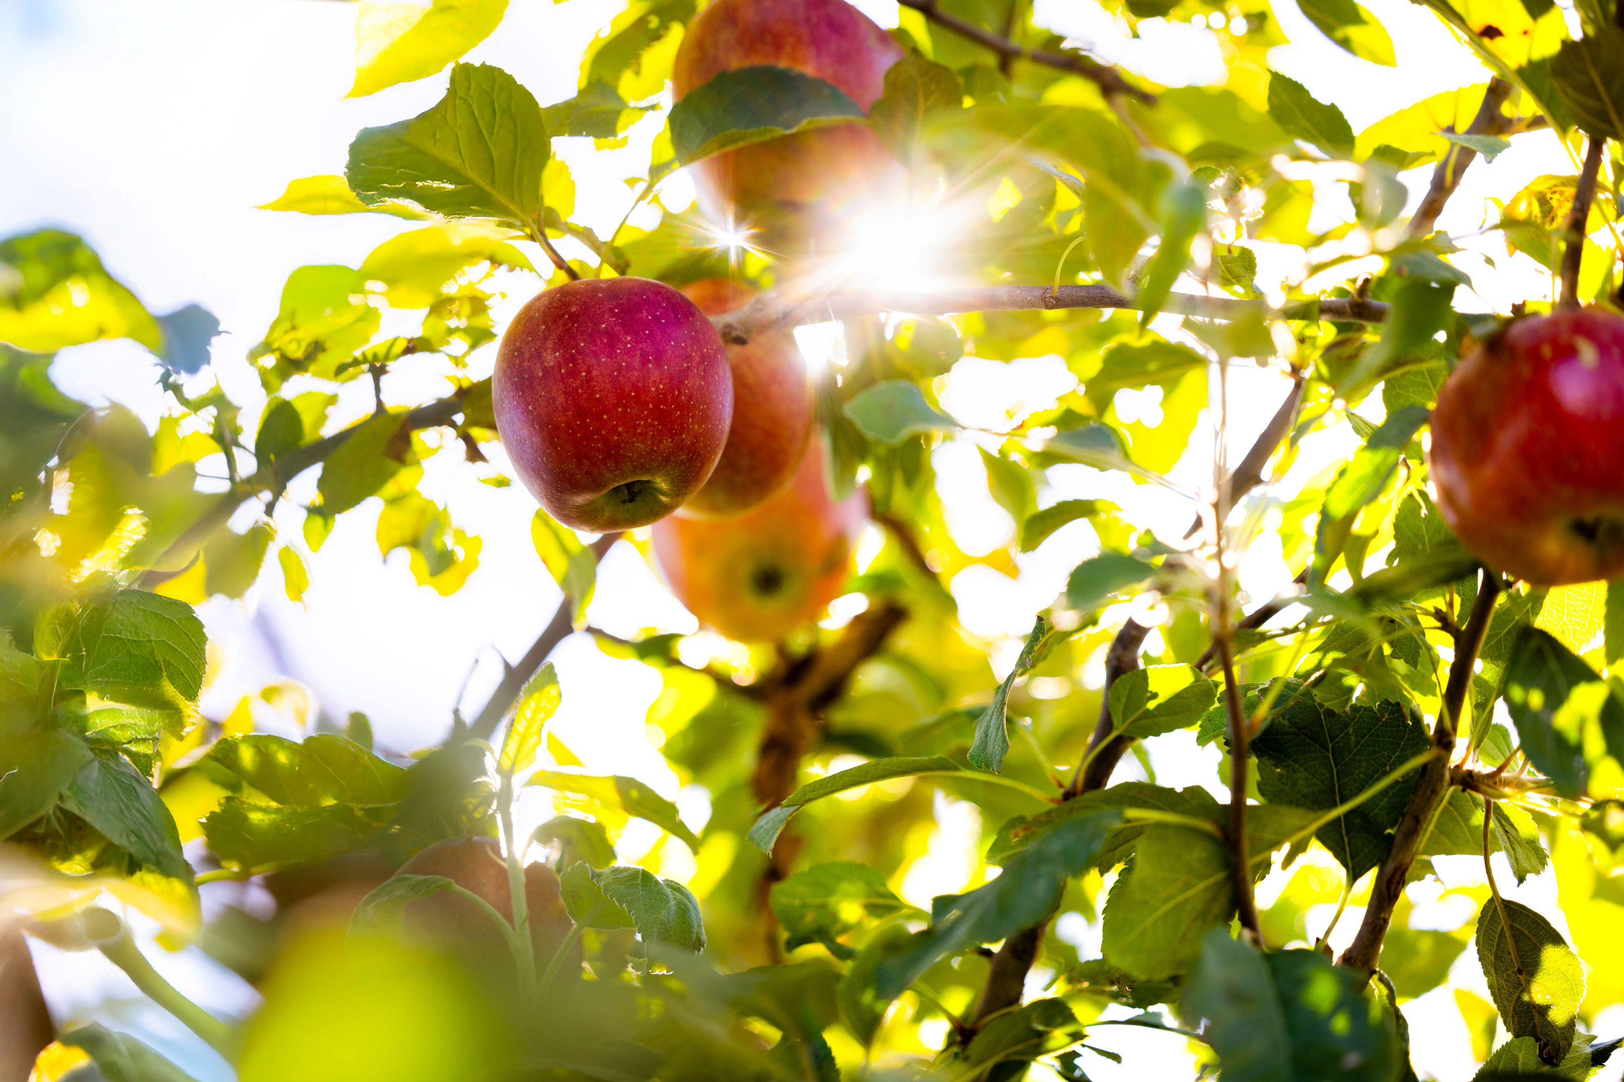
TODAY’S THEMES
  Optimizing your Assets
  Optimizing the Experience
  Cross-promotion
Notes:
So, why are we talking about agritourism anyways?
Well there are some key reasons we'll talk a little more about here.

Slide 5
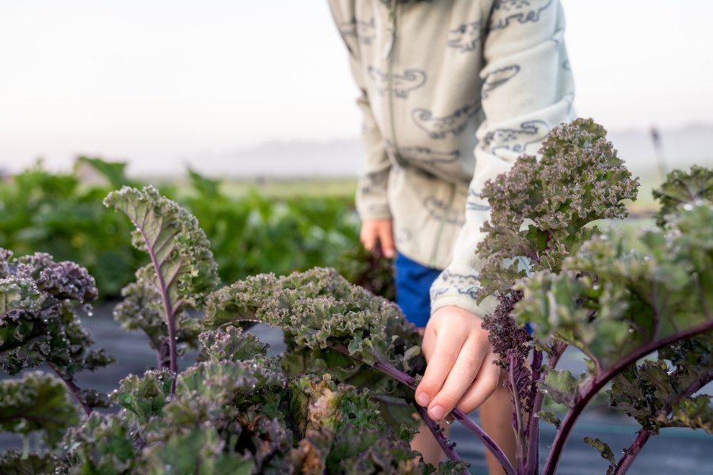
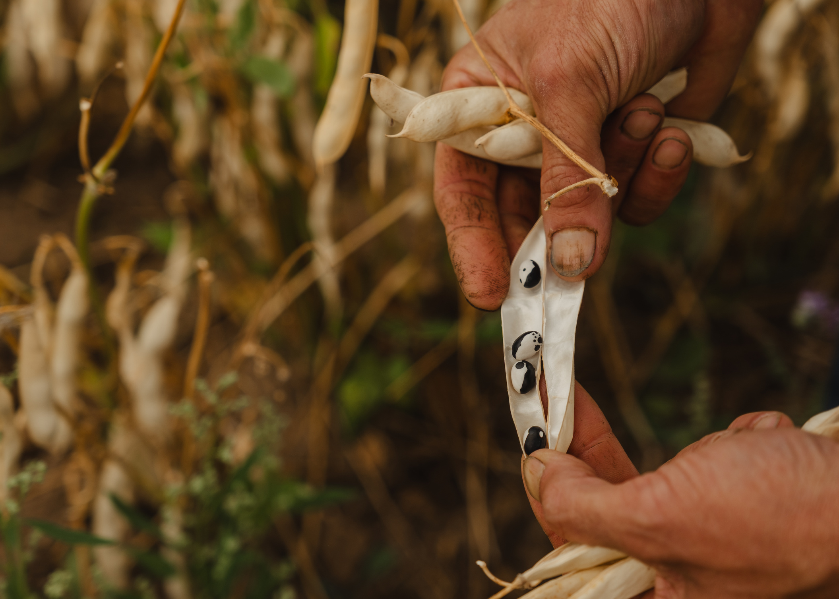
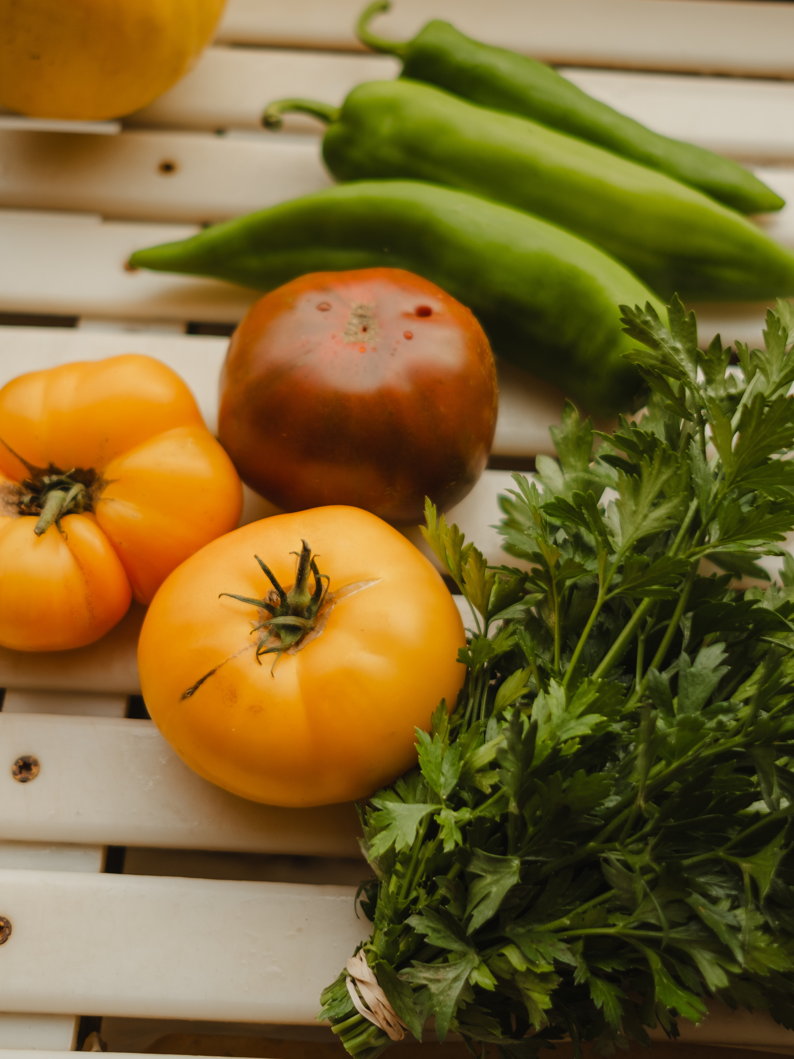
OPTIMIZING YOUR ASSETS
Before investing any time or money into campaigns and strategies that reach more people, make sure your assets are optimized when they arrive in your digital spaces.
DIGITAL ASSETS WE’LL EXPLORE
  Brand and Story
  Website
  eCommerce and Ticketing
  Email Marketing
  Google Business Profile
  Directories and Databases
Notes:
First, Diversifying revenue streams.
If you rely solely on one source or method of revenue for your businesses' income you may be putting your business at risk.
As more competition enters the market place, costs increase or the economic forces out of your control seem to be impacting your customers spending, you could be feeling your margin thinning.
When we talk about diversifying I don't recommend spreading yourself thin, but having some variety, so that if one revenue stream slows in growth another can support the business as a whole, that's good strategy.

Slide 6
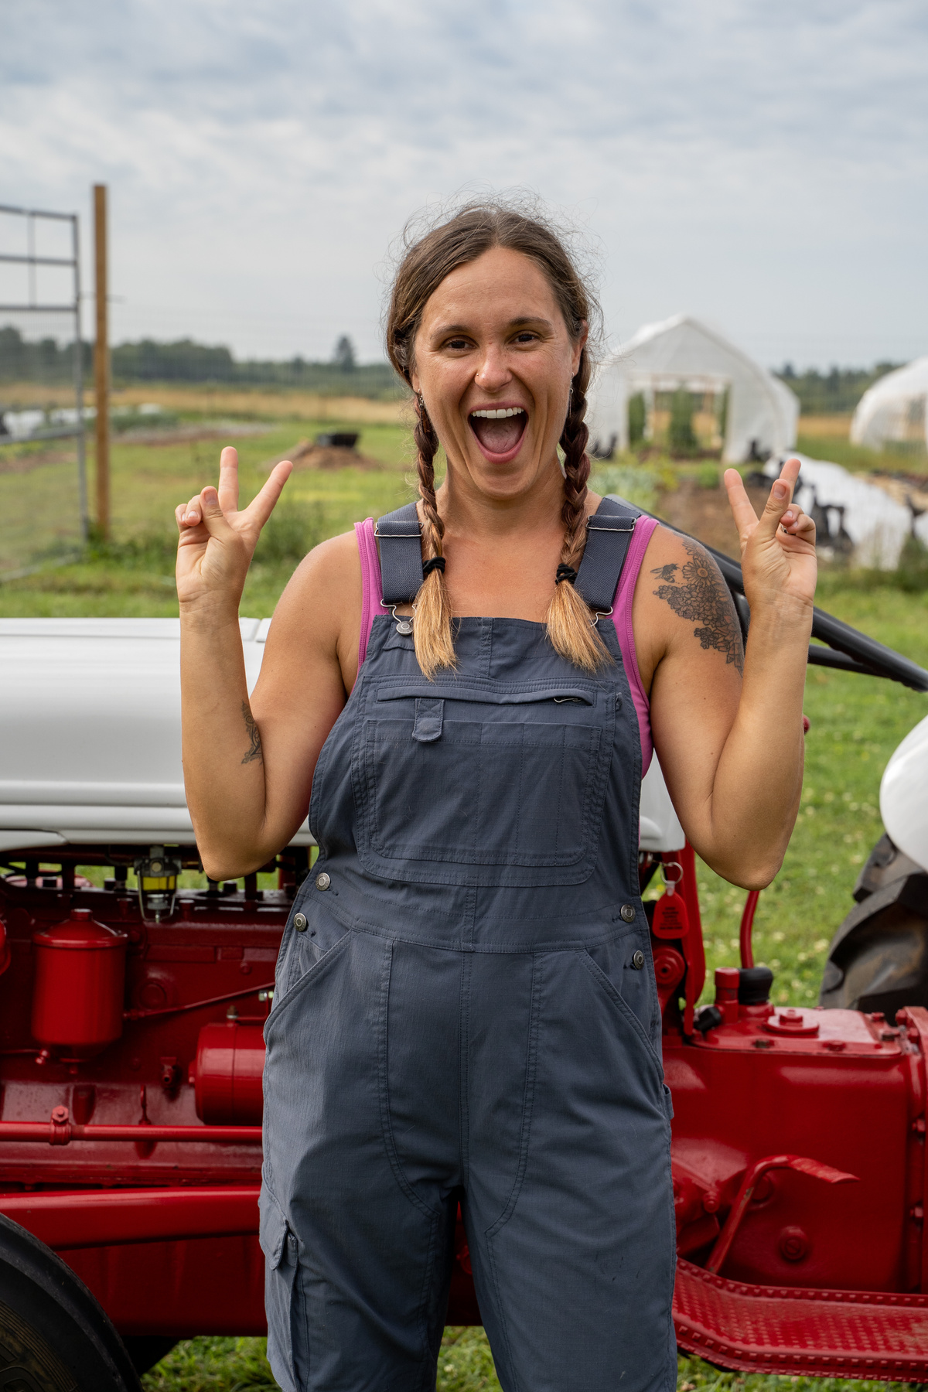

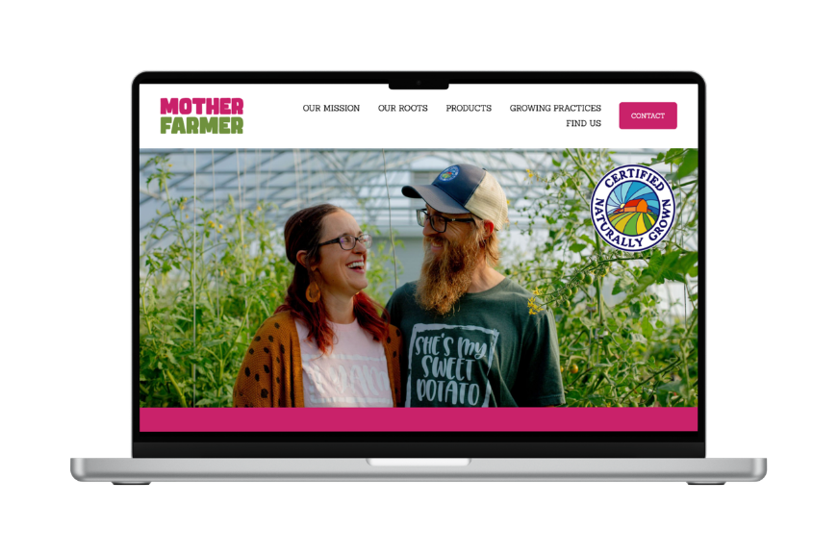
WHaT IS a BRaND?
IT’S MORE THAN JUST A LOGO
It’s how you show up in the world as a business!
YOUR BRAND INCLUDES:
  Business name
  Logo
  Tagline
  Colors
  Voice
  Values
localfoodmarketing.com

Slide 7
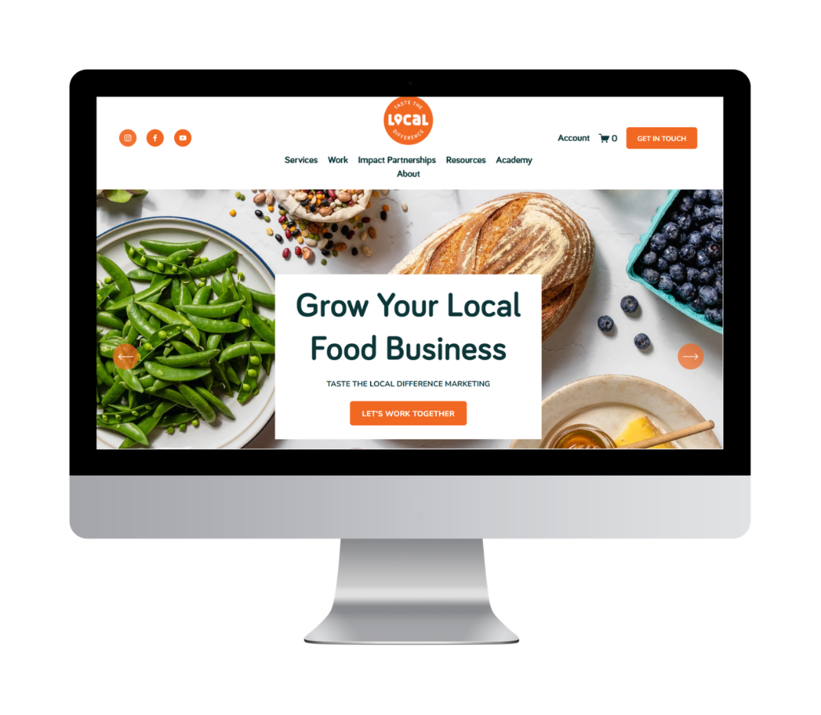
WEBSITE
REMEMBER
  Make it user-friendly and optimized for mobile
  Tell a story through copy and high-quality images - make sure to break up your text in headers, paragraphs, and don’t get too wordy
  Details should be easy to find
    cost, ticketing, parking, food, bathrooms, accessibility, etc.
  Structure the site information for Search Engine Optimization
localfoodmarketing.com

Slide 8
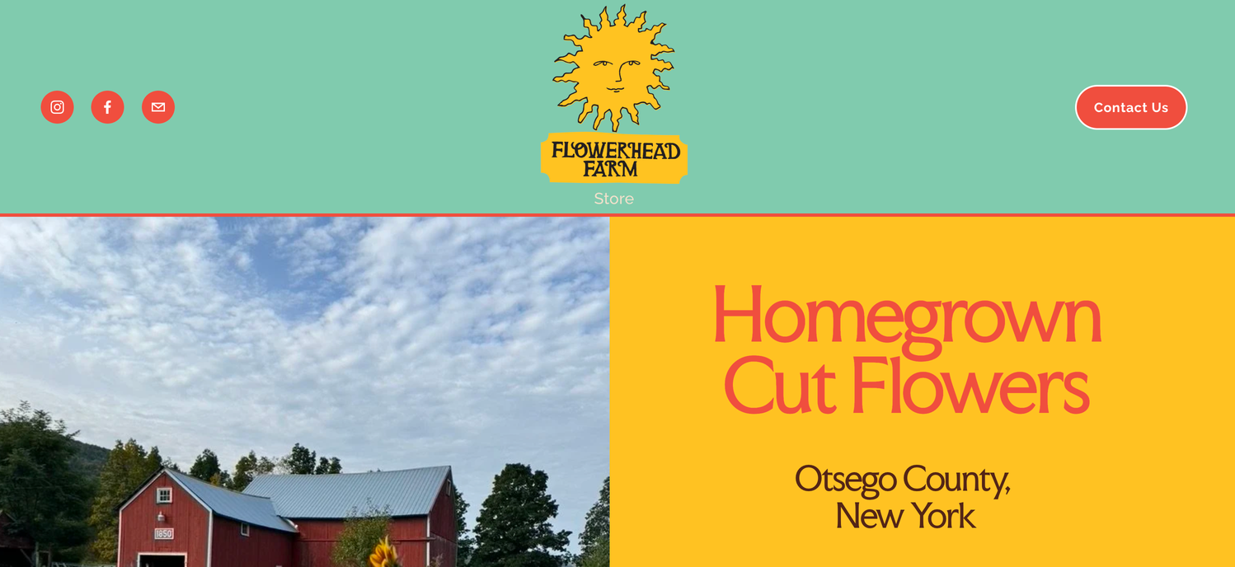
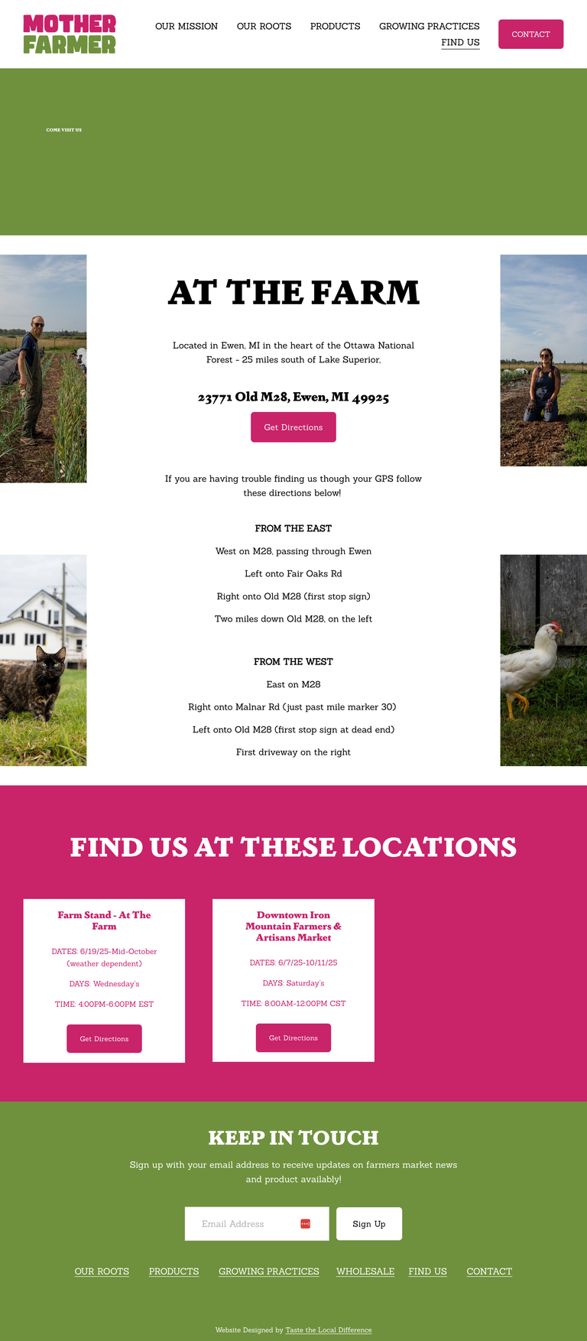
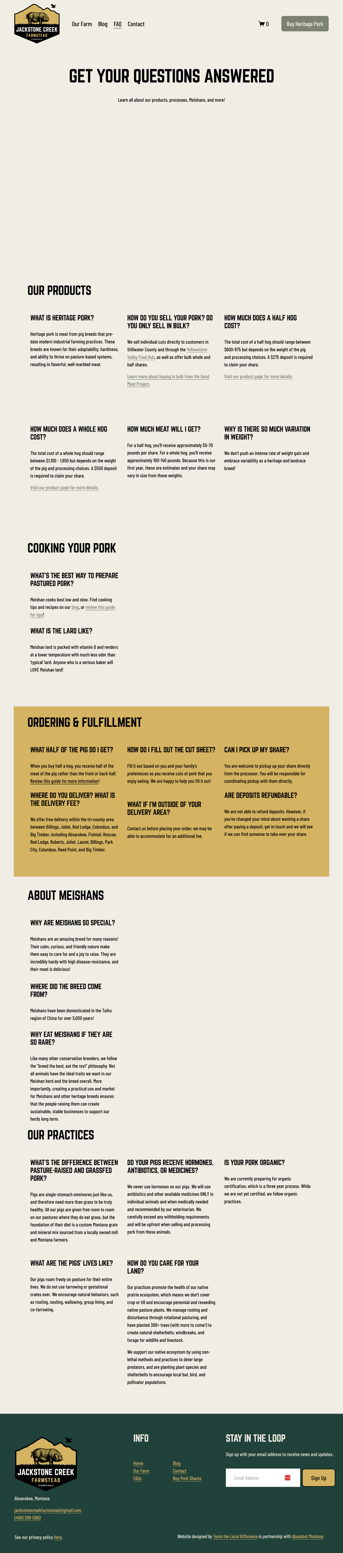
HOW SEaRCH ENGINES WORK
GOOGLE’S JOB IS TO
  Find websites
  Understand what they’re about
  Decide which ones best answer a search
  Show the most helpful + trustworthy results first
YOUR JOB AS THE WEBSITE OWNER
  Make your site clear; who you are, where you are, what you sell
  Make it helpful; answer common questions your customers have
  Make it easy for Google to understand; use strong page titles, headers, keywords, and alt text
localfoodmarketing.com

Slide 9

eCOMMERCE AND TICKETING
DO THIS
  Ensure customers can easily understand how to purchase tickets.
    Include key details
    Add an FAQ section
  If you sell products online, be sure to have:
    High-quality photos
    Unique and accurate descriptions
    Alt text
  It’s crucial that pickup, delivery, and shipping information is clear
localfoodmarketing.com

Slide 10
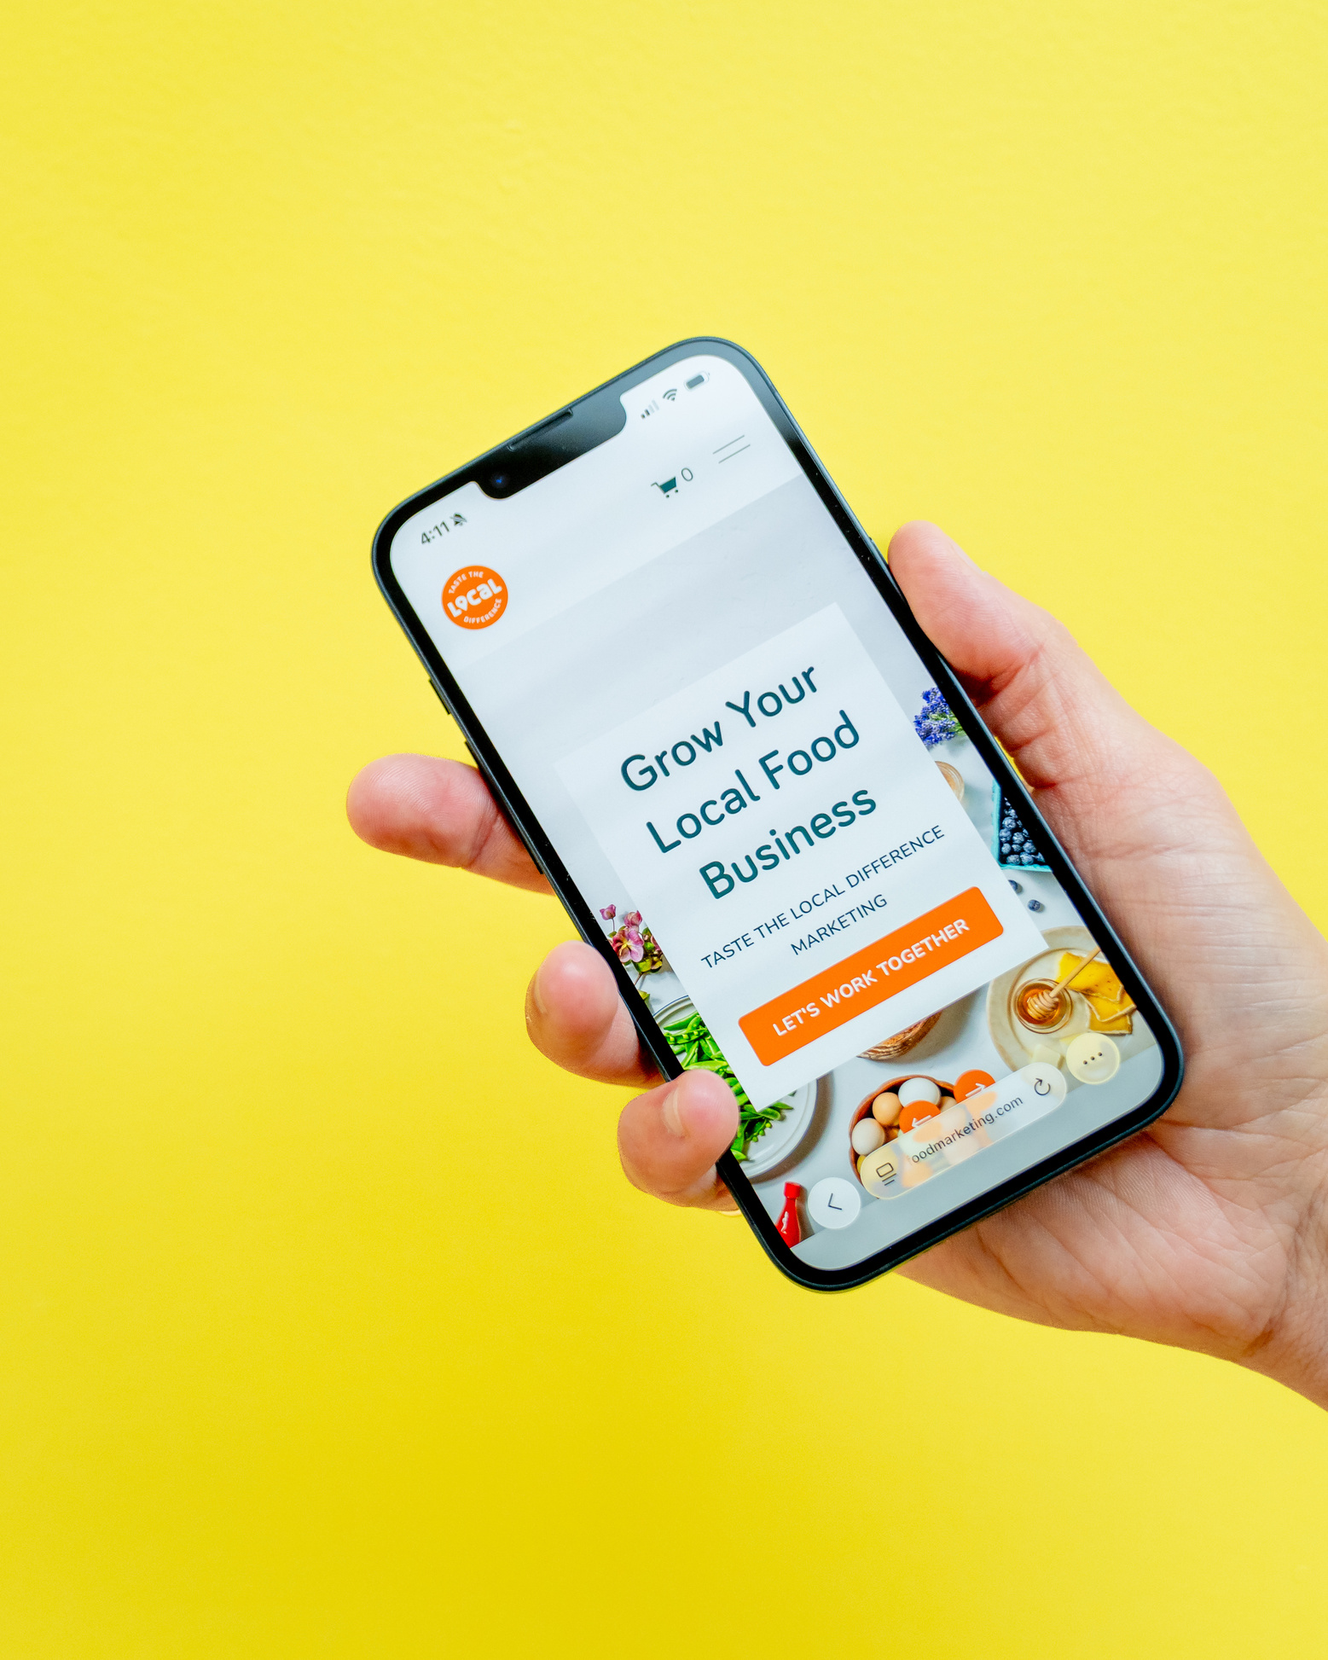
CaPTURING VISITOR DaTa
  Make sure you retain their info from any registration systems
  If you don’t require registration, have signage around that incentivizes opt-ins
  See about capturing their info at checkout in person
  If you offer eCommerce that can be shipped, you can email them about products in between visits
  Incentivize existing list members with early-bird pricing or enrollment, special events, or other promotions
  Keep communicating even during the “off season” with behind-the-scenes (BTS) storytelling
Use this information for email marketing and segmentation as well.
localfoodmarketing.com

Slide 11
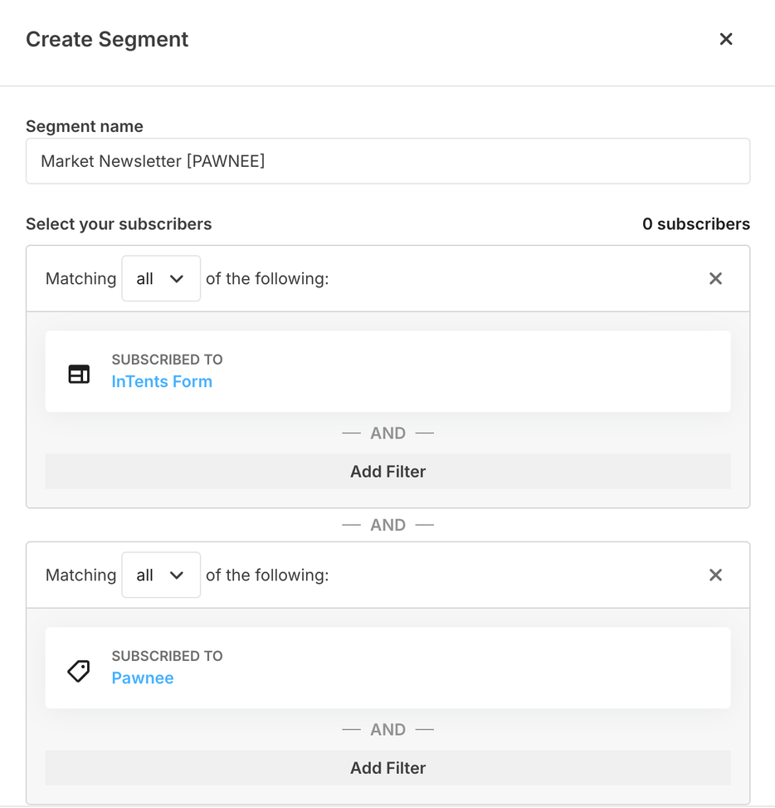
EMaIL MaRKETING
HELPFUL HINTS
  Use an Email Marketing Software (EMS) like Mailchimp or Constant Contact vs free email like Gmail for marketing emails
  Utilize segmentation and tags for contacts – especially if you have multiple facets to your business, for example:
    Farmers market
    CSA
    U-pick
    Special events
NAME OF FORM
This segment is set up for the weekly newsletter to the members of a specific market.
NAME OF LIST SEGMENT TAG
Notes:
If direct to consumer sales at farmers markets is your thing, agritourism is a way to amplify those efforts.
You can increase sales at the farm, build awareness for your brand because people are coming directly to you, and you can do all of this without attending more markets, this means you won't need to increase your labor costs to have someone sitting idly by until customers arrive, they can be on the farm actively participating in production.

Slide 12
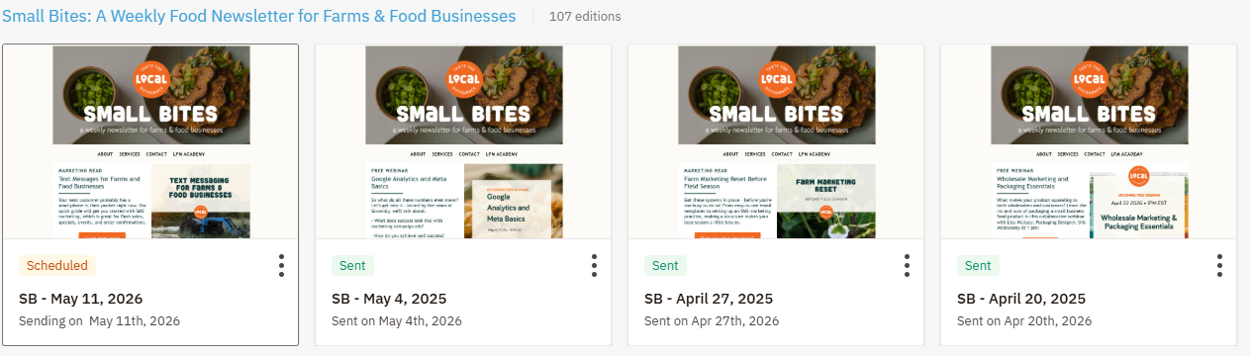
EMaIL MaRKETING
THE IMPORTANCE OF TEMPLATES
Create and use branded templates, and be sure to communicate regularly on a cadence that makes sense for your schedule and audience.
Templates keep your brand and messaging consistent, so customers know what to expect and can anticipate your communication.
EXAMPLE
TLD’s weekly marketing newsletter
Notes:
If direct to consumer sales at farmers markets is your thing, agritourism is a way to amplify those efforts.
You can increase sales at the farm, build awareness for your brand because people are coming directly to you, and you can do all of this without attending more markets, this means you won't need to increase your labor costs to have someone sitting idly by until customers arrive, they can be on the farm actively participating in production.

Slide 13

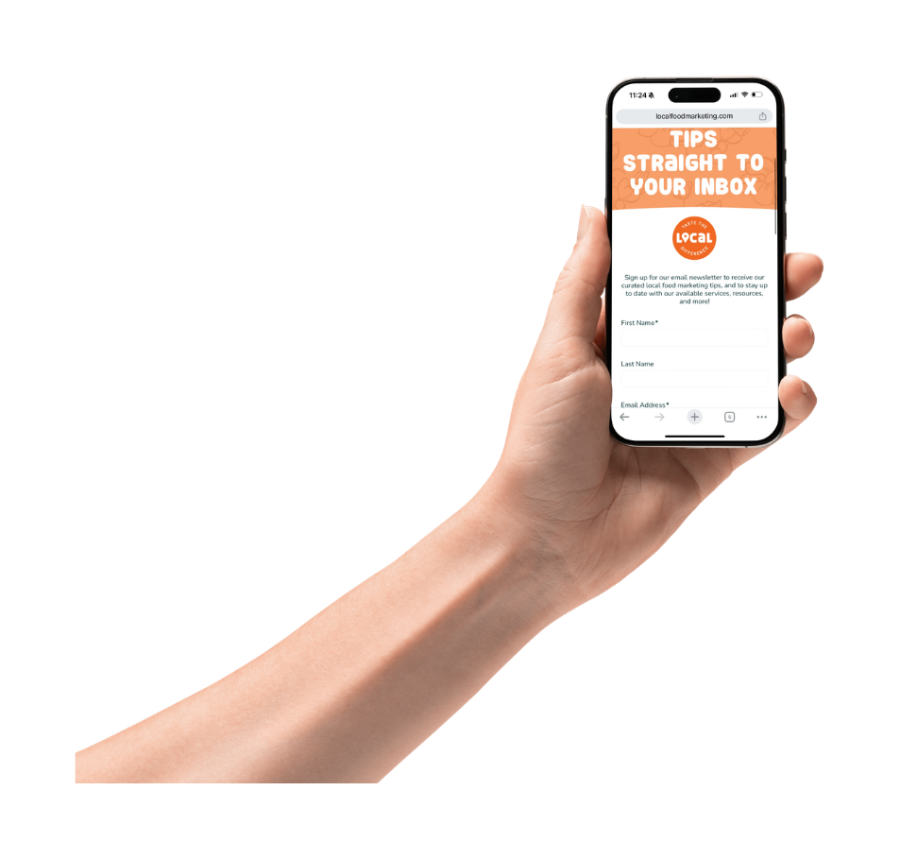
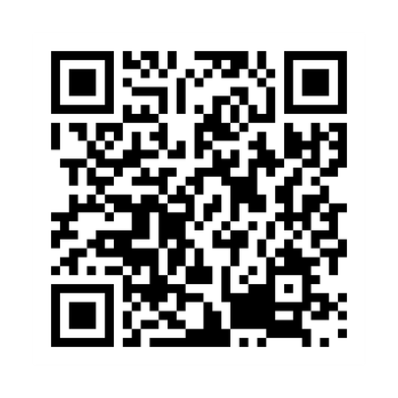
SIGN UPS MaDE EaSY
RECOMMENDED METHODS
  iPads, paper forms (digital is better!)
  QR codes, mobile-friendly opt-in pages
  Displayed prominently on your website
  Integrated with eCommerce/other tech
PRO TIP
Put them where folks will see them
& ask while interacting with
customers/attendees.
SIGN UP HERE!
localfoodmarketing.com

Slide 14
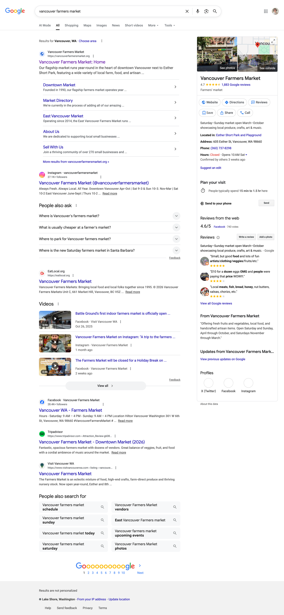
GOOGLE BUSINESS PROFILE
BEST PRACTICES
  Set up and optimize your Google Business Profile; it’s free, and people expect to find it!
  Add good-quality images and all relevant information (hours, description, contact information)
  Include keywords that would help folks find you:
    “U-pick strawberries in Metro Detroit”
    “On-farm dinners in Southwest Michigan”
    “Organic wine tasting in Traverse City”
  Encourage people to leave reviews, and make sure you respond to them (positive AND negative - but don’t get defensive, just thank them for the feedback and invite them to follow up via email)
localfoodmarketing.com

Slide 15
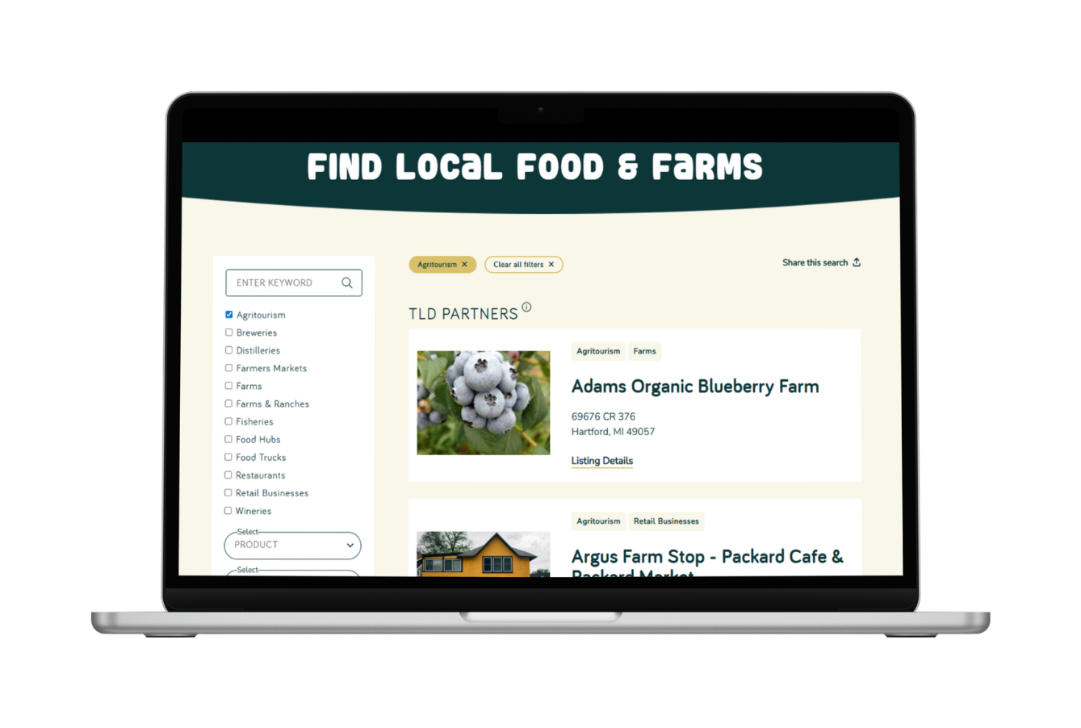
DIRECTORIES AND DaTaBaSES
BE EVERYWHERE YOU CAN
  Include your business in free or low-cost guides, databases, directories, etc. that your target audience might view
  Examples:
    TLD’s Find Farms & Food Directory
    Local Business Directory
    Tourism Magazines
These are big SEO helpers.
Notes:
If direct to consumer sales at farmers markets is your thing, agritourism is a way to amplify those efforts.
You can increase sales at the farm, build awareness for your brand because people are coming directly to you, and you can do all of this without attending more markets, this means you won't need to increase your labor costs to have someone sitting idly by until customers arrive, they can be on the farm actively participating in production.

Slide 16
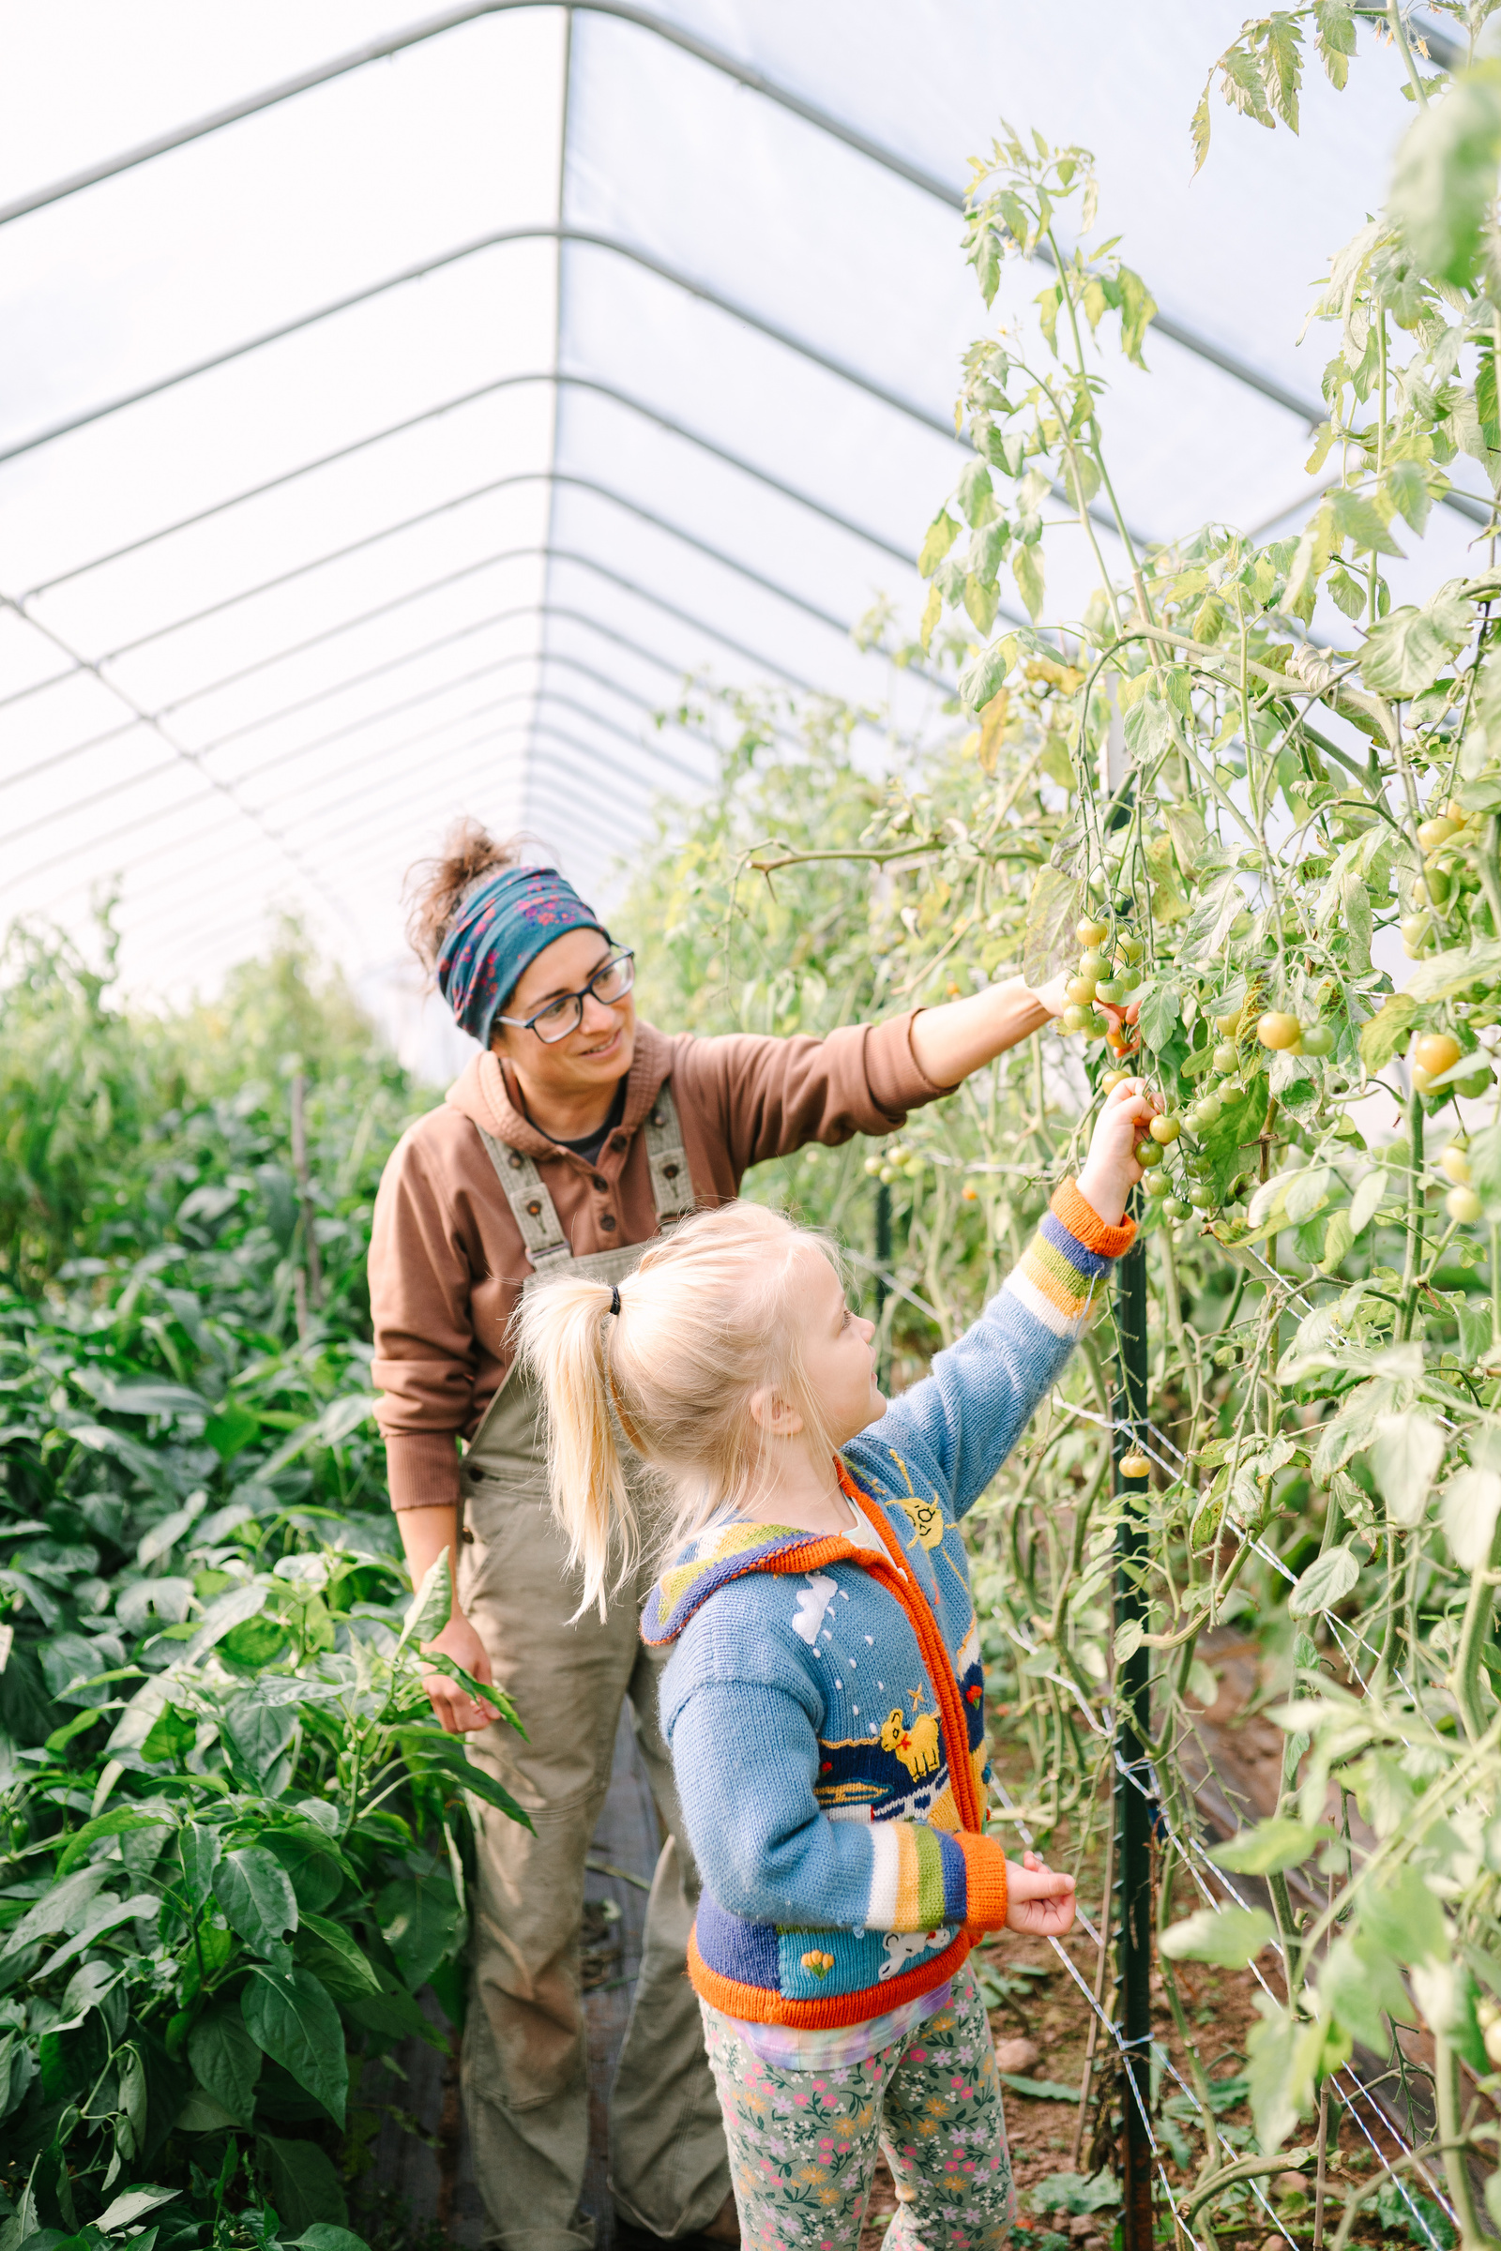

OPTIMIZING THE EXPERIENCE
You’ve got your customers to the farm, now let’s make the most of it! Having folks on-farm is an opportunity to expose them to your other products, experiences, and services.
Notes:
First, Diversifying revenue streams.
If you rely solely on one source or method of revenue for your businesses' income you may be putting your business at risk.
As more competition enters the market place, costs increase or the economic forces out of your control seem to be impacting your customers spending, you could be feeling your margin thinning.
When we talk about diversifying I don't recommend spreading yourself thin, but having some variety, so that if one revenue stream slows in growth another can support the business as a whole, that's good strategy.

Slide 17
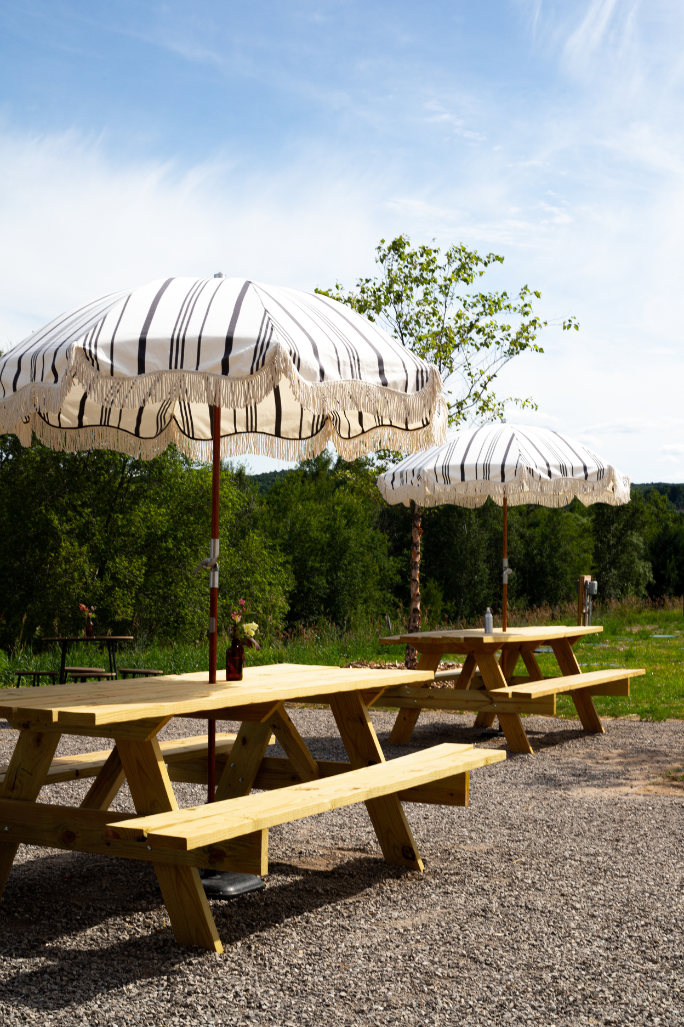
AT THE EVENT
CONSIDER THIS
  Plan a way to segment these customers in advance (we’ll discuss more later!)
  If you have a farm stand or market, make sure it’s open for business before, during, or after the event (i.e., farm dinner or concert) to encourage even more sales.
    If it’s not possible to staff the store, bring out your top-sellers to the gathering space and accept mobile payments.
  Share information about additional events and experiences you offer (ex, farm camp, dinners, yoga, workshops, tours) with ways to get involved or sign up
Remember:
Don’t assume people know about all of the amazing things you do and offer – it needs to be communicated!
Notes:
If direct to consumer sales at farmers markets is your thing, agritourism is a way to amplify those efforts.
You can increase sales at the farm, build awareness for your brand because people are coming directly to you, and you can do all of this without attending more markets, this means you won't need to increase your labor costs to have someone sitting idly by until customers arrive, they can be on the farm actively participating in production.

Slide 18
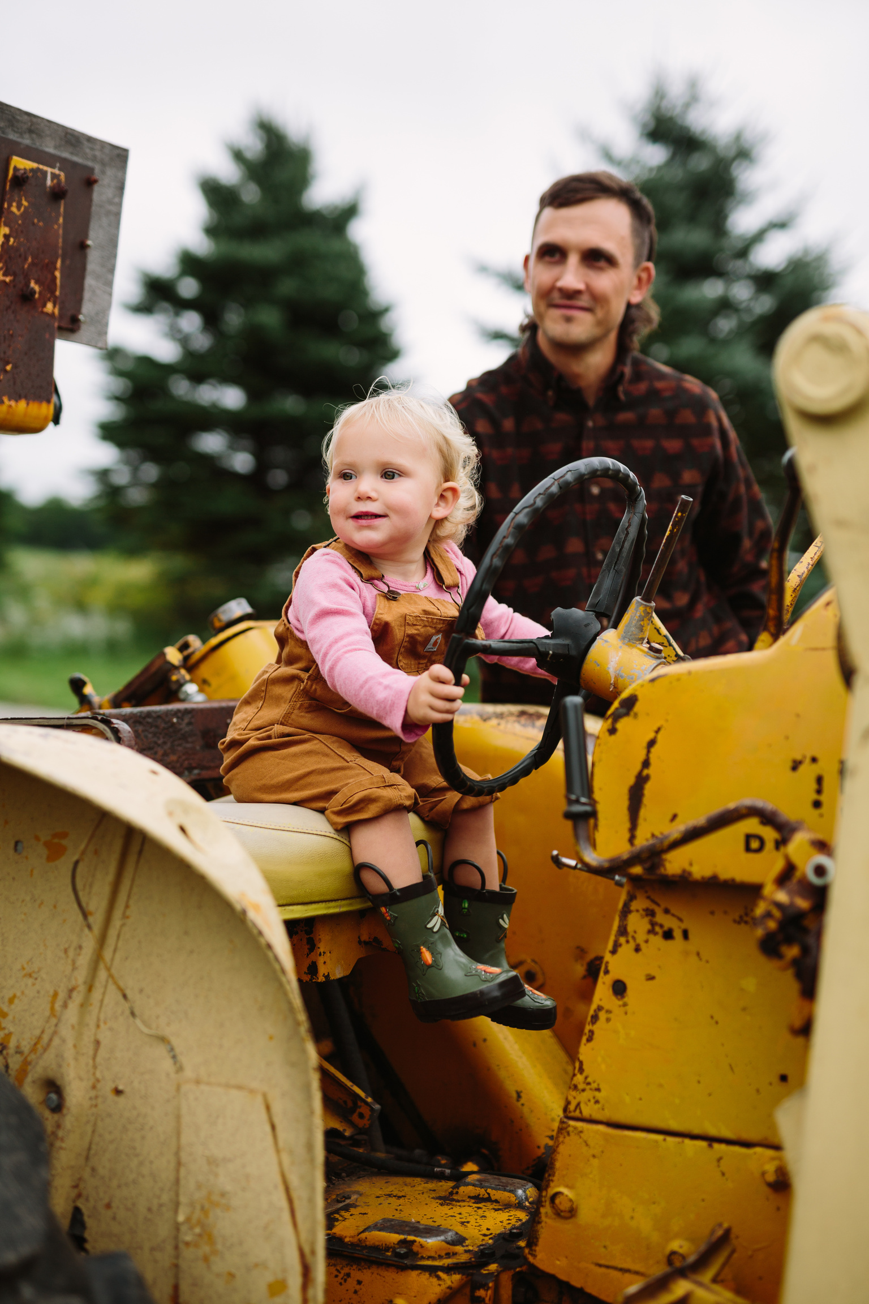
CROSS-PROMOTION
Think of where your target audience consumes information, and strategize creative ways to get in front of them.
FIND OUT
  What digital platforms they use
  Where they find information offline
  Niche interests
  Demographics
How do you acquire this information?
Analytics, surveys, conversations
Notes:
First, Diversifying revenue streams.
If you rely solely on one source or method of revenue for your businesses' income you may be putting your business at risk.
As more competition enters the market place, costs increase or the economic forces out of your control seem to be impacting your customers spending, you could be feeling your margin thinning.
When we talk about diversifying I don't recommend spreading yourself thin, but having some variety, so that if one revenue stream slows in growth another can support the business as a whole, that's good strategy.

Slide 19
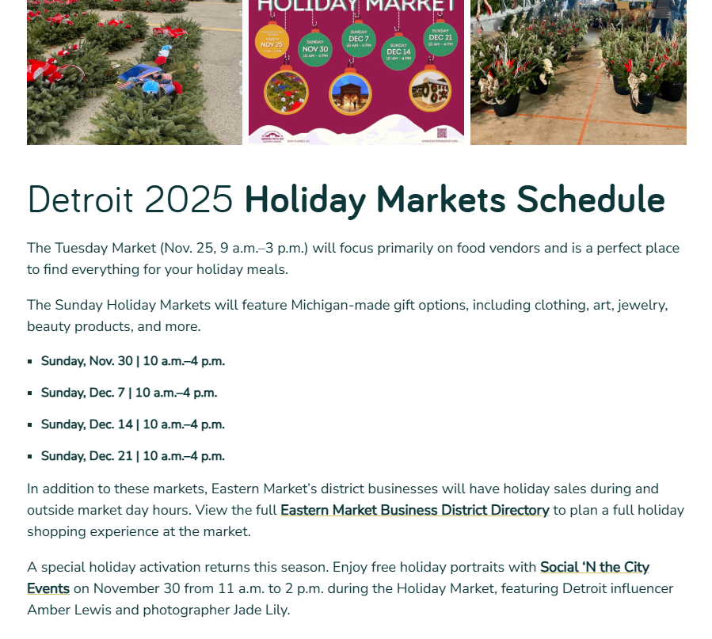
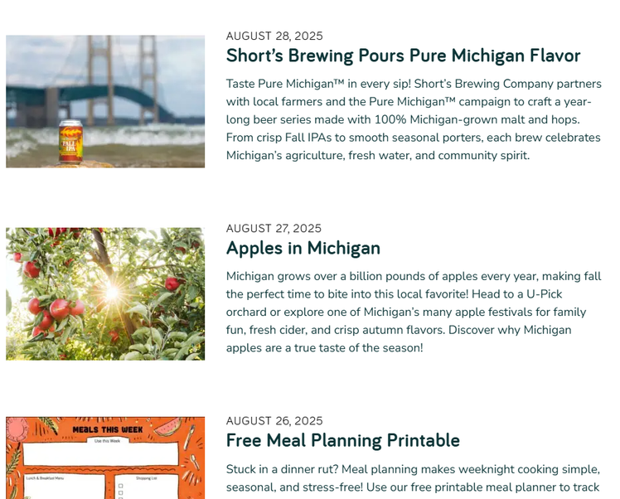
EXPOSURE OPPORTUNITIES
SHARE INFORMATION THROUGH
Free Media
  Local TV, print, and radio often need story ideas; pitch them about an upcoming event to cover
Paid Media
  Low-cost, ultra-niche media like TLD’s Local Food Companion allow you to highlight your operation to a targeted audience (and it boosts SEO, too)
Micro-influencers
  Typically paid through money or trade, sometimes free. Focus on those who speak to your audience and niche
Notes:
If direct to consumer sales at farmers markets is your thing, agritourism is a way to amplify those efforts.
You can increase sales at the farm, build awareness for your brand because people are coming directly to you, and you can do all of this without attending more markets, this means you won't need to increase your labor costs to have someone sitting idly by until customers arrive, they can be on the farm actively participating in production.

Slide 20
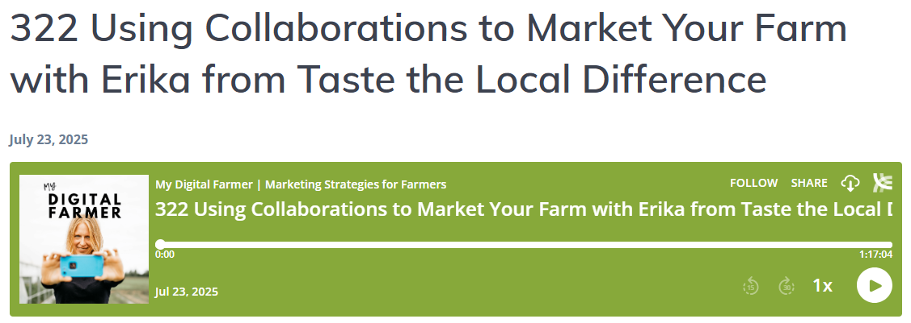
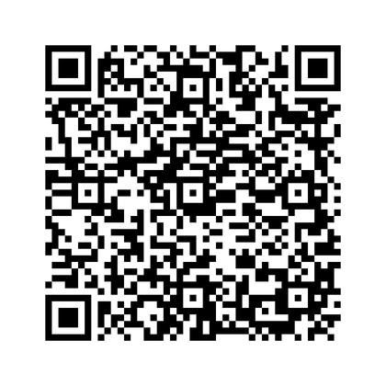
EXPOSURE OPPORTUNITIES
SHARE INFORMATION THROUGH
User-generated Content (UGC)
  Encourage visitors to “collab” tag you in their posts when they visit or share in stories
Business Collaborations
  Coordinate with other businesses or farms to leverage each other’s audiences as you market (for instance, a farm that hosts an on-farm dinner might partner with a local vineyard)
LISTEN NOW
Notes:
If direct to consumer sales at farmers markets is your thing, agritourism is a way to amplify those efforts.
You can increase sales at the farm, build awareness for your brand because people are coming directly to you, and you can do all of this without attending more markets, this means you won't need to increase your labor costs to have someone sitting idly by until customers arrive, they can be on the farm actively participating in production.

Slide 21
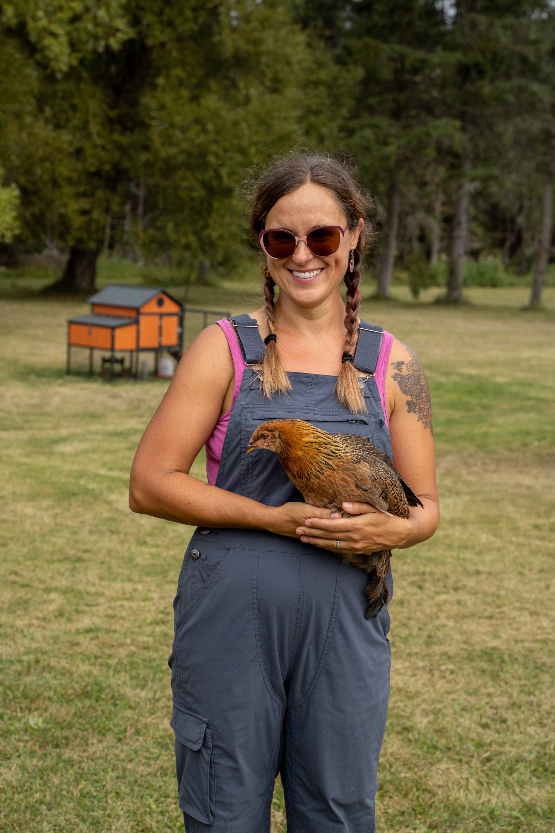
SEGMENTED AUDIENCES
HOW TO USE THEM
  Someone who attended an event or was a specific shopper (i.e., wine event, u-pick, dinner attendee), and you have a similar event coming up, choose to send only THOSE contacts a special promotion or unique invitation, such as a BOGO sale to bring a friend
  For limited-seat events, email previous attendees first to pre-fill events and encourage them to add on guest tickets as a “first-come, first-served” bonus
Notes:
If direct to consumer sales at farmers markets is your thing, agritourism is a way to amplify those efforts.
You can increase sales at the farm, build awareness for your brand because people are coming directly to you, and you can do all of this without attending more markets, this means you won't need to increase your labor costs to have someone sitting idly by until customers arrive, they can be on the farm actively participating in production.

Slide 22

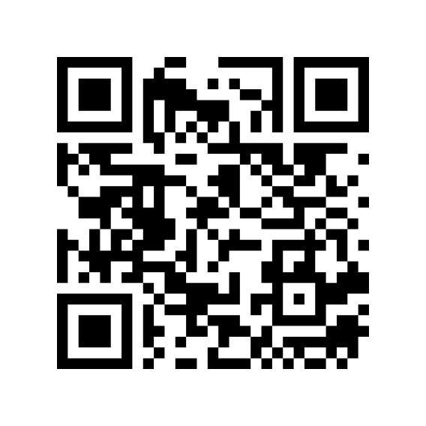
What support do you need?
Fill out our services wishlist.
Notes:
With all of that said, just because you build it, doesn't mean they will come. At least not at first.
You need to make sure people are aware, and this is an easy checklist to make sure your basic marketing strategies are in place.
https://www.localfoodmarketing.com/downloadables/marketing-plan-checklist

Slide 23
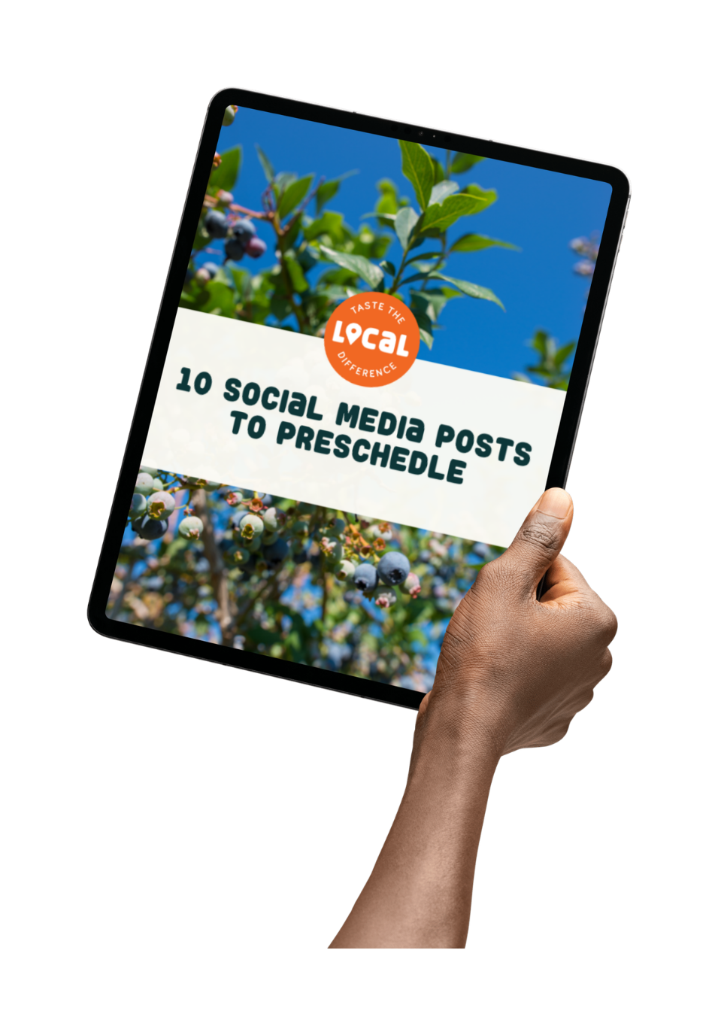
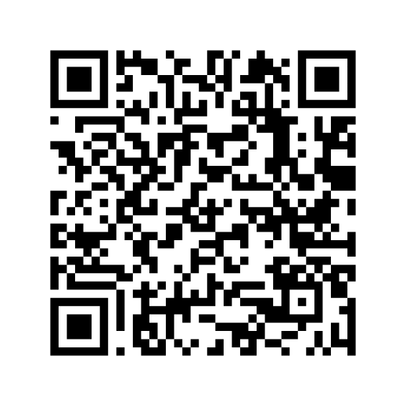
Download our resource:
10 Social Media Posts to Preschedule
Notes:
With all of that said, just because you build it, doesn't mean they will come. At least not at first.
You need to make sure people are aware, and this is an easy checklist to make sure your basic marketing strategies are in place.
https://www.localfoodmarketing.com/downloadables/marketing-plan-checklist

Slide 24
GET IN TOUCH:
LOCALFOODMARKETING.COM
erika@localdifference.org

