Slide 1
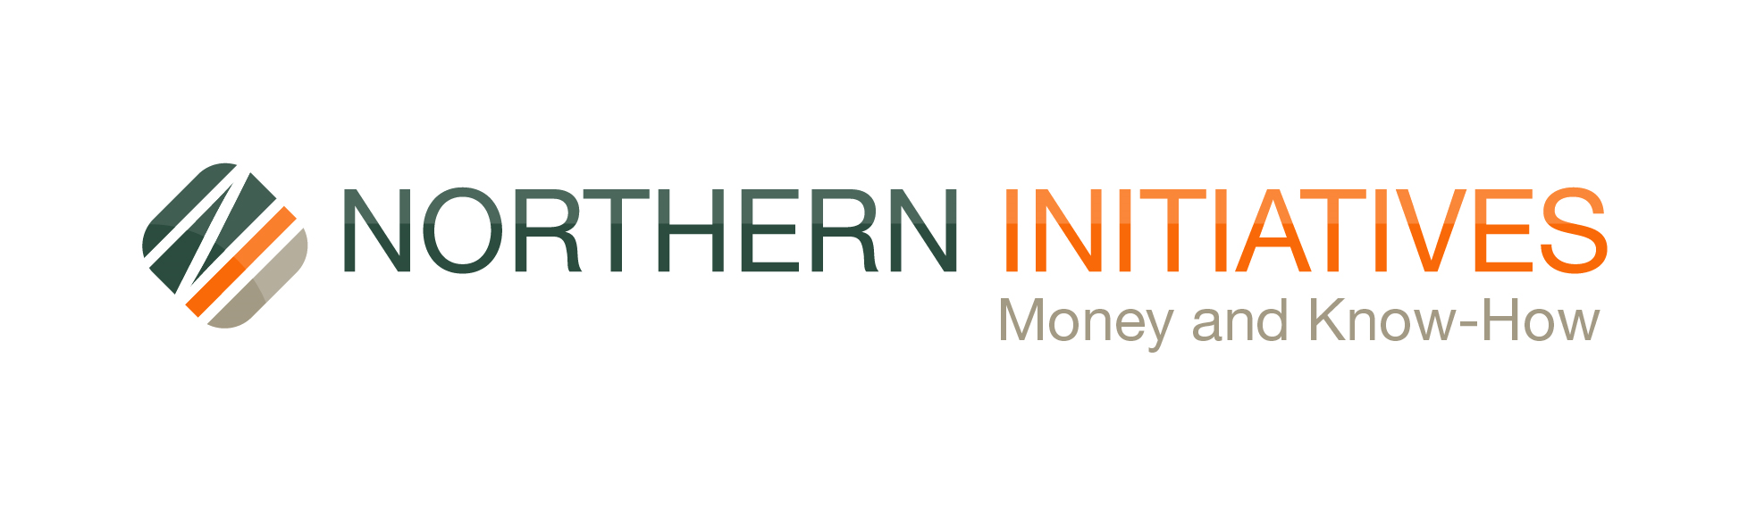
Colleen Duflo, Senior Lender
2026 Agritourism Summit

Slide 2
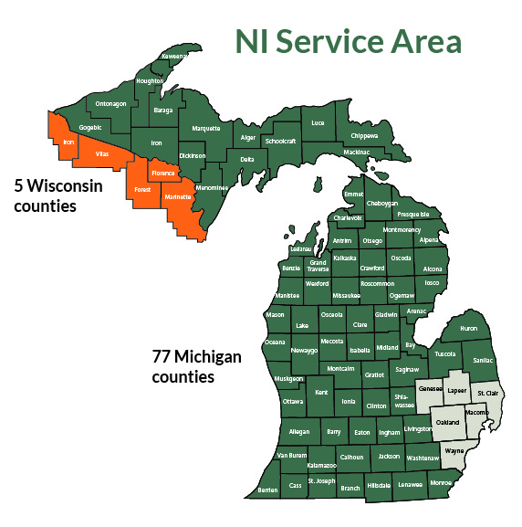
Who are we?
Northern Initiatives is a Community Development Financial Institution (CDFI). We provide loans and technical assistance for small businesses.
We make loans banks couldn’t, shouldn’t or wouldn’t do.
We have customers in almost every county in Michigan.

Slide 3
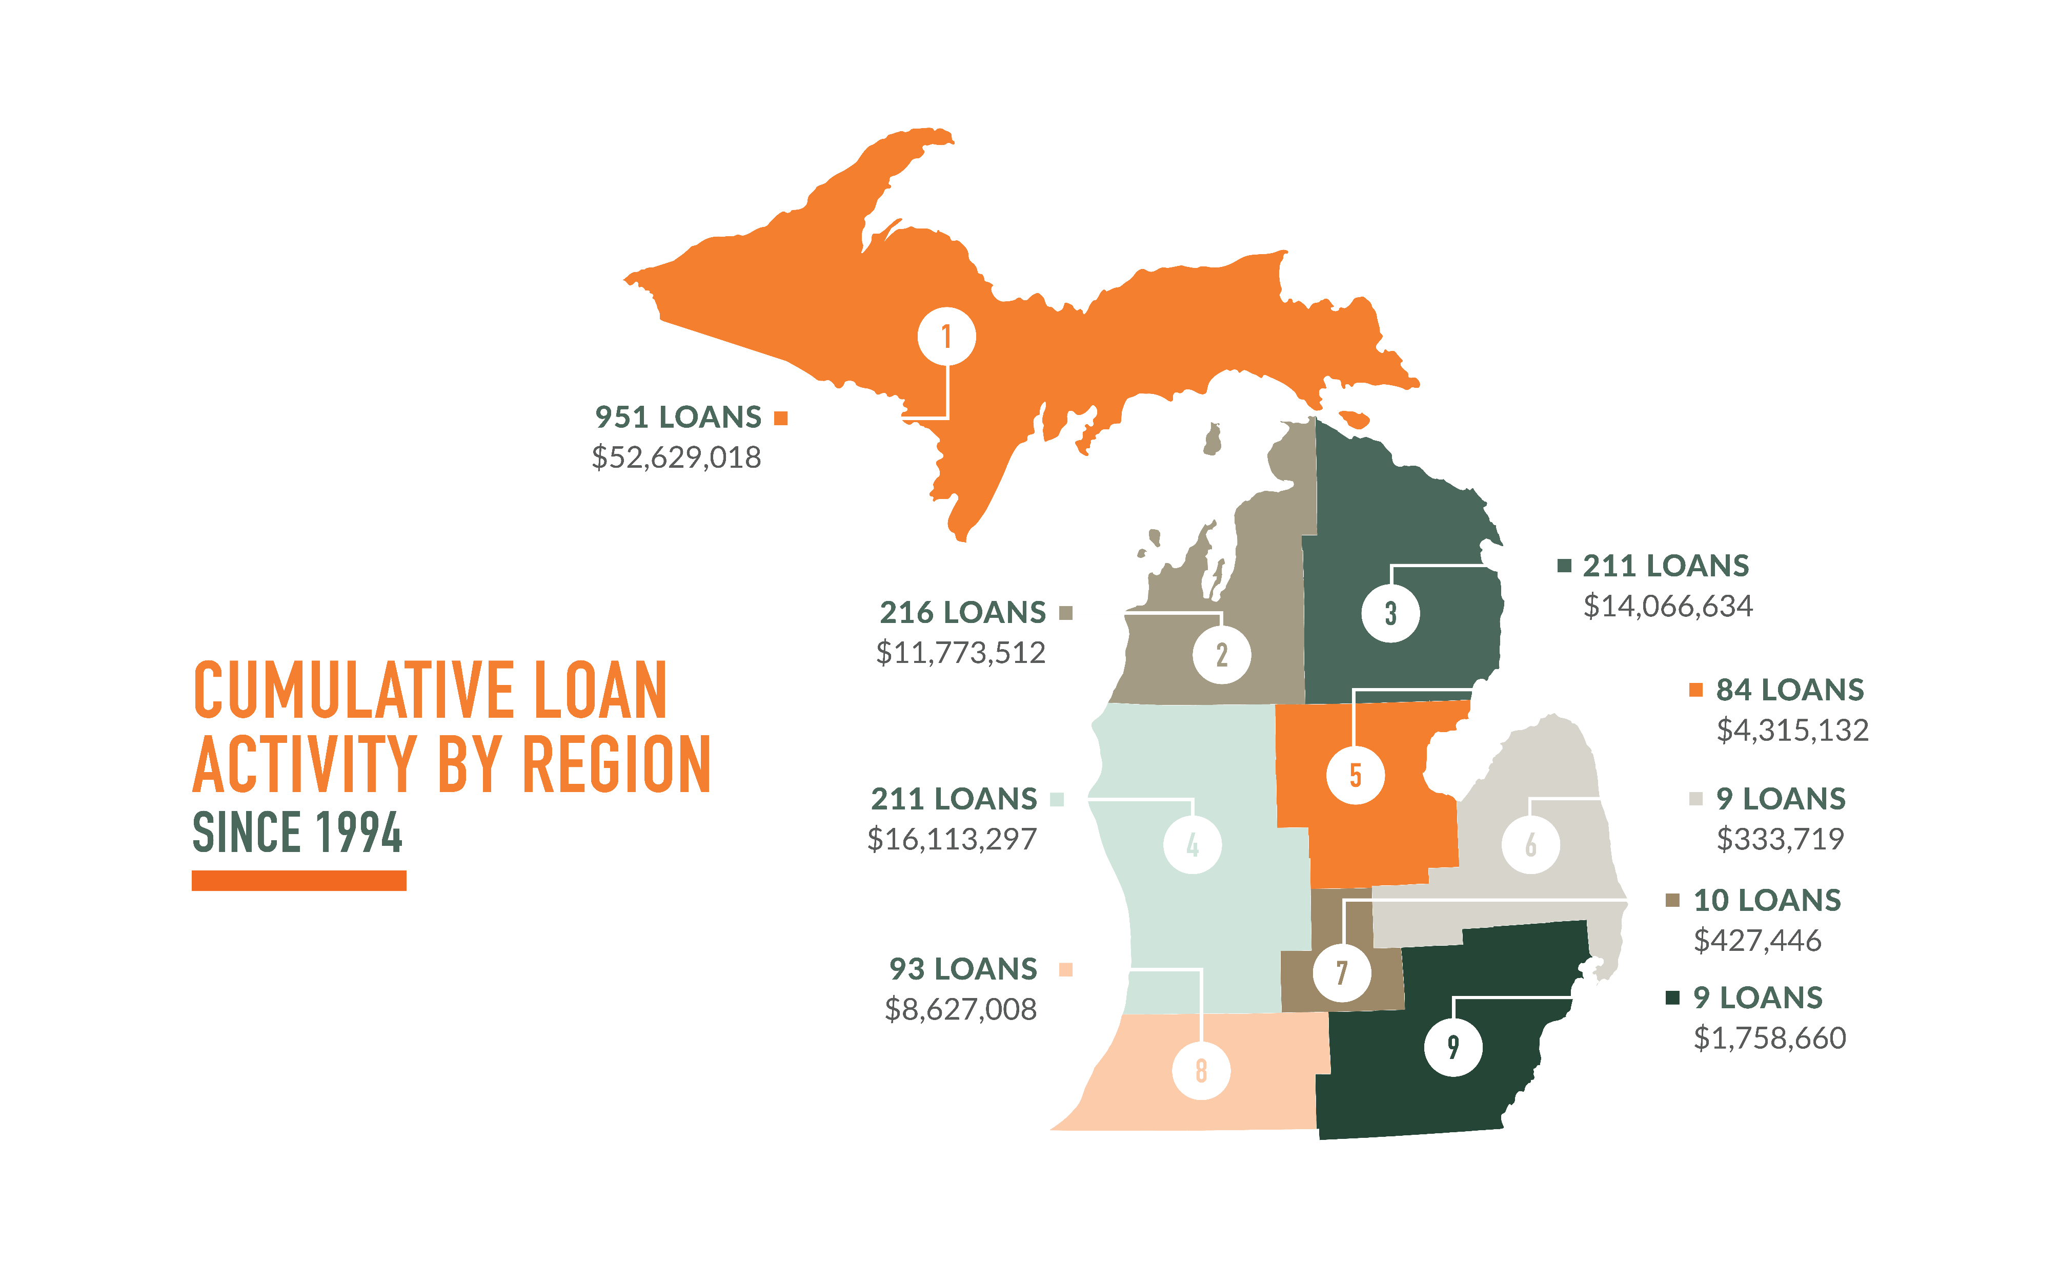

Slide 4
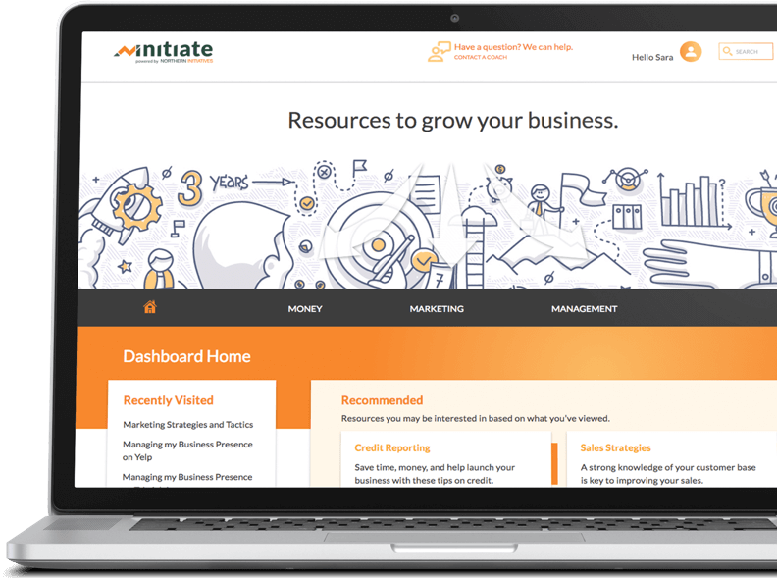
What Do We Do?
Northern Initiatives provides loans to small business owners who might not qualify for loans from traditional banks for a variety of reasons. Many times, our lending is focused on low-income, disadvantaged, and underserved communities.
We have a mission to help these small businesses create jobs and enable their communities to thrive.
Each loan comes with access to Initiate, our online learning portal, along with one-on-one business coaching.

Slide 5
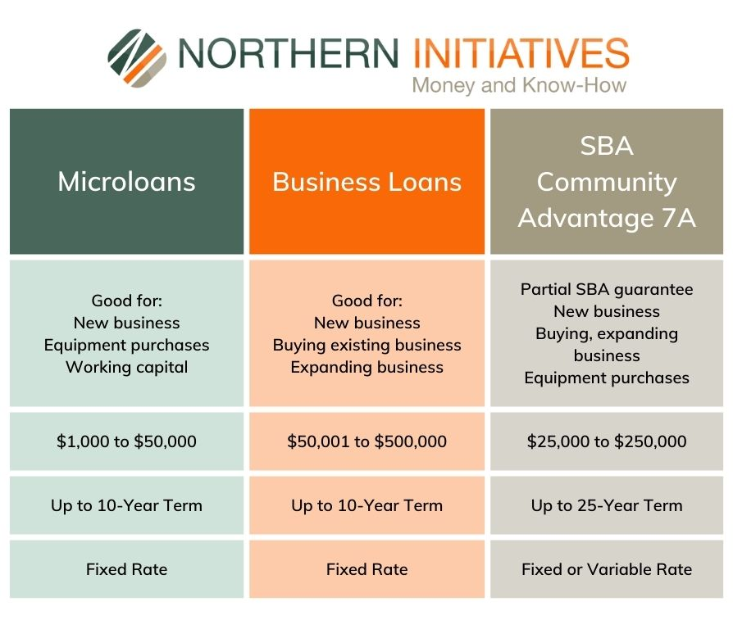
How Can We Help?
We provide access to capital and business services through various loan programs.
  Microloans
  Business Loans
  SBA Community Advantage 7a (update $350k max)

Slide 6
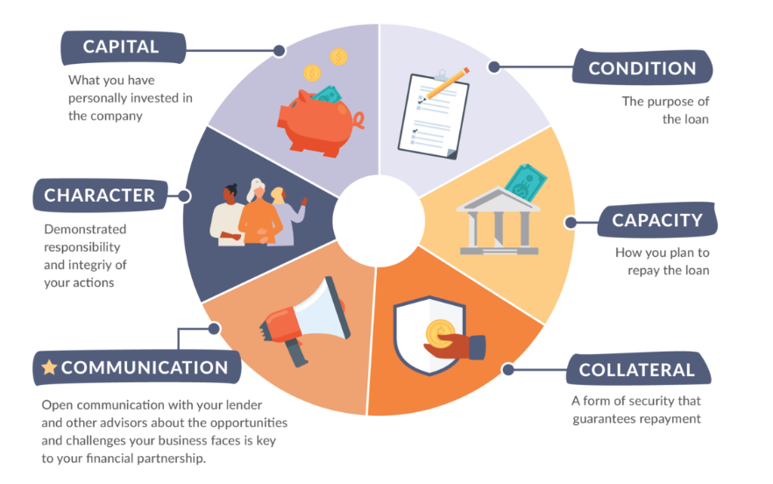
What Do Lenders Look For?
The 5 Cs of Credit
Character
Capacity
Capital
Collateral
Conditions
*Communications

Slide 7
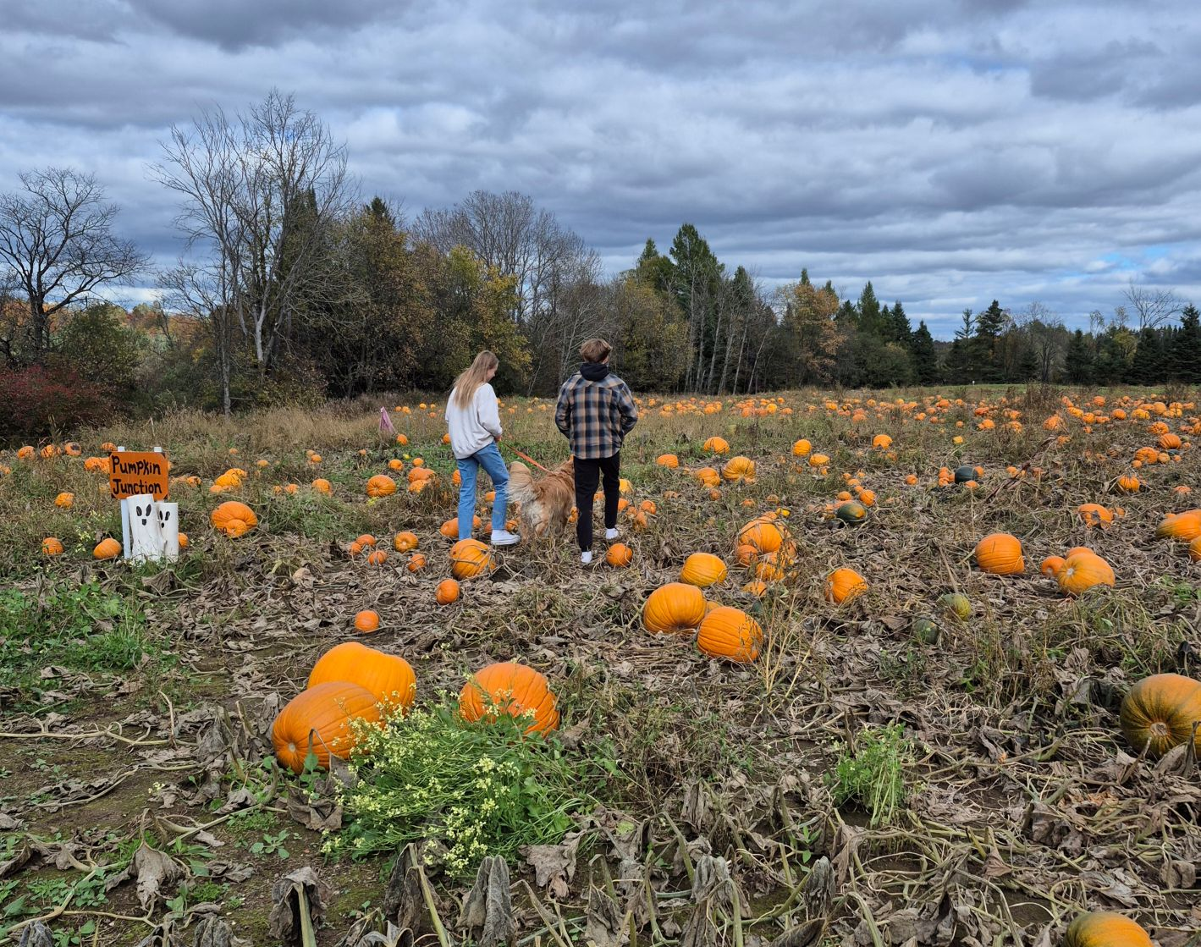
What is Agritourism?
According to The Michigan Agritourism Association
“Agritourism defines the places where agriculture and tourism connect. Anytime a farming operation opens its doors to the public and invites visitors to enjoy their products and services-- that's agritourism.”
Direct sales – farm stand, CSA, PYO
Education – tours, tastings, classes
Hospitality – farm and ranch overnight packages
Recreation – Fishing, hunting, birding
Off site/farm – farmers markets, harvest festivals

Slide 8
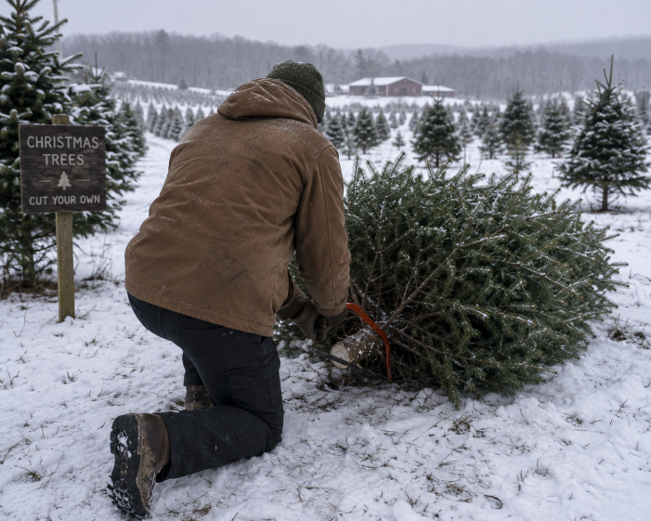
Agritourism Examples
Pumpkin Patches
Farm Stands and Markets
Christmas Tree Farms
B&B
Pick Your Own
Wineries
Tours
Festivals
Hay Rides and Corn Maize
Sleigh Rides
Workshops – cheesemaking, wool spinning
Wedding Events

Slide 9

Agritourism Industry
Risks and challenges to mitigate:
  Seasonality.
  Weather (snow, ice, flooding, drought).
  Tourism dependent.
  Zoning and regulatory issues.
  Unpredictable revenue streams.
  Liability.
  Marketing and networking.

Slide 10
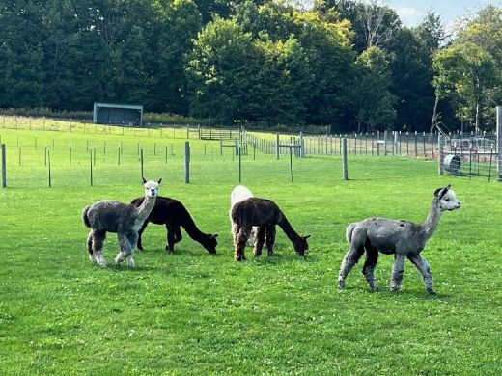
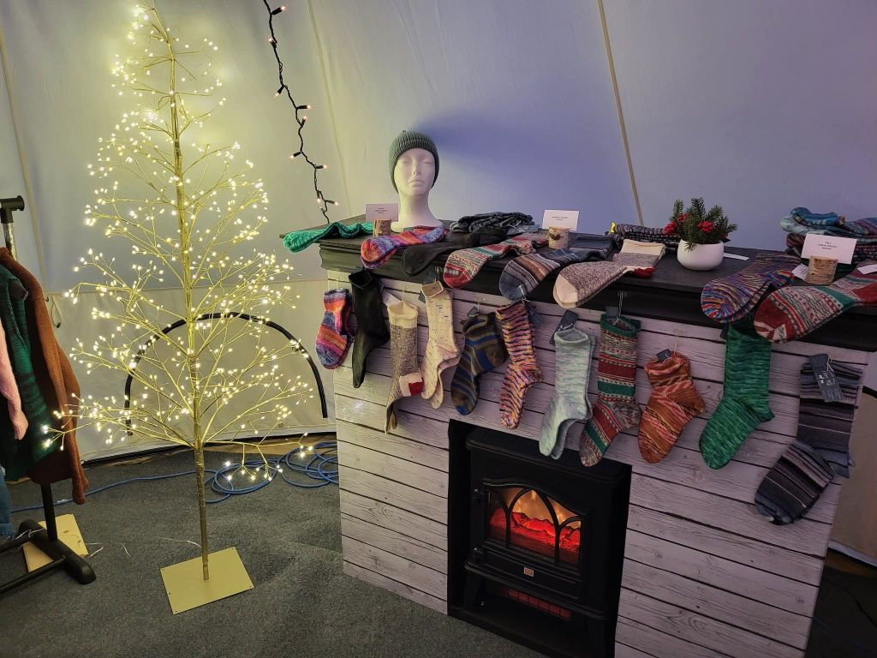
Microloans
  Less than $50,000
  Start-ups and existing
  Use of funds
    Agriculture loans
    Working capital
    Business expansion and acquisition
    Commercial real estate
    Equipment purchases
    Inventory
    Technology upgrades and expansion
Windy Acres Fiber Mill

Slide 11
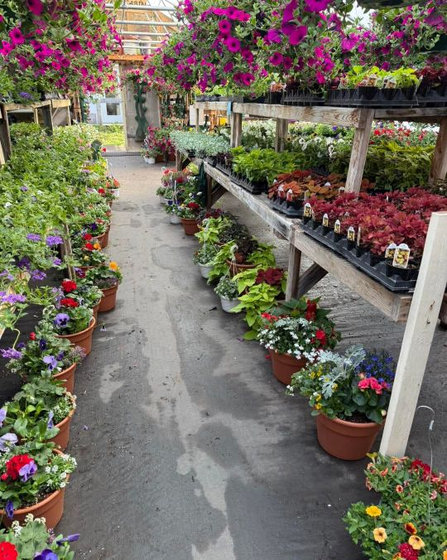
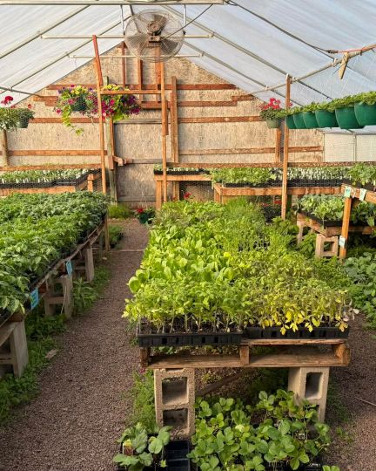
Business Loans
  $50,001 up to $500,000
  New business
  Buy or expand existing business
Lake’s Flower Cabin
Community Advantage
  $350,000 and less
  Guaranteed by SBA
  New business
  Buy or expand existing business

Slide 12
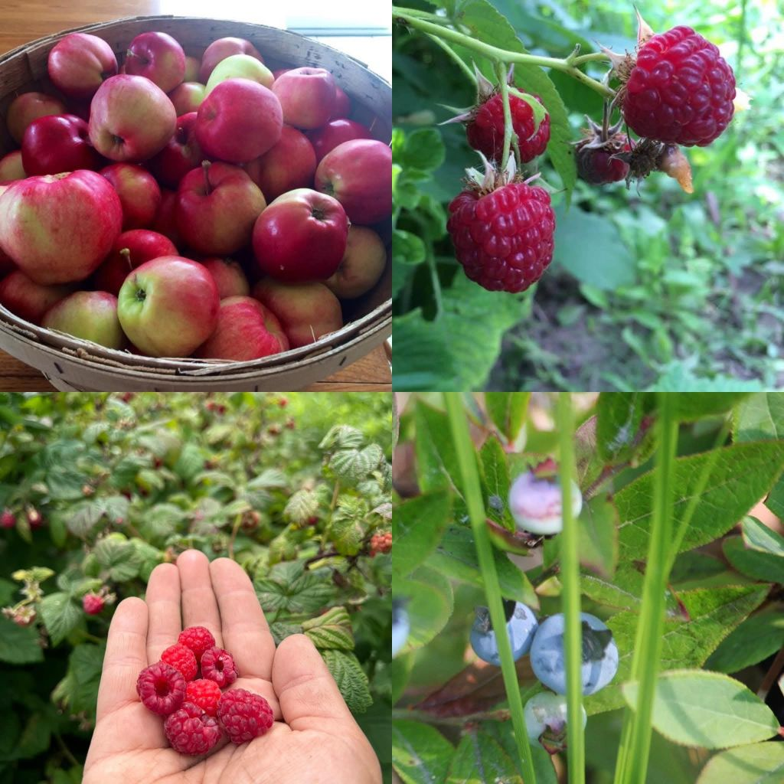
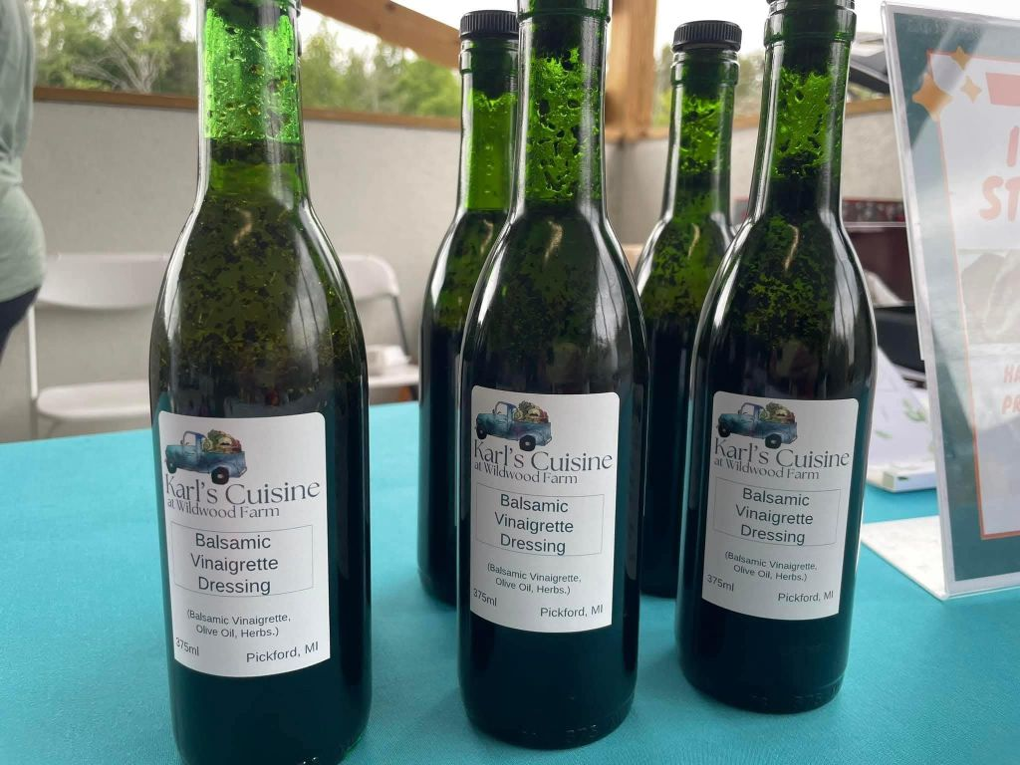
Rates and Fees
Northern Initiatives’ interest rates are typically higher than bank rates. Rates reflect the risk associated with the loan.
Fixed and variable rates
Closing costs include loan fees and third-party fees
  Loan fees are typically 2-3% of the loan amount
  Third-party fees (credit reports, lien checks, etc.)
Karl’s Cuisine Wildwood Farm

Slide 13
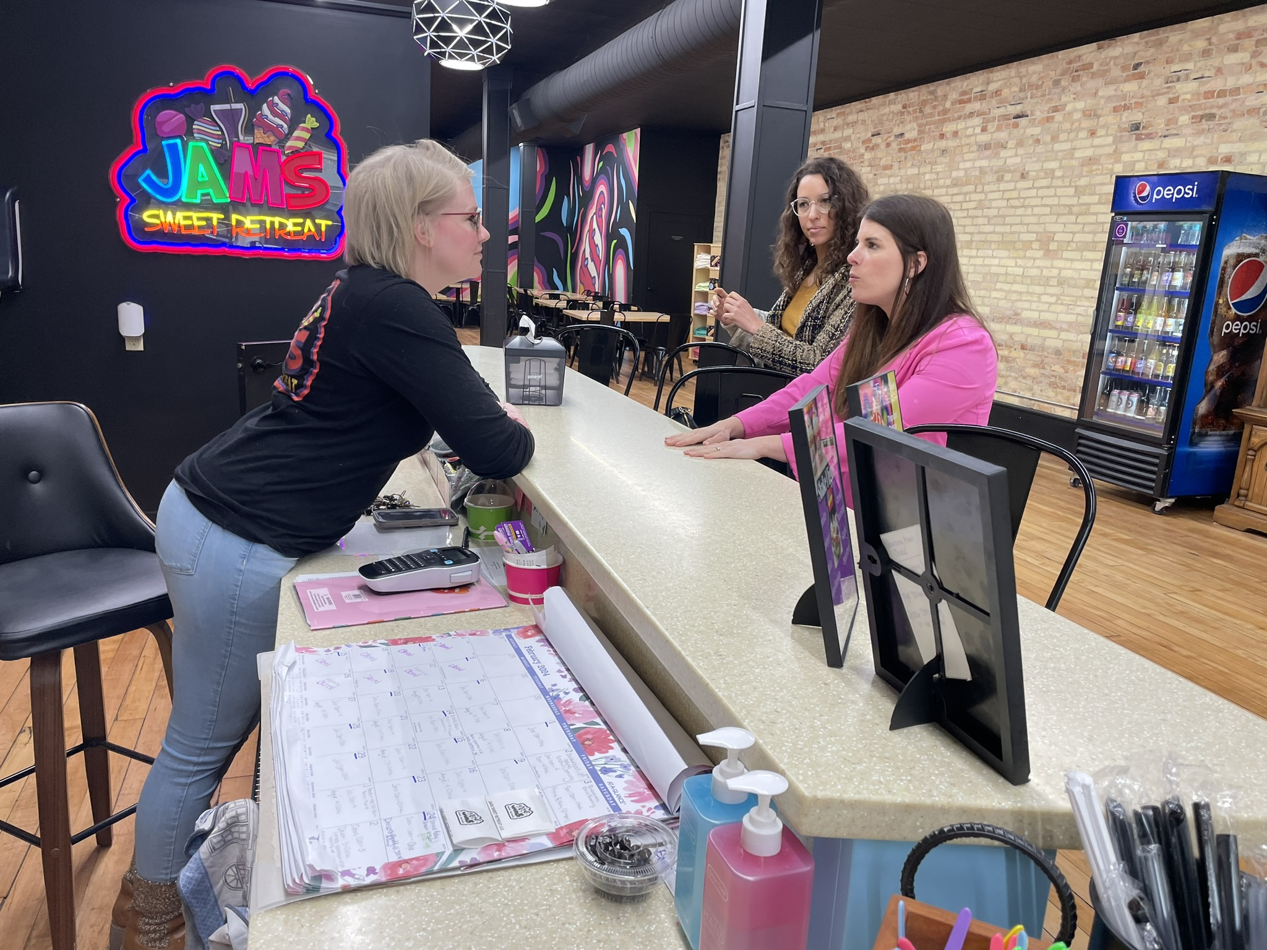
Business Services and Technical Assistance
Each loan comes with access to our Initiate portal, full of resources business owners need — templates, tools, videos, and guides.
We also offer one-on-one business coaching and help with QuickBooks training, marketing, cash flow analysis, financial goals and more.
  Jam’s Sweet Retreat and business coaches Business Coaches Mary Bickel (in pink) and Cailin Kelly.

Slide 14
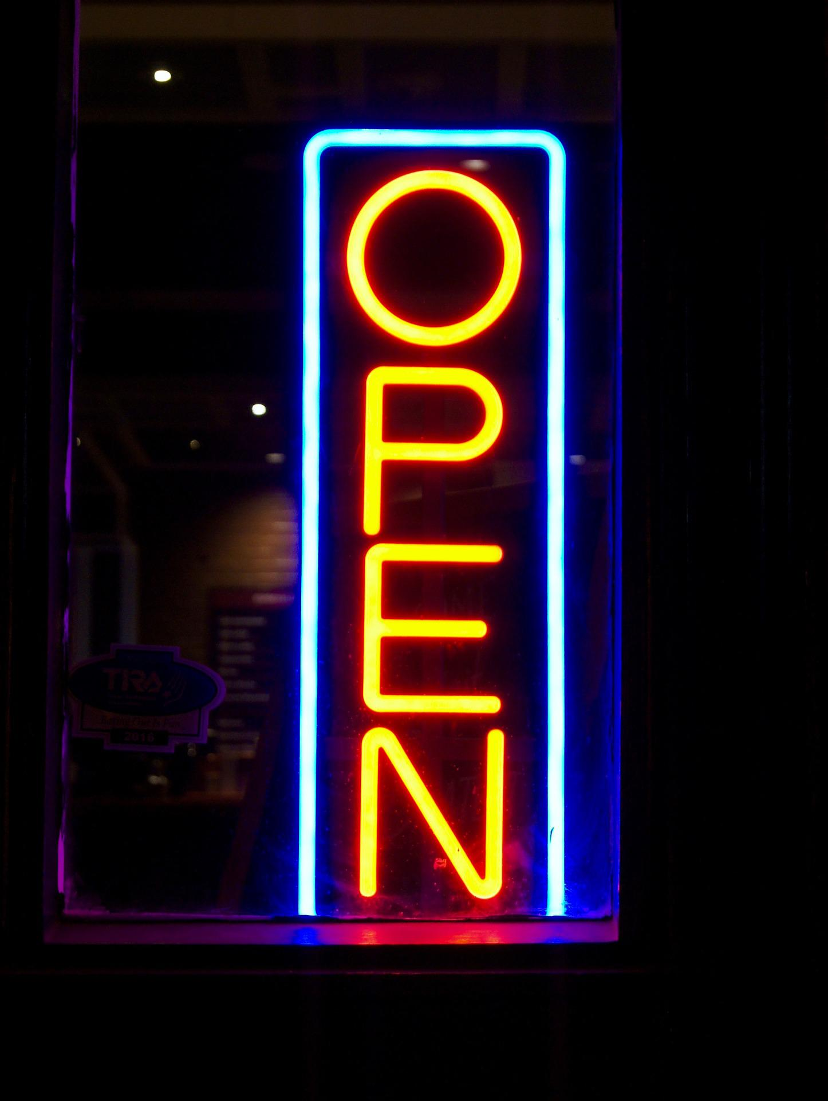
Realities — Personal Viewpoint
Business startups rarely go as planned.
Income/revenue is often lower and expenses higher.
Growing your market takes time.
Don’t get into the fast money cycle.
Implement sound systems from the start.
Every local organization will ask you for donations. Know your limit.
Do you have a model that is operationally sustainable?
Surround yourself with strong advisors – CPA, legal, mentors.

Slide 15

QUESTIONS?
Colleen Duflo
Northern Initiatives
cduflo@northerninitiatives.org
906-420-0907

