Slide 1
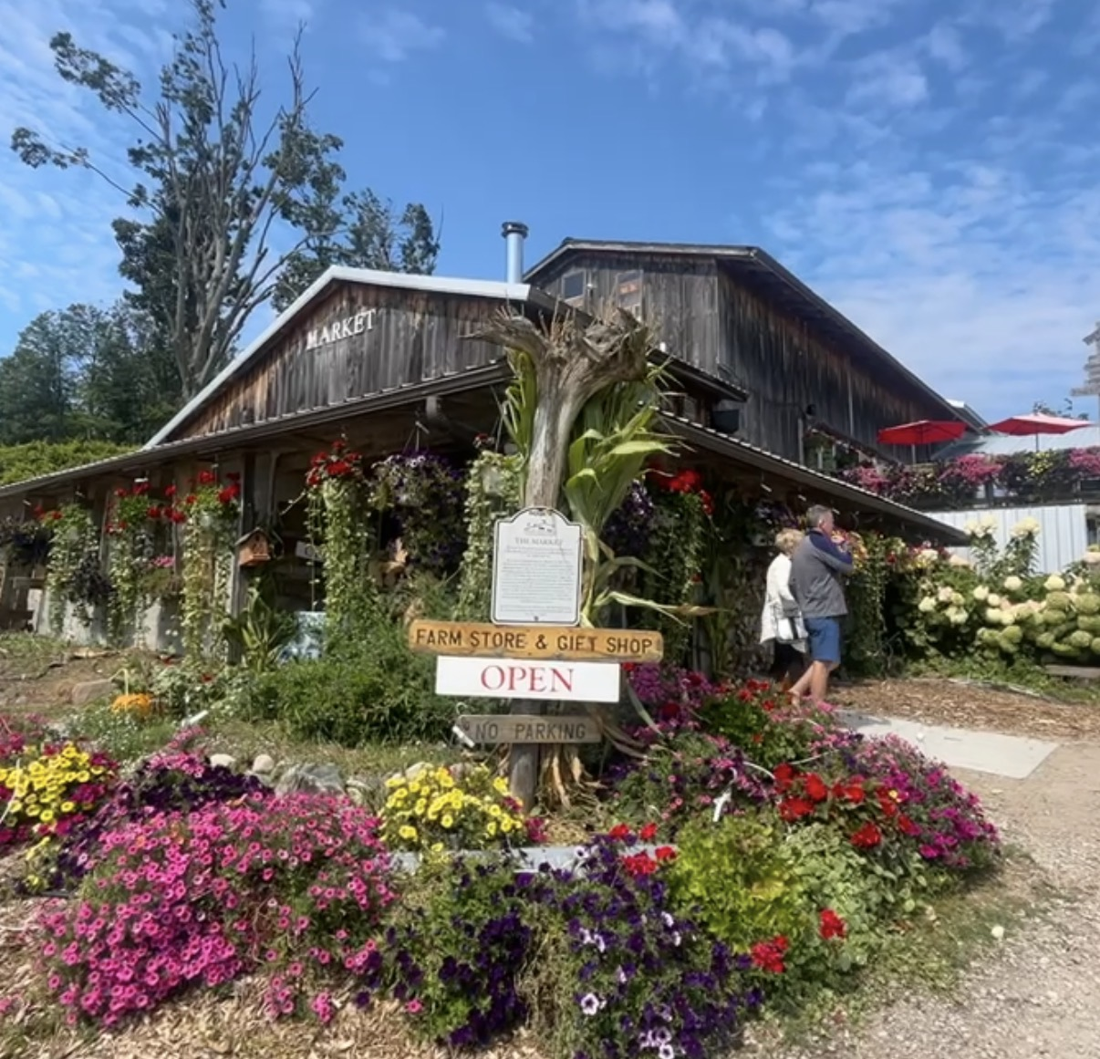
The Path to Scale
Retail Growth in Agritourism

Slide 2
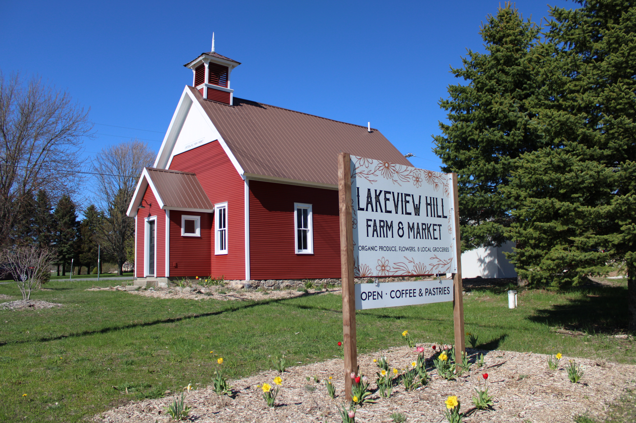
Lakeview Hill Farm & Market
John Dindia
For the love of farming, regenerative land stewardship, community, and good food
Lakeview Hill Farm & Market is a certified organic produce and cut flower farm located in Traverse City, MI. We specialize in greenhouse and hoophouse production and supply high quality vegetables and cut flowers to local grocery stores, restaurants, a 200-person CSA through MI Farm Co-op, and our year-round Farm Market.

Slide 3
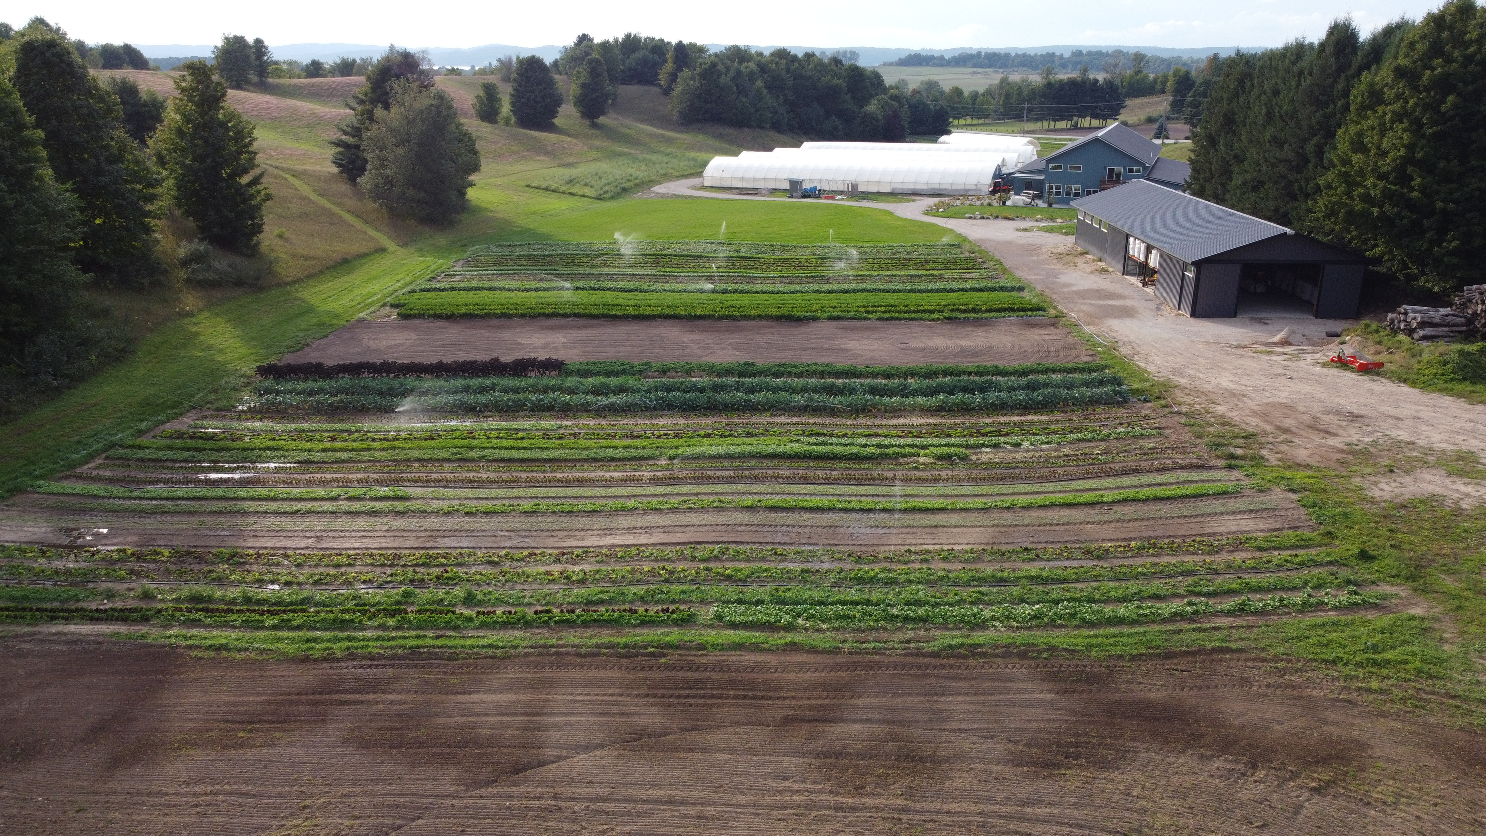

Slide 4
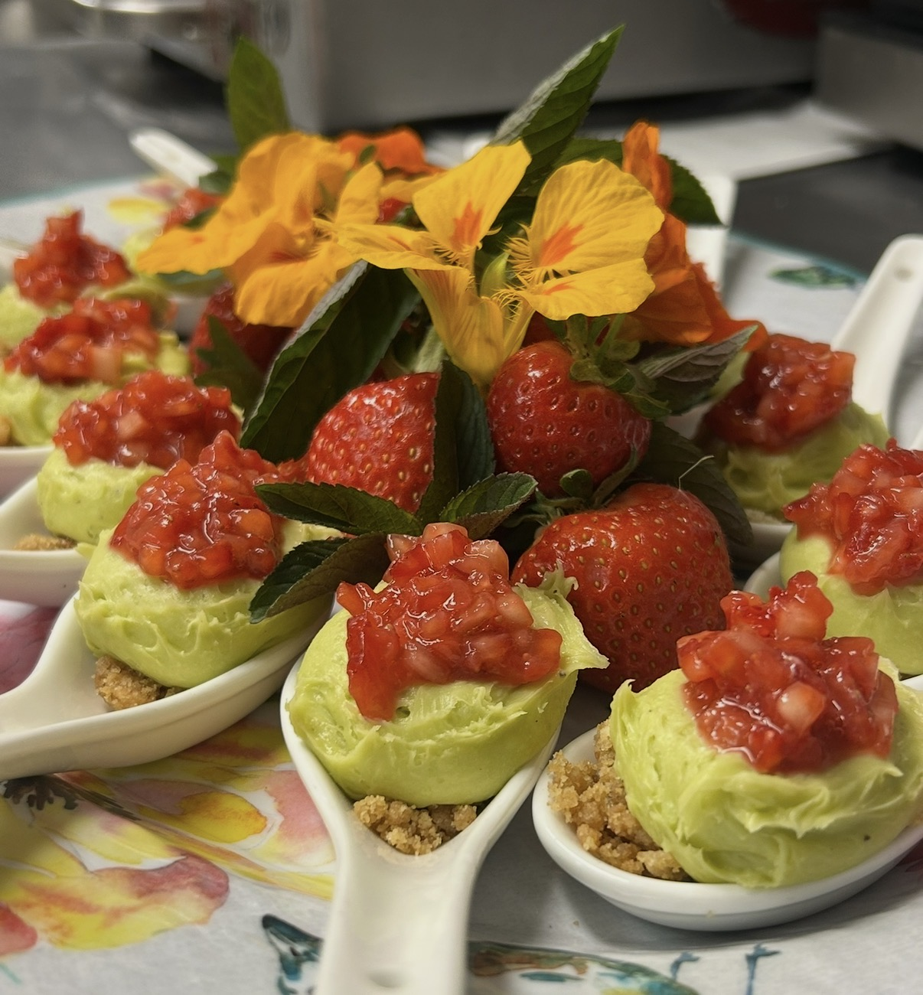
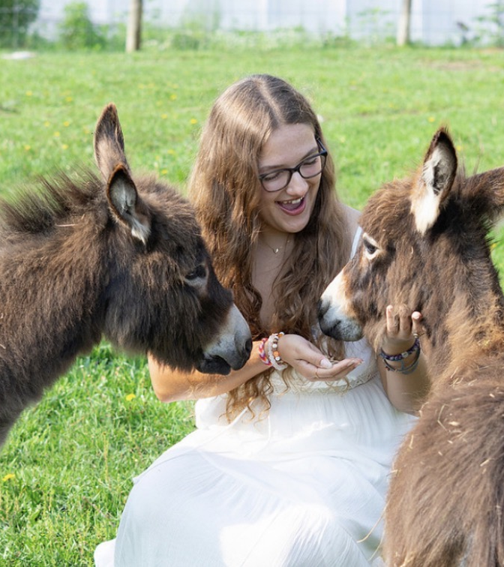
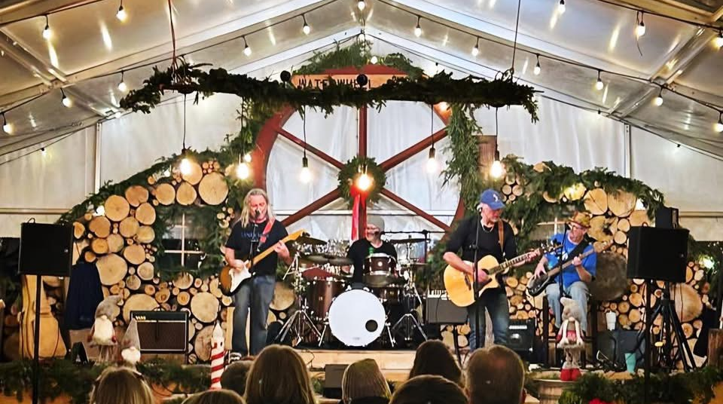
Pond Hill Farm
Jimmy Spencer
Our Core Purpose is to bring joy to families through the simple pleasures of farm life, fresh food, nature, and music.
Pond Hill Farm began when Jimmy Spencer chose a life outdoors over a desk, starting to farm his family’s property in Harbor Springs at just 17. What began as a small roadside stand selling vegetables grew into a beloved destination featuring a farm market, café, winery, brewery, and vineyard.

Slide 5
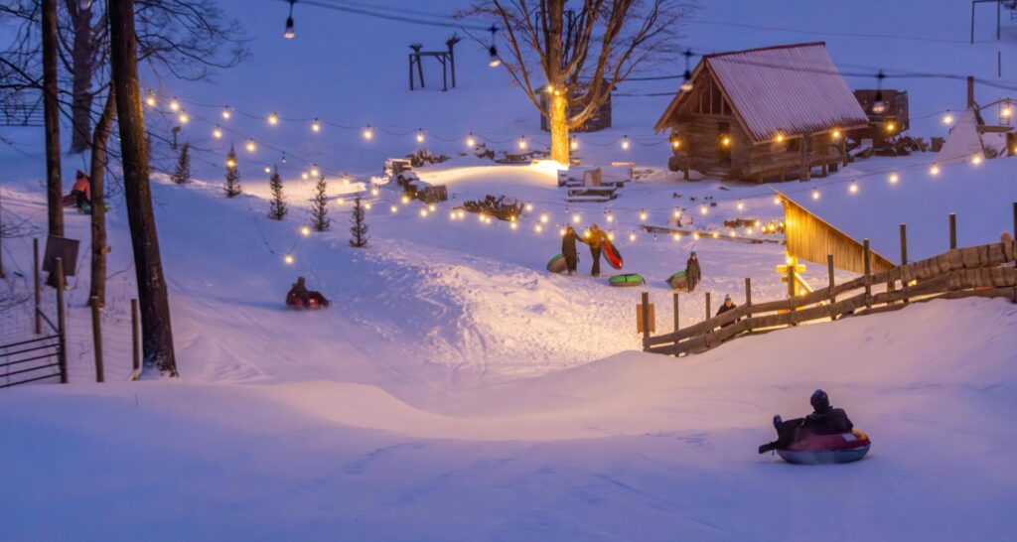
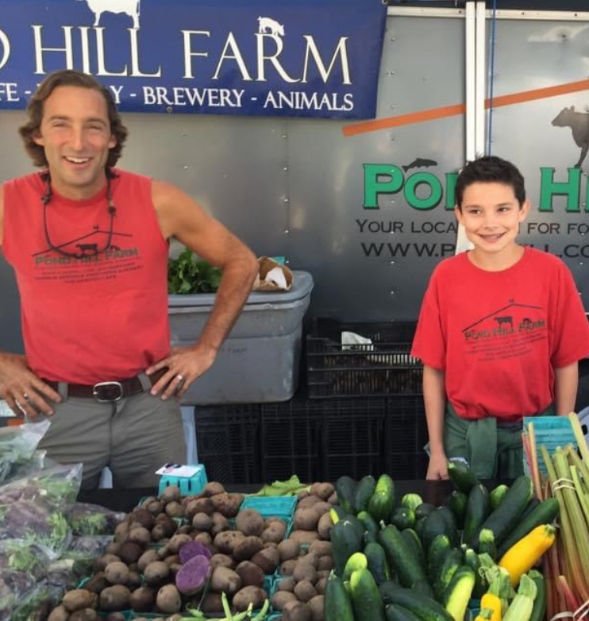
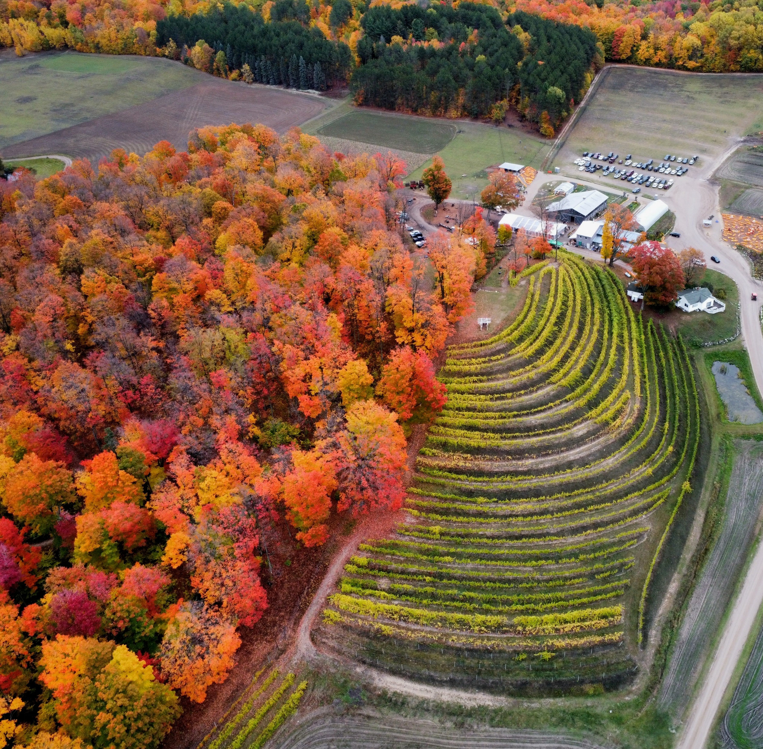

Slide 6
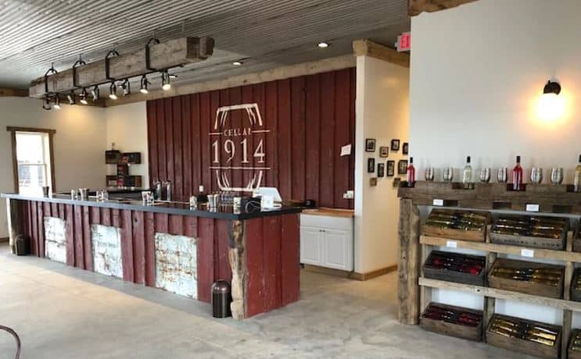
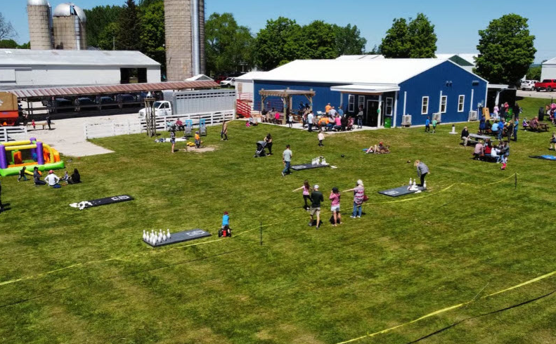
Cellar 1914
Greg Shooks
Shooks Farms is a family operated farm nestled in the beautiful countryside of northern Antrim County near Torch Lake. Our close proximity to Lake Michigan affords cool breezes necessary for the production of delicious cherries of many different varieties.
Currently the 4th generation has taken advantage of this and has begun our newest venture, an on-site winery. Cellar 1914 was launched in spring of 2019 utilizing our own grapes and equipment to provide award winning wines and hard ciders all set in a family friendly atmosphere.

Slide 7
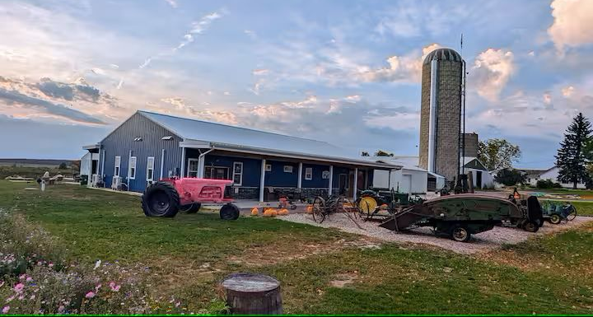
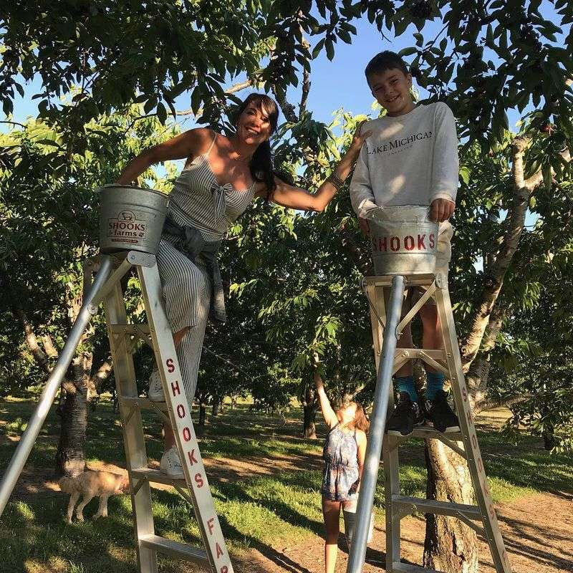
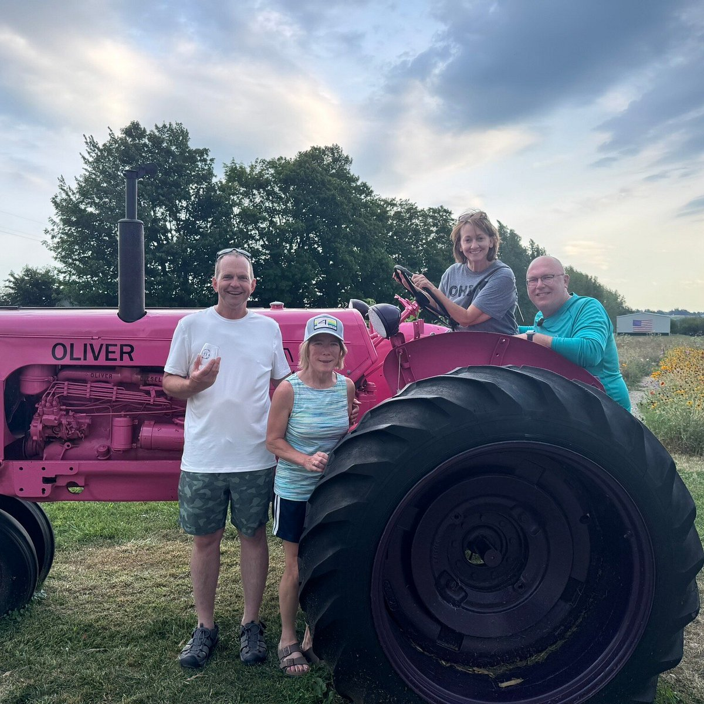
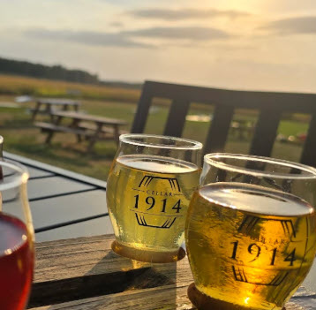

Slide 8
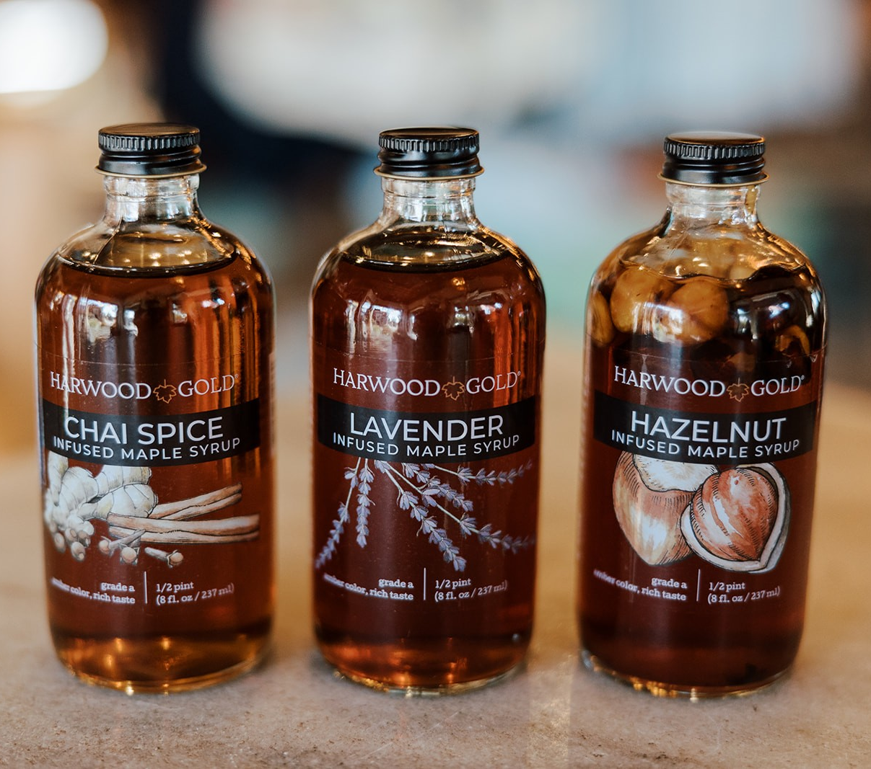
Harwood Gold
Amber Parson
Making pure maple syrup since 1898
2023 marked our 125th year making pure maple syrup on our family farm in Charlevoix, Michigan.
Providing the rich, flavorful base of our ‘Made with Maple’ products, maple syrup is the foundation of everything we do at Harwood Gold.

Slide 9
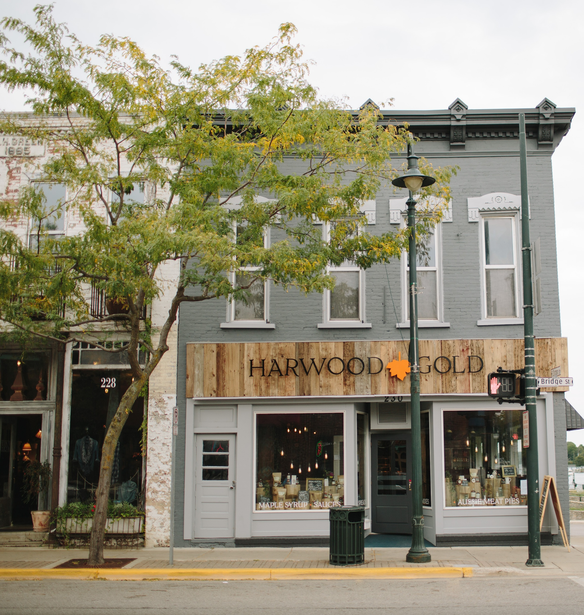
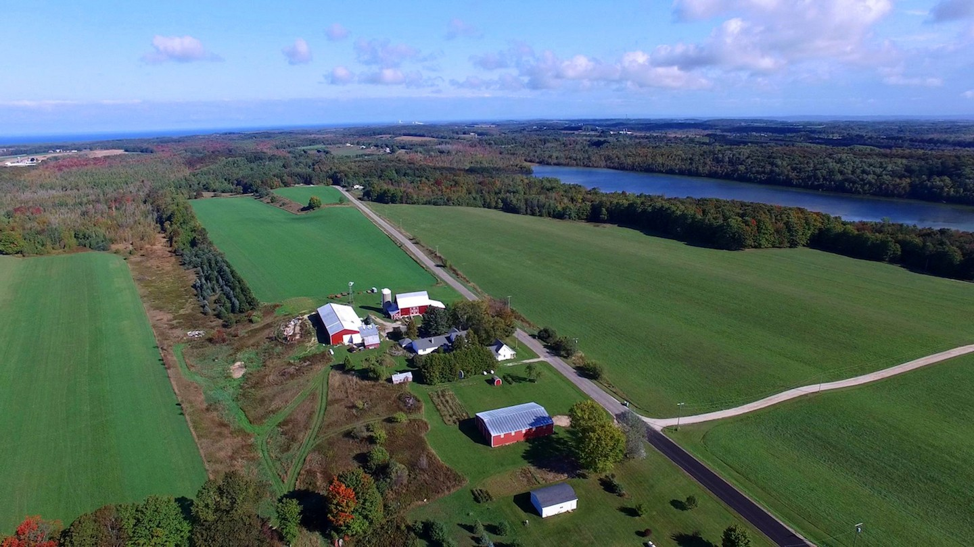
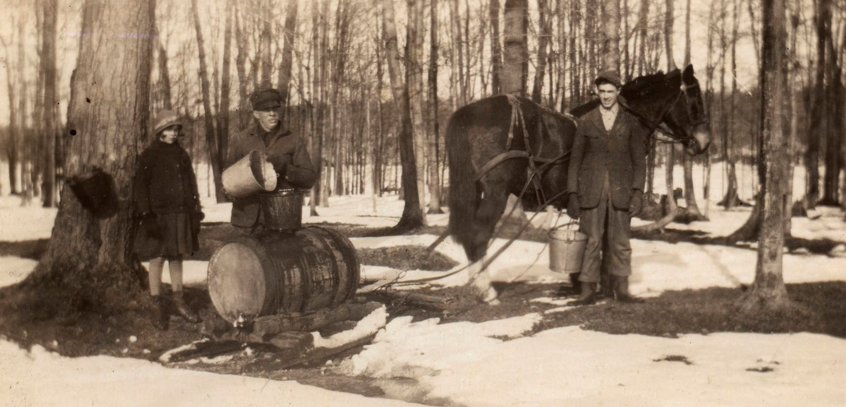

Slide 10
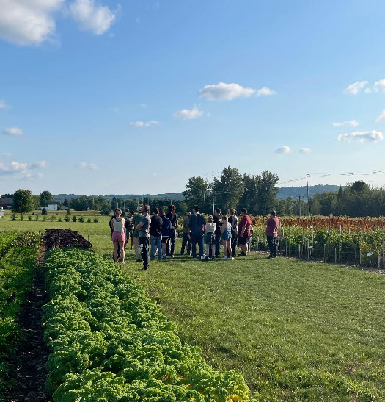
Questions/Comments

