Slide 1













Northern Michigan Agritourism Conference
April 2026
Cultivating Capital
Innovative Funding from Idle Fields
A 40-Acre Hypothetical Agritourism Model for Northwest Michigan
Location
Size
Northwest Michigan
40 acres total
Key Insight
Many Northern Michigan farms are land rich and cash poor — struggling to adapt to shifting markets, aging ownership, and changing generational interests.
Moderator:
Brad Lonberger, AICP, AIA, CNU-A
Panelist:
Claire Karner, AICP
Panelist:
Angie Doucette
Panelist:
Chris Bardenhagen
Panelist:
Kim Hayes
Place Strategies, Inc.
East Bay Township
American Farmland Trust
Michigan State University
Leelanau Conservancy

Slide 2
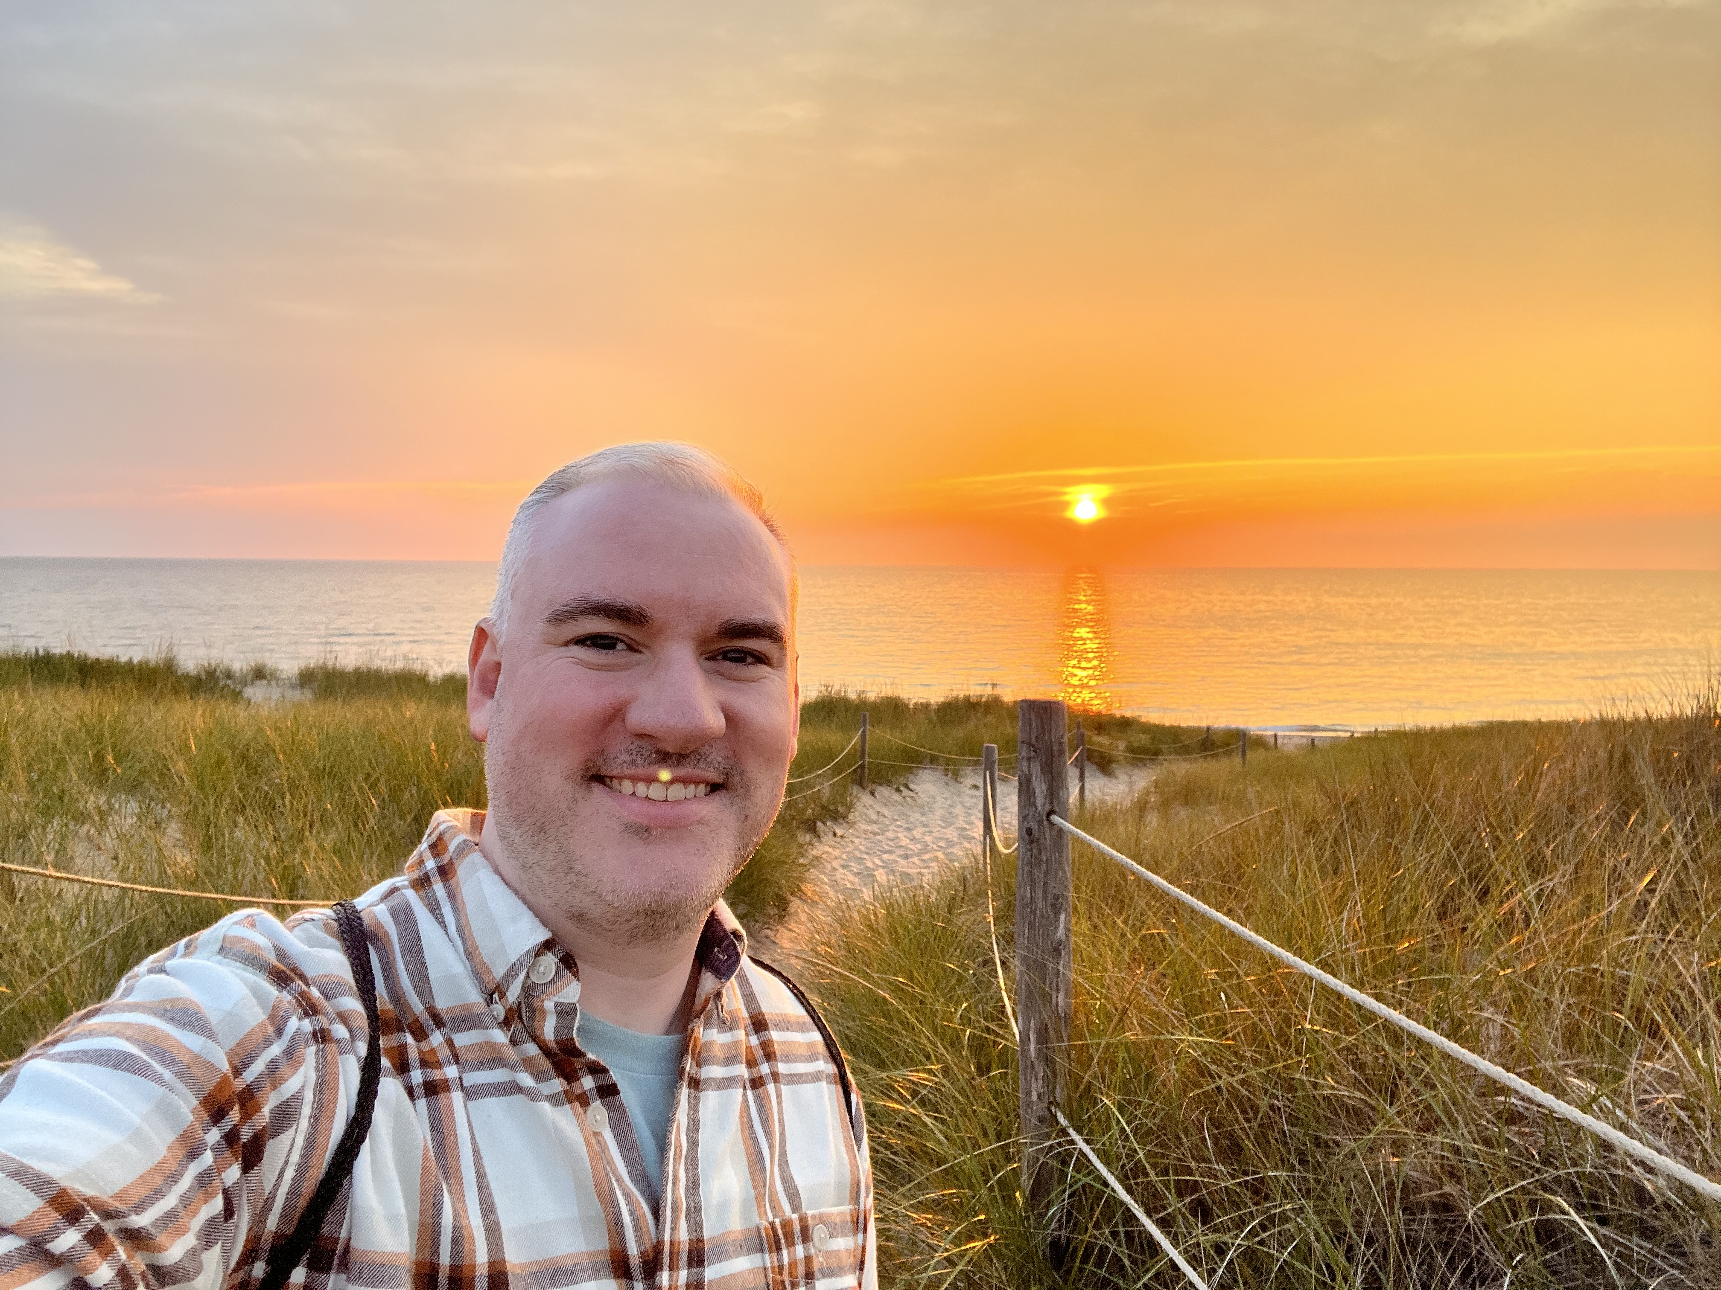
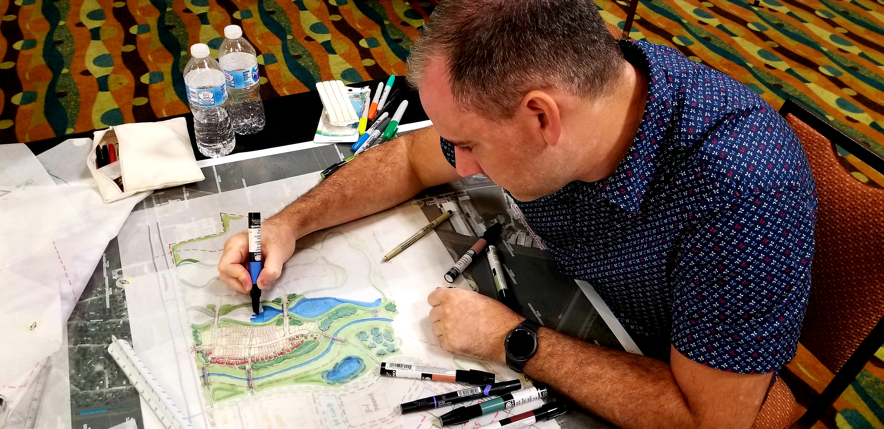

Northern Michigan Agritourism Conference
April 2026
Moderator:
Brad Lonberger, AICP, AIA, CNU-A
Place Strategies, Inc.
“Wilderness is not a luxury but a necessity of the human spirit, and as vital to our lives as water and good bread.”
― Edward Abbey, Desert Solitaire

Slide 3
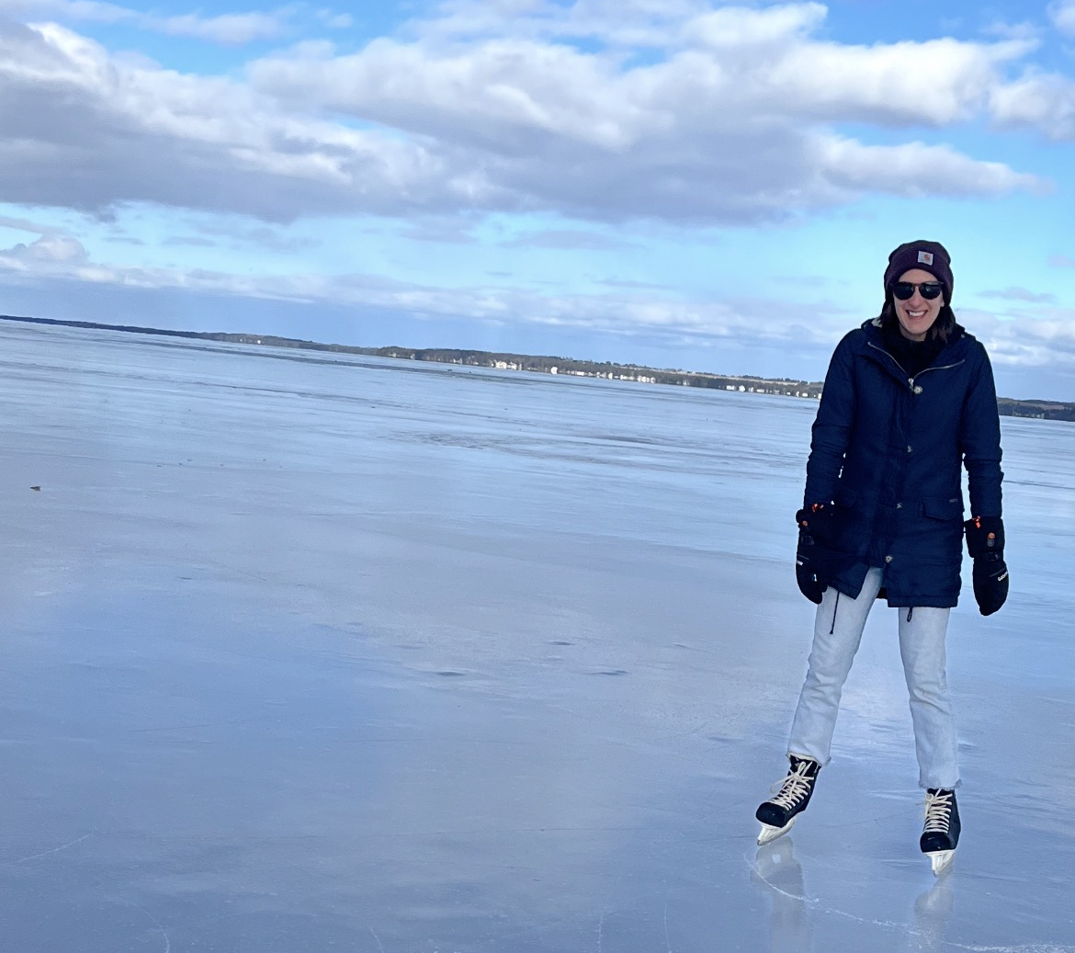
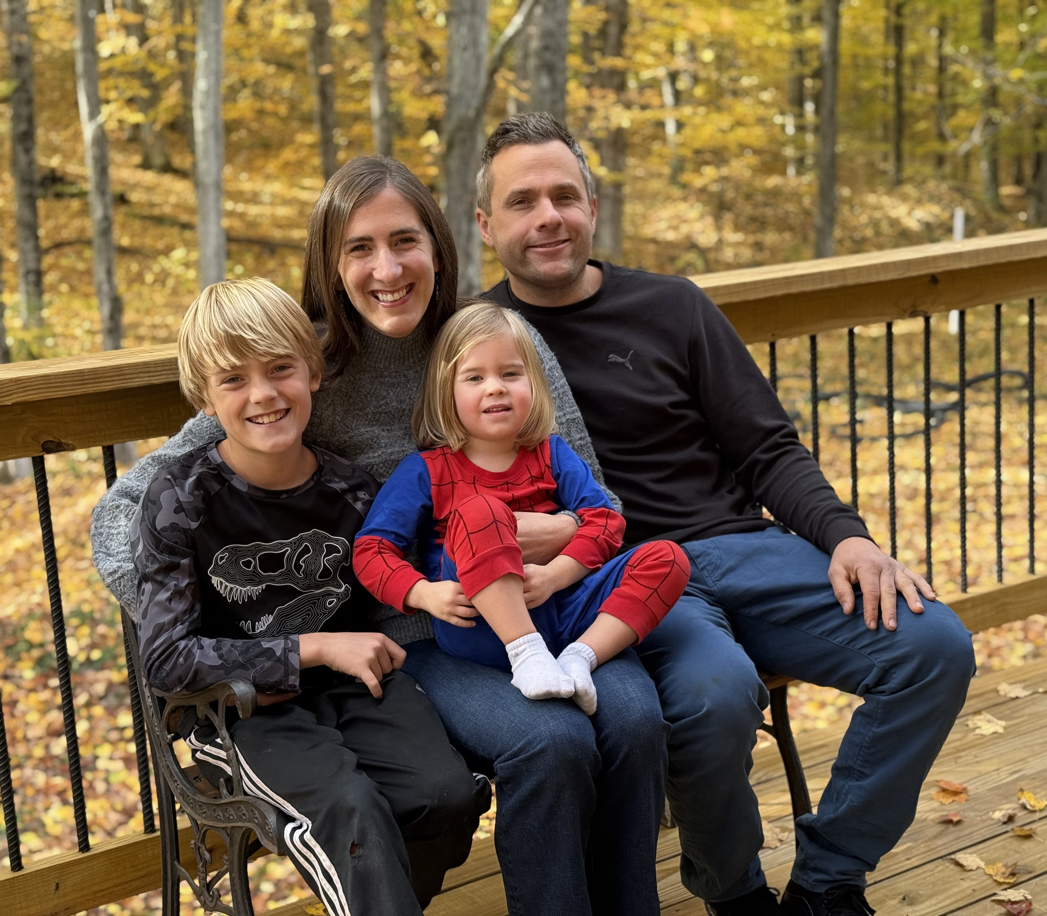
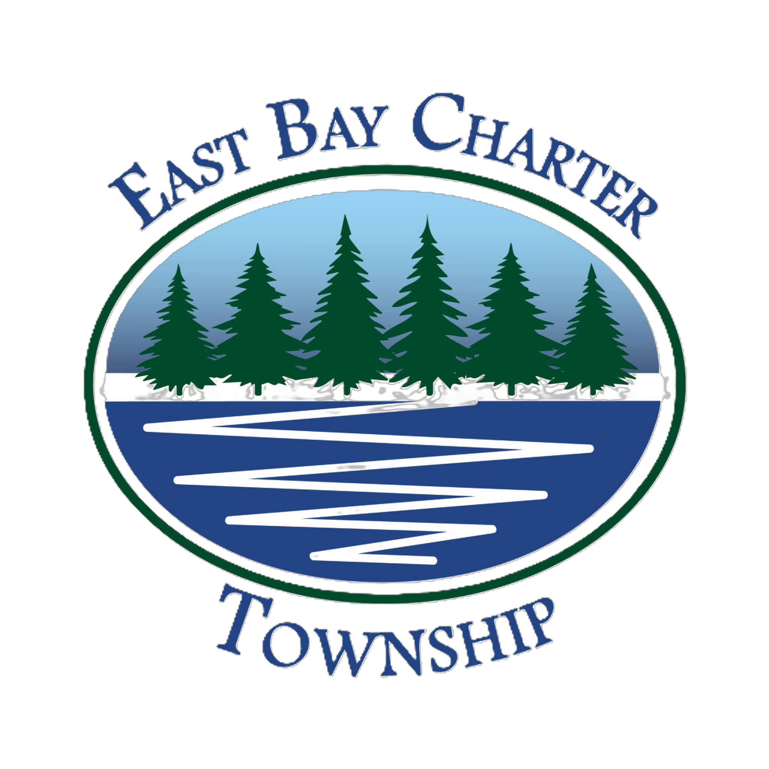
Northern Michigan Agritourism Conference
April 2026
Panelist:
Claire Karner, AICP
East Bay Township
“We do not inherit the earth from our ancestors; we borrow it from our children.”
– Native American Proverb

Slide 4
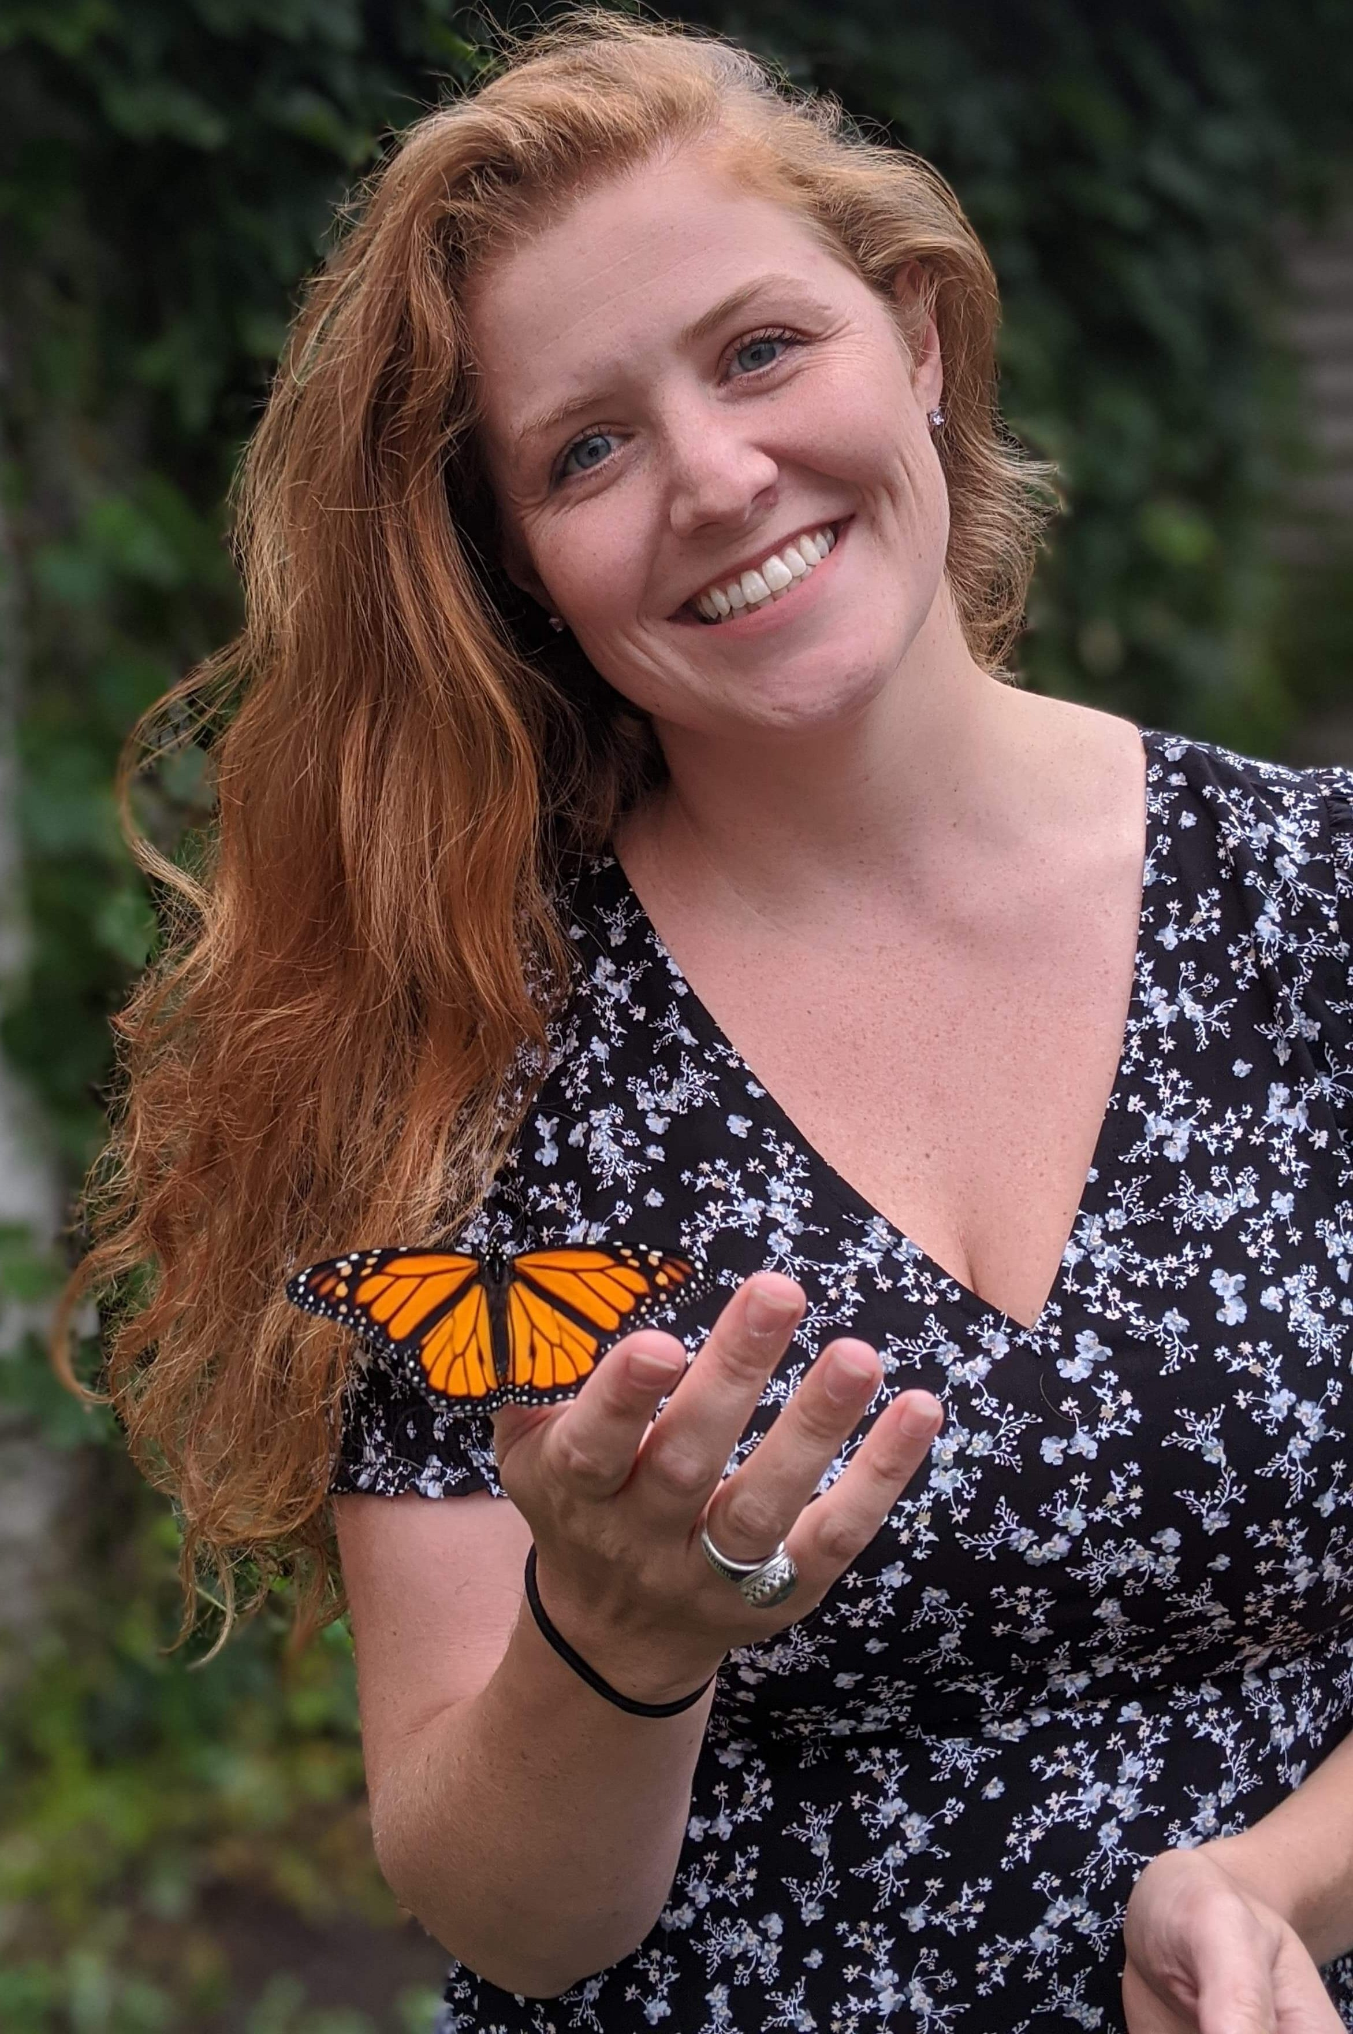
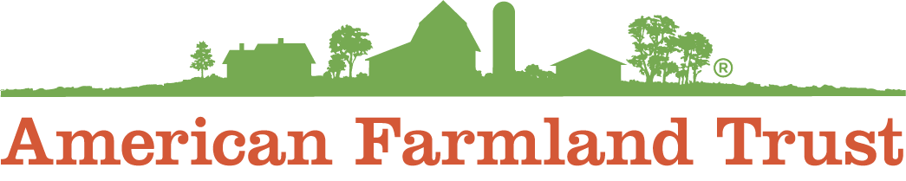
Northern Michigan Agritourism Conference
April 2026
Panelist:
Angie Doucette
American Farmland Trust
“The more clearly we can focus our attention on the wonders and realities of the universe about us, the less taste we shall have for destruction.”
– Rachel Carson

Slide 5
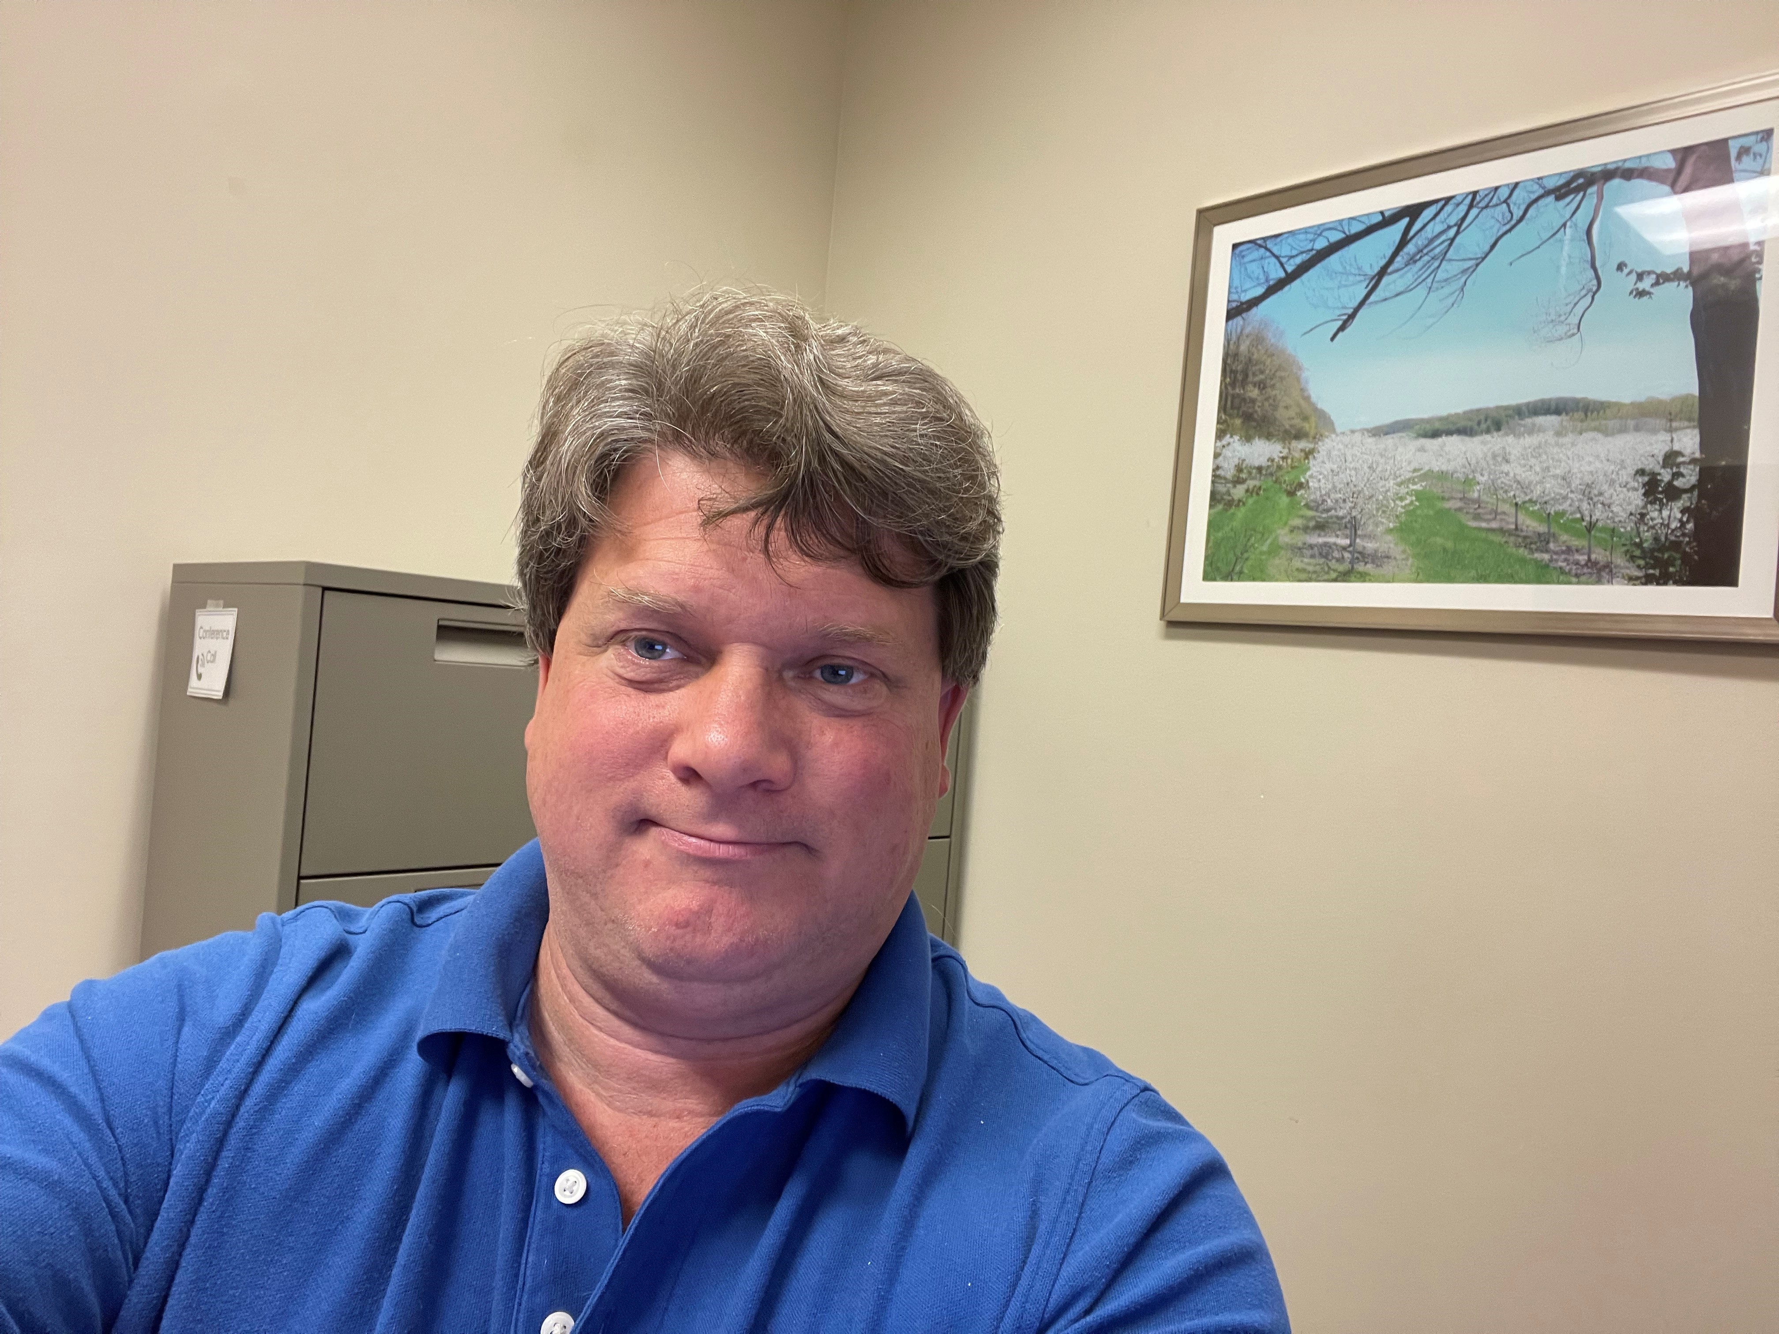

Northern Michigan Agritourism Conference
April 2026
Panelist:
Chris Bardenhagen
Michigan State University
“Meet people where they are at.”

Slide 6
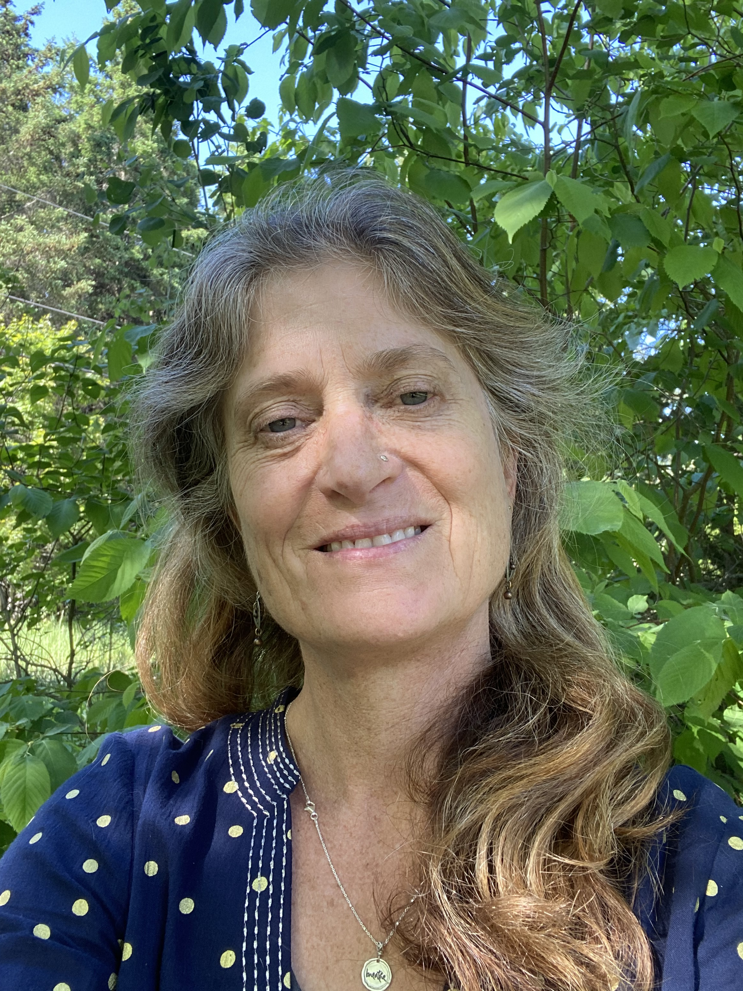

Northern Michigan Agritourism Conference
April 2026
Panelist:
Kim Hayes
Leelanau Conservancy
“Conserve the land, secure the legacy.”

Slide 7









Why This Matters
Regional Advantage
The Northwest Michigan Context
Agritourism + Conservation
Northwest Michigan's Unique Position
Regional Statistics
The region combines glacial sandy loam soils, lake-influenced microclimates, and a growing agritourism culture to create an ideal environment for sustainable farm development.
40%
$1M+
Conservation Land
Revenue Potential
Agricultural Advantages
Economic Drivers
15+
25%
Glacial Sandy Loam Soils
Growing Agritourism Culture
Counties Served
Tourism Growth
Ideal for fruit production and specialty crops
Farm stays, U-pick, events
Lake-Effect Microclimates
Wine & Cherry Branding
Key Organizations
Moderate temperatures, extended growing seasons
Established regional identity
Grand Traverse Regional Land Conservancy
Seasonal Tourism Demand
Leelanau Conservancy
Specialty Crop Focus
Peak summer/fall visitors
Cherries, apples, wine grapes
USDA, MDARD & Office of Rural Prosperity
The Core Question
Conservation Success
Regional conservancies have demonstrated that farmland preservation is viable when paired with strategic capital.
The question isn't whether to preserve farmland—it's how to preserve it while ensuring financial resilience.
Key Insight: Northwest Michigan's agricultural landscape is both economically fragile and culturally invaluable
Source: Regional Land Conservancy Data

Slide 8














The Core Challenge
Northwest Michigan
Land-Rich, Cash-Poor Farms
Agricultural Context
Land-Rich, Cash-Poor Dilemma
Key Statistics
Many Northern Michigan farms face a critical financial paradox: high land values but insufficient cash flow to sustain operations and support succession planning.
40%
$3M+
Land Value Increase
Potential Revenue
Financial Pressures
Operational Issues
65%
25%
Family-Owned Farms
Profit Margin
Rising Land Values
Aging Ownership
Property values increasing faster than farm income
Succession planning challenges
Workforce Housing
Challenge Breakdown
Thin Margins
Labor shortages affecting operations
Financial
45%
Seasonal volatility affecting profitability
Operational
35%
Infrastructure Needs
Seasonal Volatility
Maintenance and upgrade costs
Succession
20%
Weather-dependent income fluctuations
Critical Insight
The Goal
The question isn't whether to preserve farmland—it's how to preserve it while ensuring financial resilience.
Keep land productive and in family hands while making it pay its way through diversified revenue streams.
Challenge: Rising land values, thin margins, and seasonal volatility
Source: Regional Agricultural Survey 2025

Slide 9
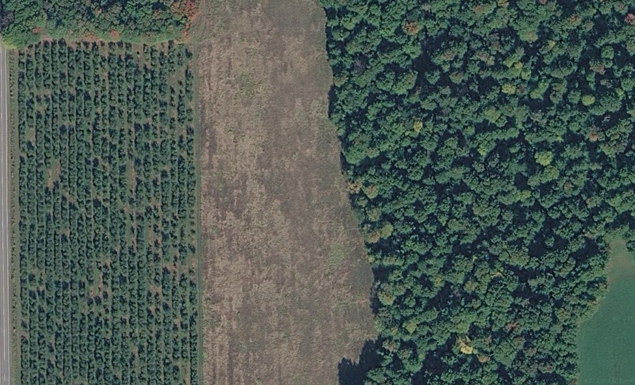












Hypothetical 40-Acre Base Map
Location: Northwest Michigan
Existing Conditions & Site Structure Analysis
40 Acres
Site Overview
Approx. 1,320' × 1,320'
Total: 40 acres
Orchard: 11 acres
Orchard Block
Open Field
Open: 11 acres
Flexible use area
Woods: 16 acres
Road: 2 acres
Power Available
Development Zones
From roadway
Creek/Floodway
Active agriculture
Seasonal drainage
Flexible use
Conservation
County Road Frontage
Public access & visibility
CONSERVATION
Gentle Slope
Wooded Habitat
16 acres of wooded habitat with seasonal creek protection area.
AND
11 acres of farm orchards for active farming
Eastward fall
16 acres conservation
Note: Conceptual planning diagram — hypothetical 40-acre site, not based on surveyed conditions
Cultivating Capital 9
Notes:
Discuss why 40-acres – average size of farms in Michigan – demonstration of how existing tools can be used on the average sized home

Slide 10
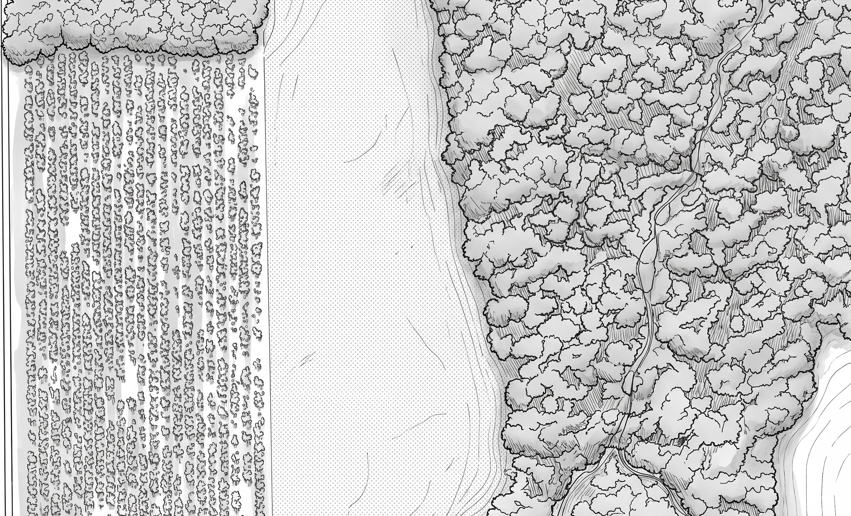
Hypothetical 40-Acre Base Map
Location: Northwest Michigan
Existing Conditions & Site Structure Analysis
40 Acres
Site Overview
Approx. 1,320' × 1,320'
Total: 40 acres
Orchard: 11 acres
Orchard Block
Open Field
Open: 11 acres
Flexible use area
Woods: 16 acres
Road: 2 acres
Power Available
Development Zones
From roadway
Creek/Floodway
Active agriculture
Seasonal drainage
Flexible use
Conservation
County Road Frontage
Public access & visibility
CONSERVATION
Gentle Slope
Wooded Habitat
16 acres of wooded habitat with seasonal creek protection area.
AND
11 acres of farm orchards for active farming
Eastward fall
16 acres conservation
Note: Conceptual planning diagram — hypothetical 40-acre site, not based on surveyed conditions
Cultivating Capital 10

Slide 11









40-Acre Land Allocation
68% Protected
32% Activated
Land Use Allocation
Protected vs Activated
Using the physical site analysis overlay (topography, soils, drainage, access, microclimate), the 40-acre site is allocated as follows:
Protected (68%)
27.2 acres
Activated (32%)
12.8 acres
Land Use Breakdown
Total: 40.0 acres (100%)
68%
Protected Land
Land Category | Acreage | Percentage | Function | Status
Core Agricultural Production | 11.0 ac | 27.5% | Orchards, specialty crops | Active
Conservation / Woodland | 16.0 ac | 40.0% | Wetlands, habitat, slopes | Protected
Pocket Neighborhood | 2.0 ac | 5.0% | 10–14 clustered homes | Development
Agritourism & Restaurant | 2.0 ac | 5.0% | Hospitality anchor | Mixed Use
Event / Circulation | 3.0 ac | 7.5% | Barn, parking, access | Planning
Seasonal Attractions | 6.0 ac | 15.0% | Maze, pumpkin patch, etc. | Seasonal
32%
Activated Land
$1M+
Revenue Potential
CONSERVATION PRIORITY
68% of the land is permanently protected for conservation and agricultural use, ensuring long-term ecological sustainability.
Cultivating Capital 11

Slide 12
Hypothetical 40-Acre Base Map
Location: Northwest Michigan
Opportunity Zones
Market Space
Parking
Site Overview
Production Sales
Access Route
Total: 40 acres
Cottage Cluster
Housing Options
Orchard: 11 acres
Orchard Block
Homestead
Programmed: 11 acres
Food & Bev
Woods: 16 acres
Road: 2 acres
Event Space
Programmed Space
Gathering Field
Market/Homestead
Creek/Floodway
Seasonal drainage
Parking
Cottage Cluster
Event Space – Gathering Place
Org Production – CSA Growing
Organic Production
Or Pollinator Field
CONSERVATION
CSA Growing, Community Growing
Wooded Habitat
16 acres of wooded habitat with seasonal creek protection area.
AND
11 acres of farm orchards for active farming
16 acres conservation
Note: Conceptual planning diagram — hypothetical 40-acre site, not based on surveyed conditions
Cultivating Capital 12

Slide 13
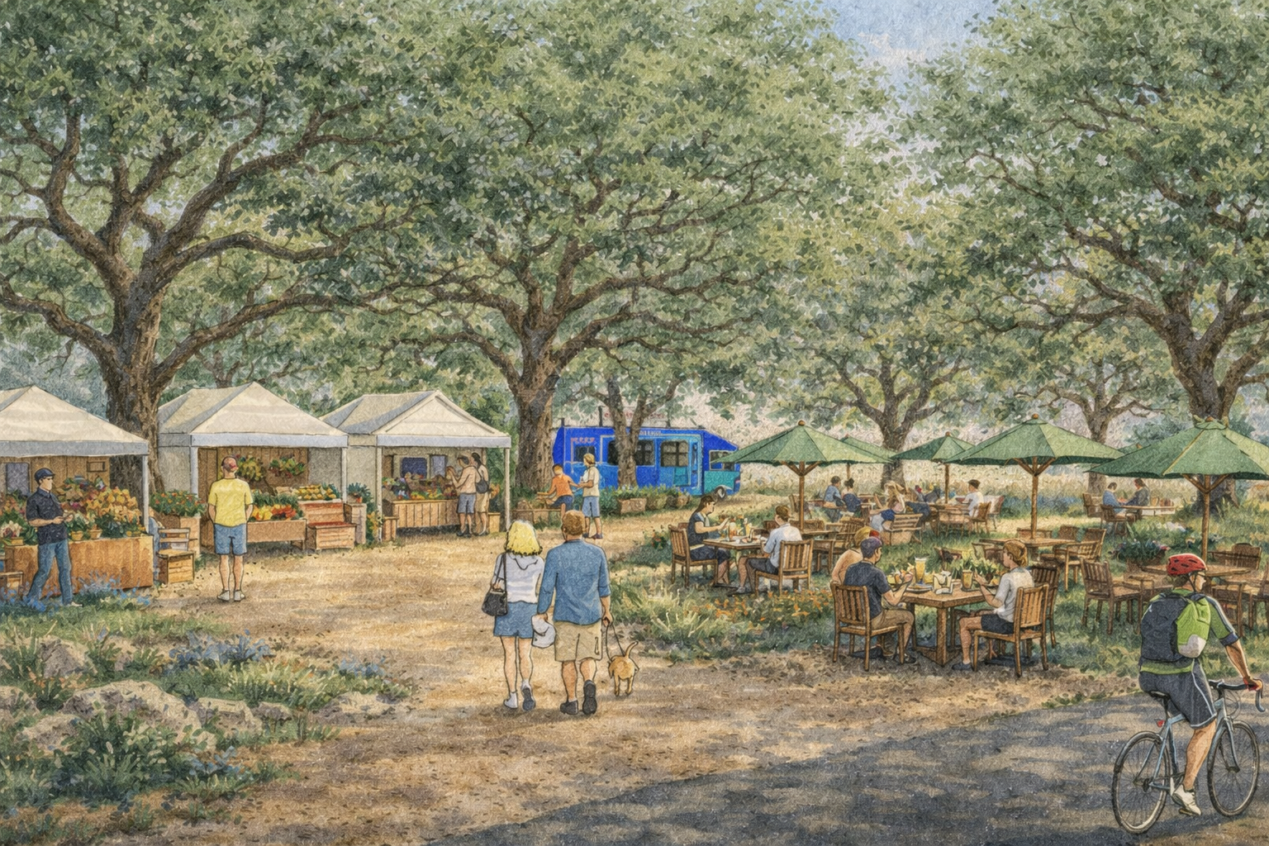
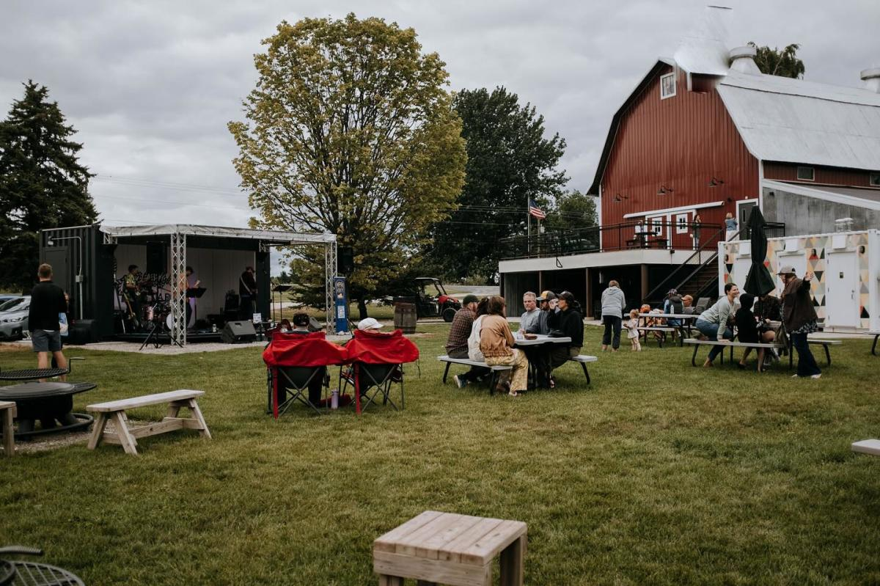
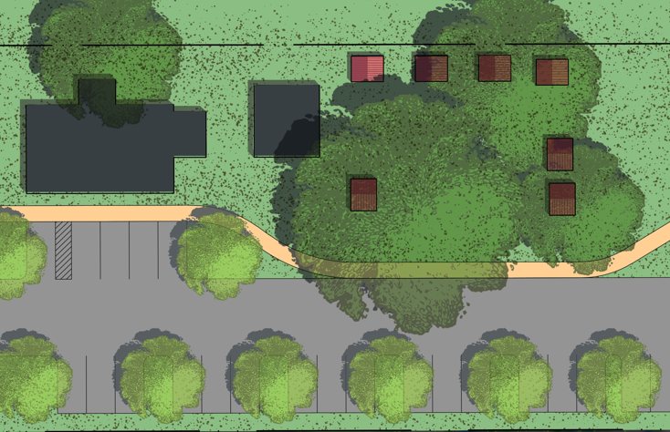
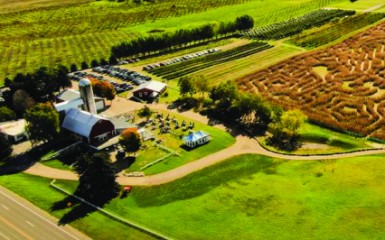
Hypothetical 40-Acre Base Map
Location: Northwest Michigan
Visualizing Opportunity
Market Space
Event Space
PIONEER GROVE - TEXAS
JACOBS FARM - MICHIGAN
Note: Conceptual planning diagram — hypothetical 40-acre site, not based on surveyed conditions
Cultivating Capital 13

Slide 14
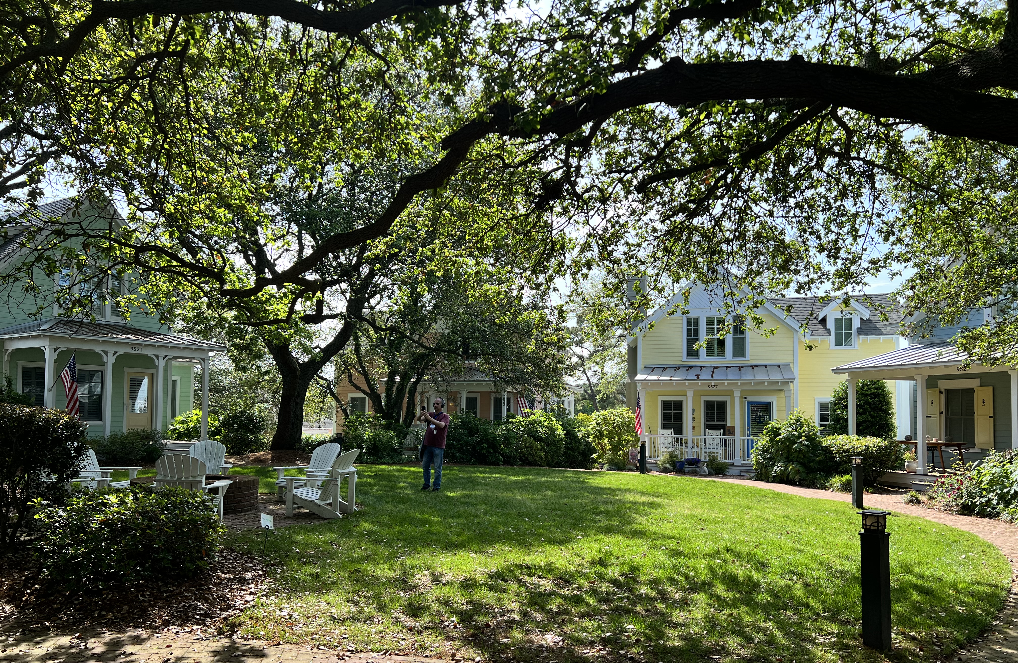
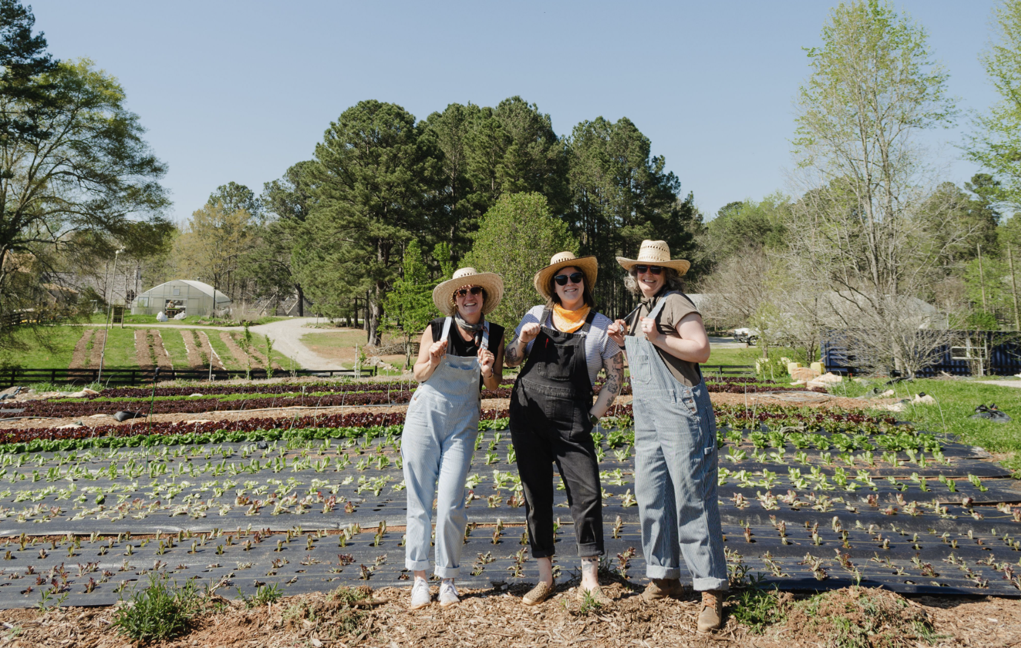
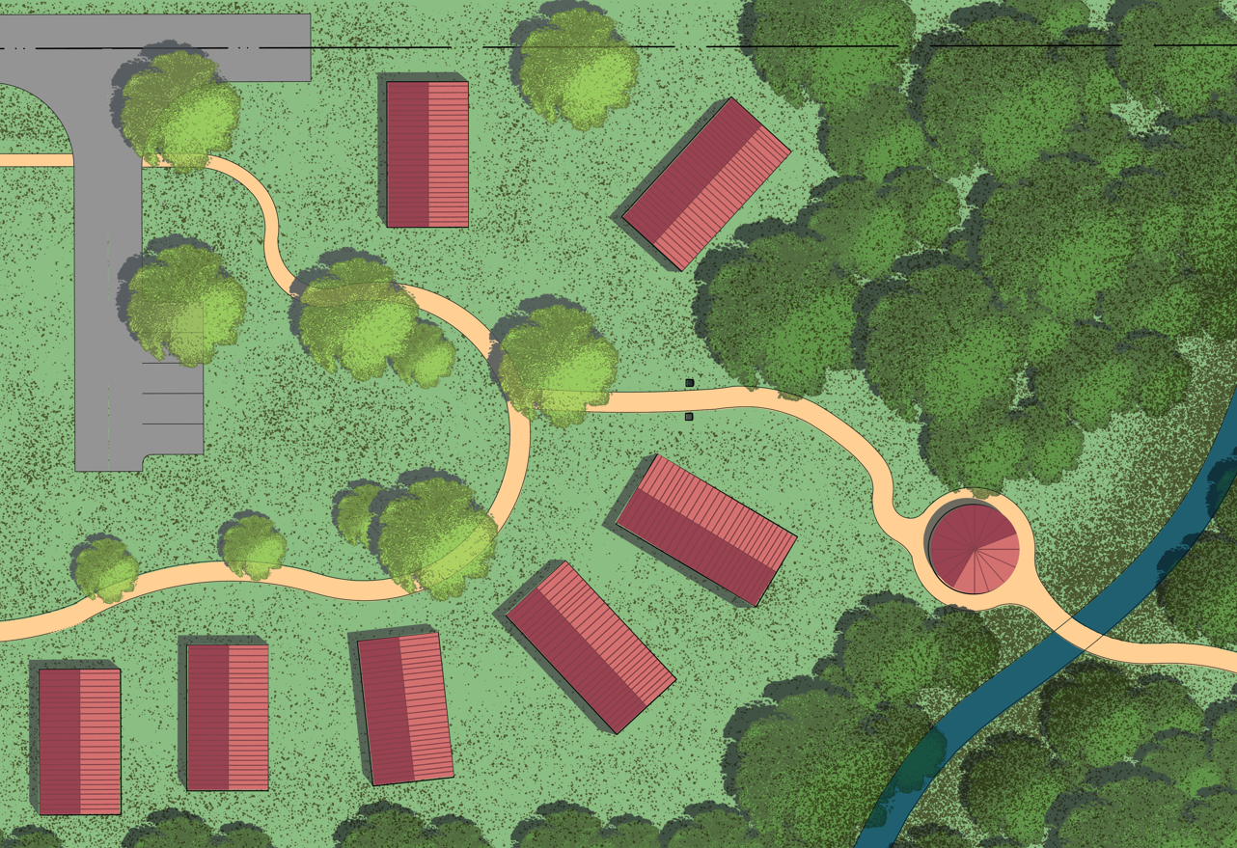
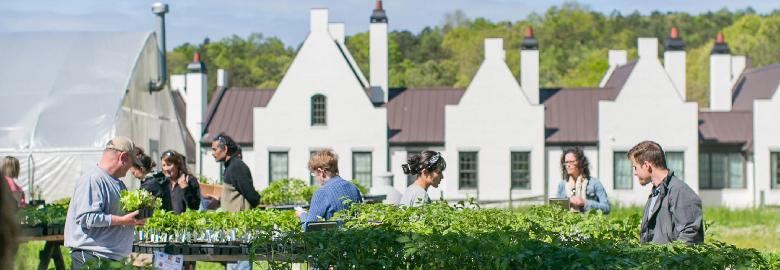
Hypothetical 40-Acre Base Map
Location: Northwest Michigan
Visualizing Opportunity
Housing Space
Growing Space
COTTAGES - VIRGINA
SERENBE - GEORGIA
Note: Conceptual planning diagram — hypothetical 40-acre site, not based on surveyed conditions
Cultivating Capital 14

Slide 15
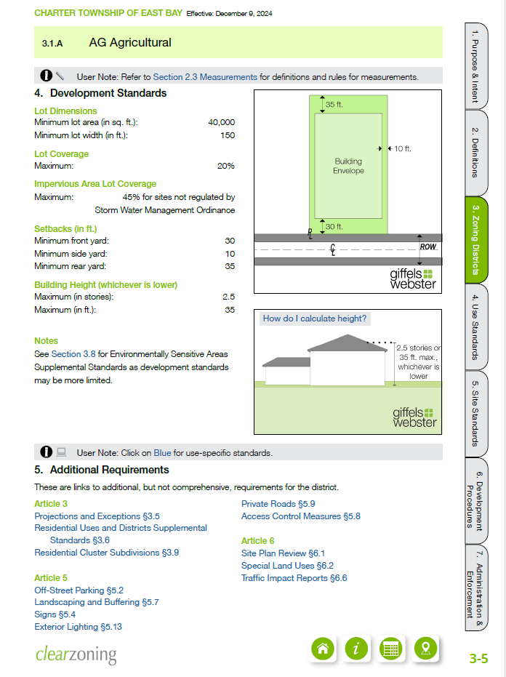
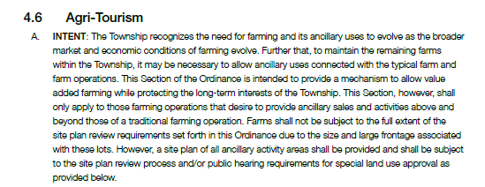
Getting to Development
Implementing Opportunity
Zoning Options for Farmers
  Housing in Agriculture Districts
    Have a purpose behind the housing, set limits
    Farm workers versus family/heirs
    Community land trusts (CLTs)
  State allowance – Right to Farm Act – GAAMPs
  Commercial property and farming allowances
    Design and performance criteria to minimize impact on neighbors
Excerpts from East Bay Zoning Ordinance
Note: Conceptual planning diagram — hypothetical 40-acre site, not based on surveyed conditions
Cultivating Capital 15
Notes:
Claire

Slide 16
Getting to Development
Implementing Opportunity
East Bay Township Zoning Improvements
  Easier site plan review process
    Building in Agritourism options for farms
  Don’t rely on PUDs as a zoning process – creates issues long-term
    Work with your community to build appropriate rules into standard districts
    Use design criteria to set boundaries for good design
    Allow staff to work with the landowner and only go to the public hearing process for special considerations
    Foster agriculture in the community by crafting the zoning rules for agritourism in AG districts
Note: Conceptual planning diagram — hypothetical 40-acre site, not based on surveyed conditions
Cultivating Capital 16
Notes:
Claire

Slide 17
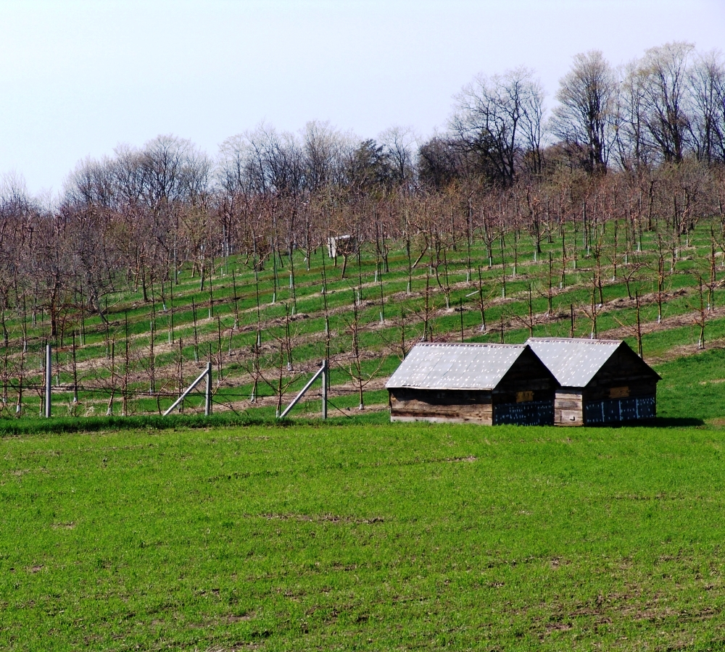
Getting to Development
Implementing Opportunity
Farmland and Natural Area Conservation
  What land is appropriate, and could be considered for CE?
    Natural Areas / Undeveloped
    Farmland and agricultural production can be included
  What areas should be excluded?
  Conservancy’s role in the conservation process
  Permanently protect land and define building areas and special use areas
  Supporting & securing funding for the Purchase of Development Rights (PDRs)
  Long-term partnership with landowner and Conservancy
  Assist landowners by discussing short-term and long-term goals for areas to be protected
Note: Conceptual planning diagram — hypothetical 40-acre site, not based on surveyed conditions
Cultivating Capital 17
Notes:
Kim

Slide 18
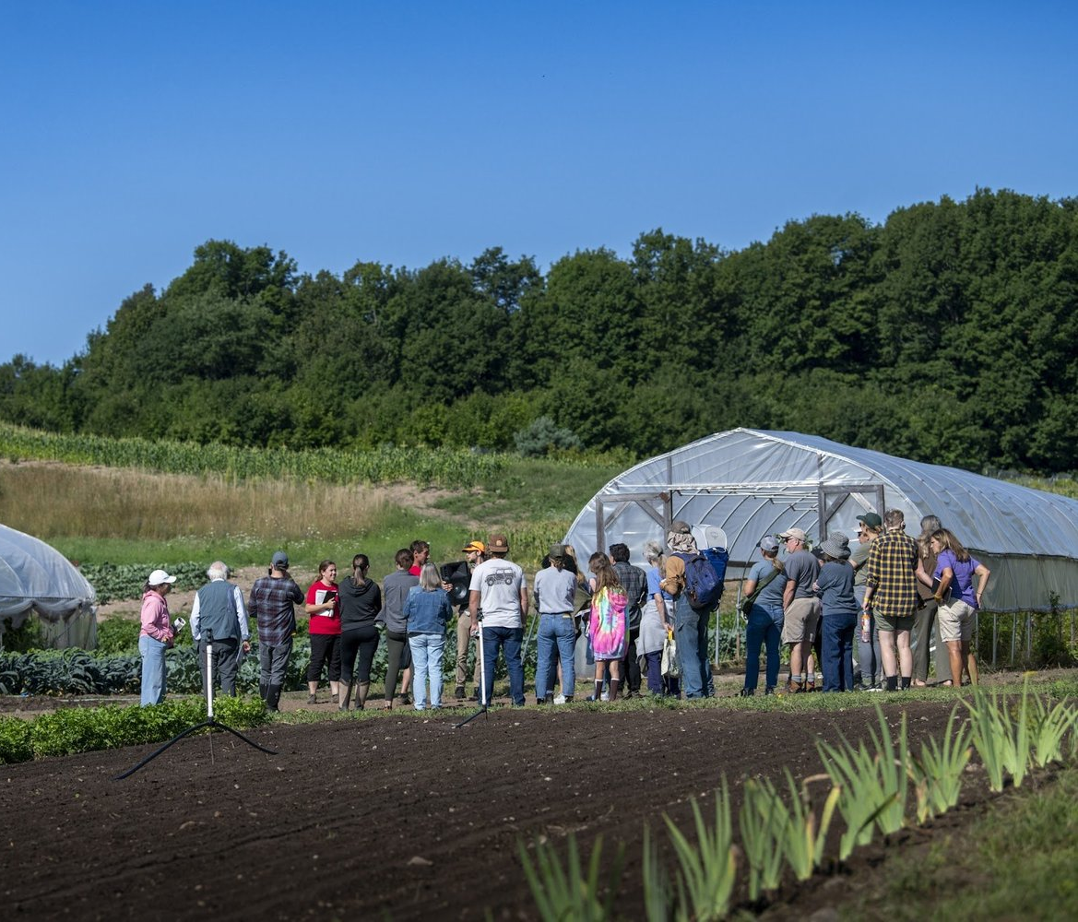

Making the Decision
Getting Inspired
Who is the right person to do this?
Requires an energetic businessperson
Inquisitive, looking to ramp up the farm program and expand options
Next generation chapter for farms in
NW Michigan
Investors who want to keep farming alive
Why would a retiring farmer want to do this?
Farm legacy, family legacy
Values-based decision, ancestral legacy
Financial need
Provides options for multiple farming partners
  Looking for a future farmer?
  Attend local events, get involved
  Agritourism Conference, great place to start!
  Northern Michigan Small Farm Conference
  Post on MI Farm Link – www.mifarmlink.org
Photo Credit: GARY L HOWE – Small Farm Conference
Note: Conceptual planning diagram — hypothetical 40-acre site, not based on surveyed conditions
Cultivating Capital 18
Notes:
Chris

Slide 19



Capital Layers For Farmland
U-Pick & Seasonal Attractions
CSA
Farm Restaurant & Sales
Permanent Ag Protection
Pocket Neighborhood Housing
Event Barn & Weddings
Layers of Capital
Strategic Value
Layering multiple platforms supports a varied portfolio of income and aligns with varied levels of management
Cultivating Capital 19

Slide 20






$150,000+
Permanent Agricultural Protection (PDR/ACEP)
Estimated One-Time Capital
Permanent Agricultural Protection
Financial Summary
Selling development rights on 25-30 acres while retaining ownership, providing upfront liquidity and permanent farmland protection.
$150K
30 ac
Estimated Capital
Protected Area
PDR/ACEP Program
Key Impacts
$5K
100%
Development Rights Sale
Upfront Liquidity
$150K+
Per Acre Value
Ownership Retained
Sell development rights on 25-30 acres; retain ownership and agricultural use
Estate Relief
Reduced Pressure
Typical NW Michigan Value
Program Benefits
$3,000-$8,000 per acre
(varies by location and quality)
Permanent Protection
100% Protected
Immediate cash flow
Funding Eligibility
Enhanced Access
Tax advantages
Estimated Capital
30 acres @ $5,000 = ~$150,000
Estate planning benefits
Conservation legacy
Strategic Value
Program Eligibility
PDR/ACEP programs provide upfront liquidity while ensuring permanent farmland protection and improved funding eligibility for future projects.
Available through USDA NRCS Agricultural Conservation Easement Program (ACEP) and local PDR initiatives using local, state, and private dollars.
Key Insight: PDR programs unlock capital while preserving agricultural heritage
Source: USDA NRCS, Michigan Department of Agriculture
Cultivating Capital 20

Slide 21












Controlled Rural Housing - Pocket Neighborhood
$1M+
Estimated One-Time Capital
Pocket Neighborhood Housing
Site Statistics
10-14 clustered homes on 2 acres around shared green space, using cluster zoning to protect farmland while providing workforce housing.
2 ac
10-14
Total Area
Homes
Housing Configuration
Delivery Options
$3.6M
$2.6M
10-14 Clustered Homes
Option A: Market-Rate Sales
Gross Sales
Development Costs
Concentrated on 2 acres with shared green space and parking
10 homes × $350,000 = $3.6M gross.
Development cost ≈ $2.6M.
Margin supports farm reinvestment.
Key Benefits
Cluster Zoning
Preserves farmland edges and maintains open views
Minimal farmland area (2 acres)
Option B: Community Land Trust
Land remains community-owned.
Homes sold at controlled prices via ground lease.
Potential for partnership with State Land Bank.
Fixed CSA support – HOA benefit
Shared Parking
Affordable options for housing
Centralized parking to minimize land use
Ground Lease or CLT for long-term protections
Workforce Housing Priority
Zoning Note
Tied to local workforce needs with preference policies for farm workers and seasonal staff.
Cluster zoning allows concentrated development while preserving surrounding farmland.
Source: Place Strategies, Inc. / Housing North
Key Insight: Pocket neighborhoods concentrate housing to protect farmland
Cultivating Capital 21

Slide 22










Agritourism — Farm Restaurant / Seasonal Café
~$500K+
Annual Seasonal Gross
Farm Restaurant & Seasonal Café (2 Acres)
Revenue Model Breakdown
A culinary tourism anchor leveraging the region's agricultural branding, strategically sited near road access and parking while preserving core production acreage and scenic views.
$430K
$550K
Low Estimate
High Estimate
Operating Program
Financing & Siting Strategy
30
~$45
Capacity & Scale
USDA Rural Development
Operating Weeks
Average Check
~80 seats optimal for controlled growth and septic capacity limits, mostly outdoor seating
Business & Industry (B&I) Loan Guarantees for facility construction and equipment
2 Acres
Operating Season
Pure Michigan Grants
4 nights per week across a 30-week active season
Tourism marketing support and destination development funding
Footprint Allocation
Target Economics
~$45 average check based on regional culinary tourism trends
Strategic Siting
Operational Synergies
Locate near road frontage/parking; preserves core views; complements U-Pick and events
Direct outlet for farm's specialty crops
Cross-promotion with U-Pick visitors
Shared parking infrastructure with event barn
Strategic Integration
Key Constraint
The restaurant serves as a high-margin anchor that directly monetizes the farm's produce and branding, acting as a recurring revenue engine rather than a one-time capital event.
Scale is deliberately limited to ~80 seats to manage septic capacity and traffic flow within rural infrastructure limits.
Key Concept: High-value hospitality activation on a minimal land footprint
Source: Agritourism Revenue Model (Section V-A)
Cultivating Capital 22

Slide 23










Event Barn & Weddings (3 acres)
$160,000
Gross Annual Revenue
Event Barn & Weddings
Financial Projections
~20 events per year × $8,000 average = $160,000 gross annual revenue from a 3-acre event and circulation zone.
$160K
20
Annual Revenue
Events/Year
Event Program
Site Requirements
$8K
3 ac
Event Capacity
Code Upgrades
Required
~20 events/year with 80-120 guests per event
Avg/Event
Event Zone
Parking (50+ spaces)
3 acres
Revenue Model
Restrooms
ADA compliant
$8,000 average per event × 20 events = $160,000
Financing Options
Seasonal Pattern
Fire/Safety
Upgraded
C-PACE for energy systems
Peak season: May-October (70% of events)
Local grants & equity
Adaptive reuse financing
Historic preservation credits
Revenue Optimization
Site Requirements
Event barns can generate $160,000+ annually while preserving farm character through adaptive reuse of existing structures.
Code upgrades, parking, restrooms, and fire/safety systems are required for commercial event use.
Key Insight: Event barns provide stable revenue while maintaining agricultural identity
Source: Michigan Department of Tourism
Cultivating Capital 23

Slide 24













U-Pick & Farm Market + Seasonal Attractions
$105k-$350k
Annual Revenue
U-Pick & Seasonal Attractions
Revenue Summary
High-engagement agritourism activities on 6 acres generating fast-return seasonal revenue with cross-selling opportunities.
$105k
$75k
U-Pick Revenue
Attractions Revenue
$200k
$350k
U-Pick & Farm Market
Seasonal Attractions
Total Potential
Max Revenue
Visitor Volume
Visitor Volume
Key Benefits
~3,000 visitors annually × $35 avg spend
~5,000 visitors annually × $15 avg ticket
Fast-return seasonal revenue
Revenue Range
Revenue Range
Cross-selling with café/events
$105,000 - $200,000 per season
$75,000 - $150,000 per season
Brand building & engagement
Farm Market
Activities
Low capital requirements
Direct sales of produce, preserves, and products
Corn maze, pumpkin patch, hayrides
Implementation Note
Revenue Synergy
These activities can be implemented incrementally with minimal upfront investment and scaled based on demand.
U-Pick and seasonal attractions generate fast-return seasonal revenue while building brand loyalty and cross-selling opportunities with café/events.
Key Insight: U-Pick and seasonal attractions provide fast ROI while building customer loyalty
Source: Michigan Department of Agriculture, USDA
Cultivating Capital 24

Slide 25












Integrated Financial Impact
~$1.07M
Revenue Model & Projected Returns
Total Seasonal Revenue
One-Time Capital Sources
$1.35M+
$0.8M+
Initial investment & liquidity events
Total Capital
Total Expense
$150K
$1M+
$200K
$800K
Easement Sale (PDR)
Housing Sales (Net)
Grants/Loans
Infrastructure Required
30 acres @ $5K/ac
10 homes × $360K (less costs)
USDA, MEDC
Roads, septic, utilities
Recurring Revenue Streams
Revenue Mix of 10 acres
Annual projections (Year 3)
By Use
Restaurant/Café
$500,000
U-Pick & Market
$200,000
Seasonal Attractions
$150,000
Event Barn
$160K-$220K
Total Recurring Revenue:
~$1.07M
Ag Production
19%
Hospitality
47%
Events
20%
Seasonal
14%
10-12%
$230K
$800K
3 Years
$1.07M
68%
ROI
Year 3 Revenue
Initial Capital
Payback Period
Total Potential
Land Protected
Source: Financial analysis based on Section VII of the model
Key Insight: Diversified revenue streams create financial resilience while preserving agricultural character
Cultivating Capital 25

Slide 26











Public Financing & Incentives
Public Financing & Incentive Tools
Funding Sources
Strategic use of Land Bank partnerships and layered financing to maximize capital efficiency and project feasibility.
40%
30%
Grants/Loans
Equity
20%
10%
Land Bank & Infrastructure
Additional Tools
TIF
Other
Land Bank & Land Trust Partnerships
Purchase/Transfer of Development Rights (PDR/TDR)
Assemblage, workforce housing coordination, brownfield tools, conservation easements, permanent protection
Millage options to move development rights to protect sensitive areas
Program Benefits
Infrastructure cost recovery
MDARD & Office of Rural Prosperity
Carbon Credits
Michigan Department of Agriculture and Rural Development
Woodland retention for carbon market participation
Workforce housing support
Rural Enterprise Zones
Project bankability
USDA (FSA & NRCS)
Tax incentives for rural business development
Short-term for operational as well as funds for permanent conservation easement
Community investment
Opportunity Zones 2.0
Tax incentives for capital investments
Strategic Advantage
Layering public financing tools with conventional debt and impact equity creates bankable projects with multiple capital sources.
Key Insight: Public financing tools reduce project risk and improve capital access
Cultivating Capital 26
Notes:
Angie

Slide 27
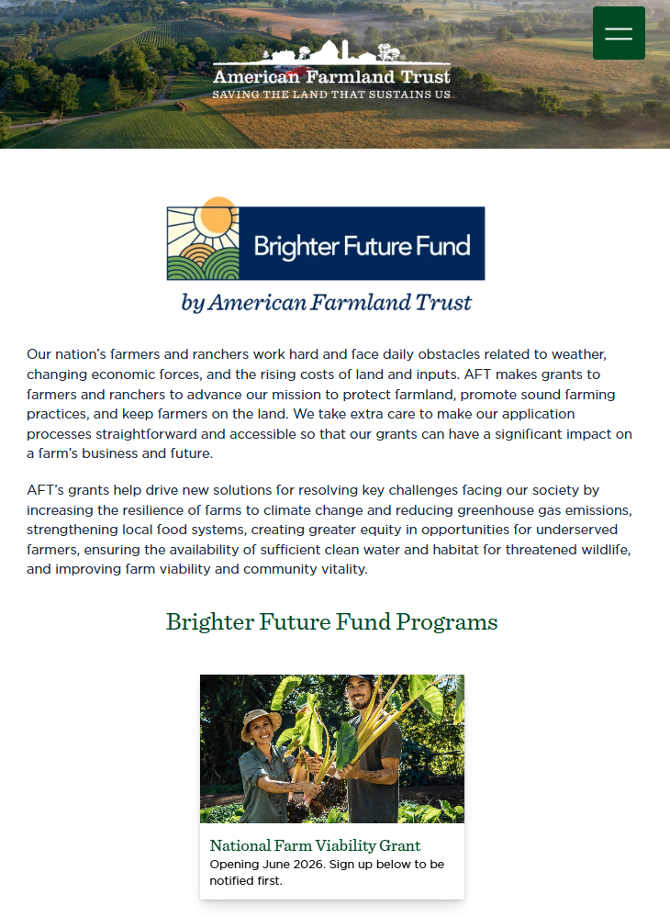

Private Financing
Private Financing
American Farmland Trust – Brighter Future Fund
Recommended private financing partners to support your mission.
Banks / REITs / CDFIs
Ag Focused Capital Investments
Farm Credit
Dirt Capital
Iroquois Valley
Foodshed Capital
Potlikker Capital
Akiptan
Steward Regenerative Capital
GreenStone Farm Credit Services
MAD Capital
Strategic Advantage
Layering public financing tools with conventional debt and impact equity creates bankable projects with multiple capital sources.
https://farmland.org/brighterfuture
Key Insight: Public financing tools reduce project risk and improve capital access
Cultivating Capital 27
Notes:
Angie

Slide 28


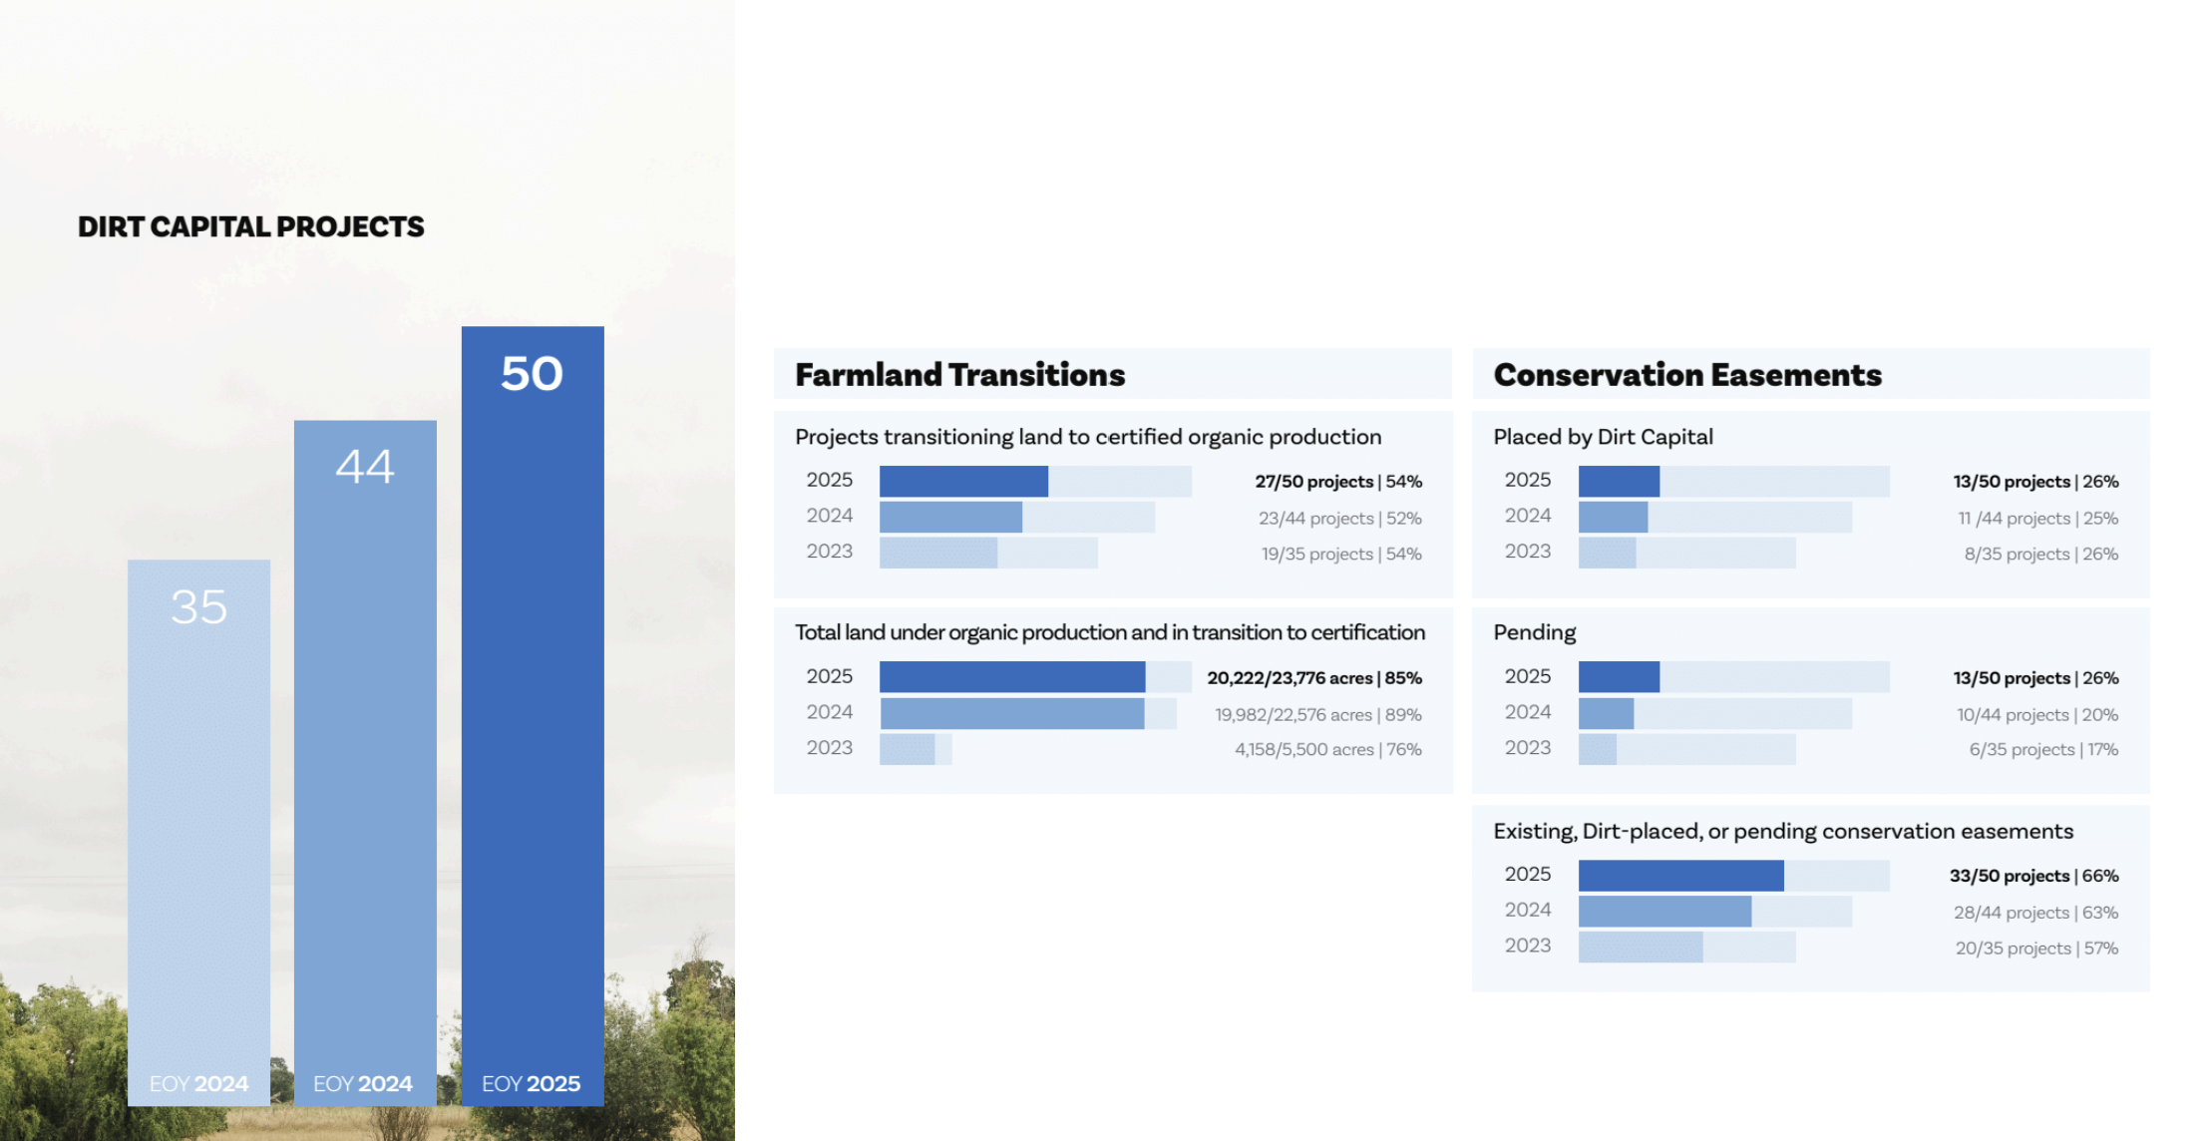

This Is Already Happening Today
Regional advantages & strategic positioning
Cultivating Capital 28
Notes:
Angie

Slide 29






Risks and Constraints
6 Key Areas
With Mitigation Strategies
Risk Assessment
Seasonal Volatility
Zoning/Hospitality Limits
Traffic/Parking
Revenue fluctuations
Regulatory constraints
Access management
Risk:
Risk:
Risk:
Revenue concentrated in peak season, off-season income gaps
Zoning restrictions, code compliance, permit delays
Peak day congestion, parking shortages, ADA compliance
Mitigation:
Mitigation:
• Early engagement with planning
• Overlay/PD tools application
• Code consultant engagement
Mitigation:
• Diversify uses (events, workshops)
• Pre-book events for peak season
• Off-season programming (winter markets)
• Phased parking lots
• Shuttle service on peak days
• ADA-compliant routes
Labor Shortages
Septic/Water Capacity
Community Perception
Workforce challenges
Infrastructure limits
Local acceptance
Risk:
Risk:
Risk:
Difficulty finding seasonal workers, housing constraints
System capacity constraints, environmental concerns
NIMBY opposition, development concerns
Mitigation:
Mitigation:
Mitigation:
• Workforce housing priority
• School partnerships for labor
• Competitive wages & benefits
• Clustered systems design
• Engineering early assessment
• Phased development approach
• Conservation easements
• Design guidelines adherence
• Community open days
Key Insight: Proactive risk management ensures project viability and community support
Cultivating Capital 29

Slide 30





Closing Principle & Call to Action
Next Steps
Capitalization of Stewardship Model
Implementation roadmap
Implementation Timeline
This is not development of farmland—it is capitalization of stewardship.
Phase 1: Site assessment & PDR
(Months 1-3)
Transform your 40 acres into a diversified capital engine that preserves agricultural identity while generating sustainable revenue through strategic, incremental development.
Phase 2: Pilot revenue engine
(Months 4-6)
Phase 3: Scale operations
(Months 7-12)
Phase 4: Full integration (Year 2)
1
Map Your 40 Acres
2
Pursue PDR/ACEP First
Allocate zones for agriculture, conservation, and compact activation areas
Lock in core agricultural protection and add liquidity
Key Success Factors
68%
$1M+
3
Pilot One Revenue Engine
4
Cluster Housing on ≤2 Acres
Start with events or café before scaling operations
Prioritize workforce housing with clear preference policies
Protected Land
Annual Revenue Potential
5
Build Layered Capital Stack
Implementation Strategy
Next Steps
Start small, scale strategically. Focus on one revenue engine first, then expand based on demand and capacity.
Combine grants, PDR, co-op/impact equity, and bank debt
Contact your local planning staff or a local development advisor to begin a feasibility assessment.
Key Insight: Small, steady projects can keep farmland in family hands while generating new community value
Cultivating Capital 30
Notes:
Additional content for Consideration/Addition:
Zoning Options for Farmers
Purpose behind the housing – Need versus appropriate location
Farm workers versus family/heirs
Community land trusts (CLTs)
Not relying on PUDs as a zoning process – creates issues
Foster agriculture in the community by crafting the zoning rules for agritourism in AG districts
Who is the right person to do this?
Requires an energetic businessperson
Inquisitive, looking to amp up the farm program
Next generation chapter for farms in NW Michigan
Investors who want to keep the farming alive
Why would a retiring farmer want to do this?
Farm legacy, family legacy
Values-based decision, ancestral legacy
Financial need
Farmland and Natural Area Conservation
What is appropriate, and considered?
What areas should be excluded?
Conservancy’s role in the conservation process
Conservancy does not mandate no-build, just intentionality

