Slide 2
Right to Farm Act 201
Agritourism Scenarios and Advanced Issues
Ryan Coffey Hoag
MSU Extension

Slide 3

Contracts
Between municipality and farmer
Often utilized in complex situations
Can provide additional opportunities
May limit Right to Farm protections
Becoming more common in recent years

Slide 4
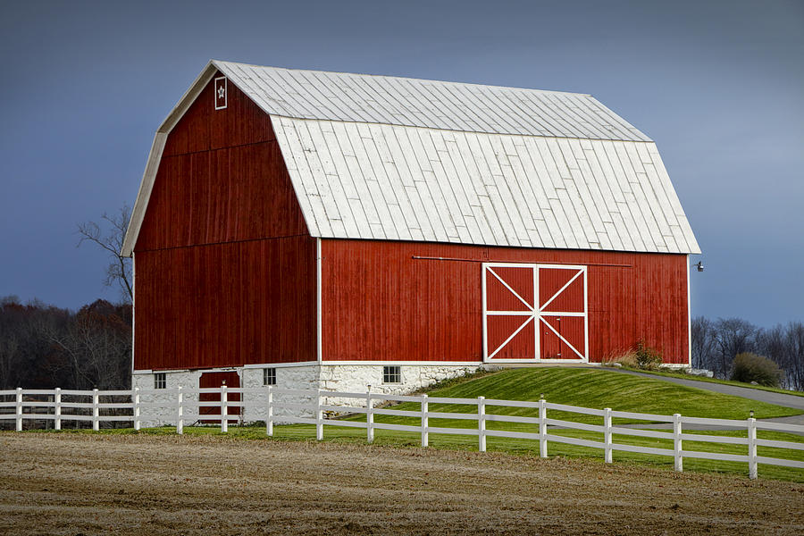
Barns, Trucks, Electric Service & Driveways
Horse barn scenario
Right to Farm limitations
Narrow court approach - is it essential?
Calculating your risk
Can GAAMPs address?

Slide 5

Liquor Licenses
Winery scenario
Necessary but not sufficient
Required by State law
Process
Can a municipality deny?
  “...a local unit of government shall not enact, maintain, or enforce an ordinance, regulation, or resolution that conflicts in any manner with this act or generally accepted agricultural and management practices developed under this act...” MCL 286.474(6)

Slide 6
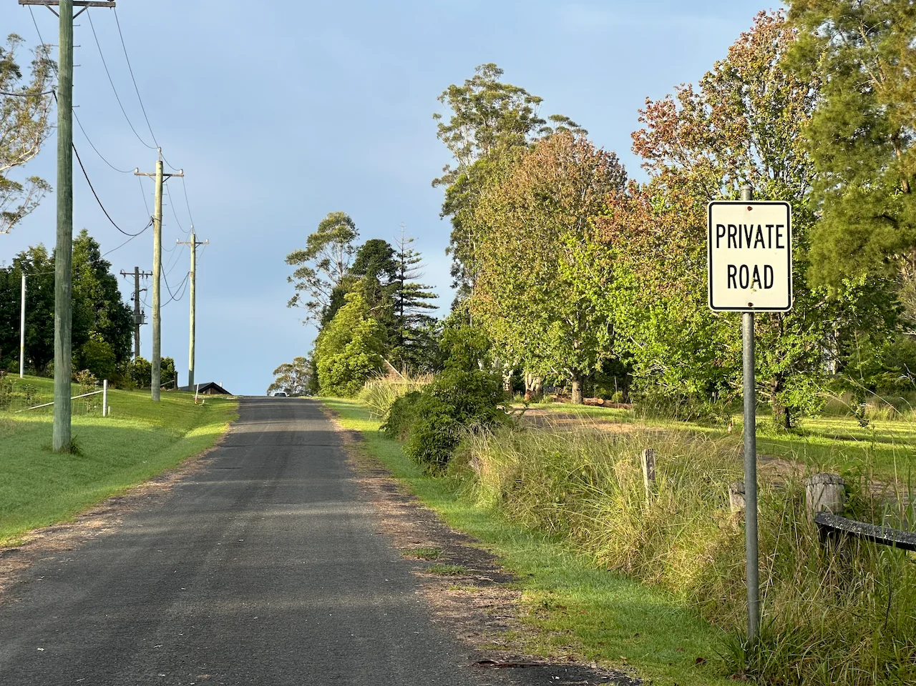
Private Drives
Farm market scenario
Right to Farm limitations
Municipality’s role

Slide 7
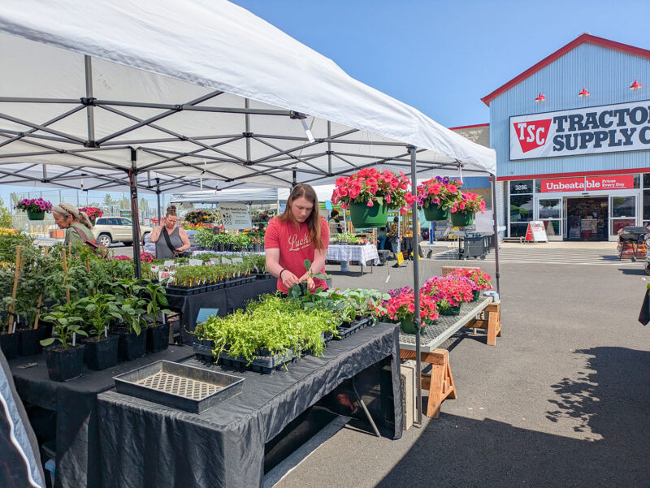
“on a farm…”
Control
GAAMPs relation to Right to Farm Act
Nuances
Considerations

Slide 8
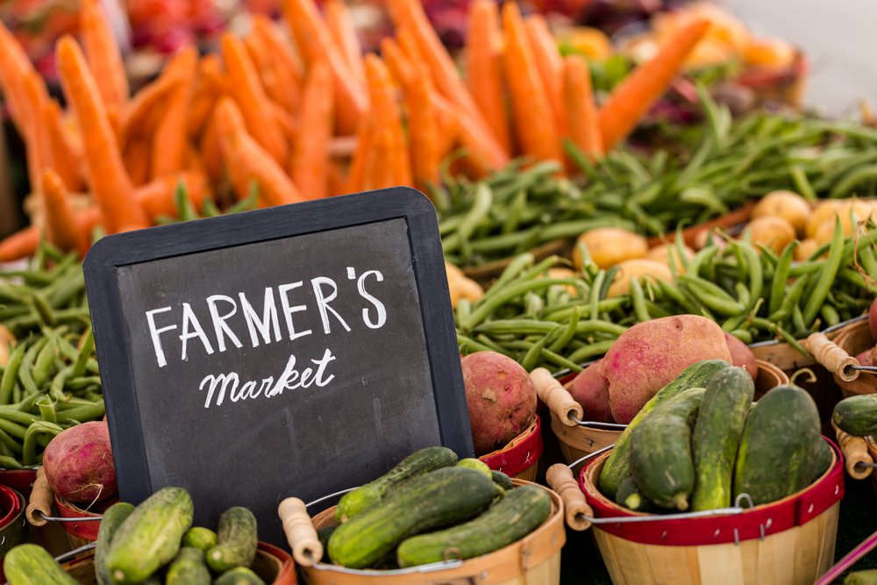
“produce”
Right to Farm & Farm Markets GAAMPs language & definitions
    produce
    farm product
Legal concerns
Options: the good, the bad & the ugly!

Slide 9

AI
Advancement
Challenges
As a tool: trust but verify
Context

Slide 10
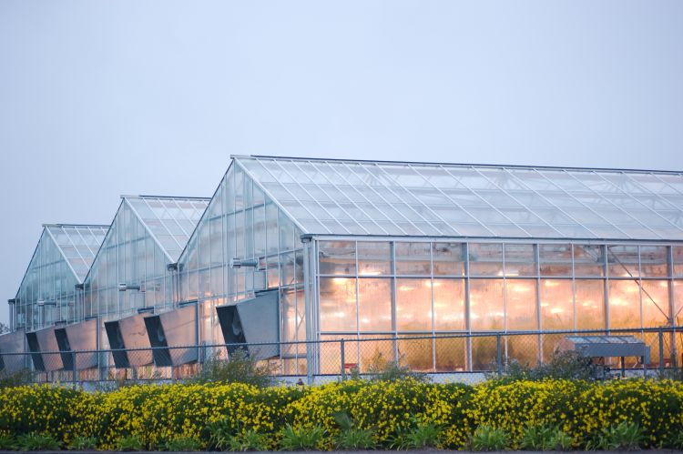
Greenhouses
New GAAMPs coming soon!!!

Slide 11

Q & A

Slide 12
Thank you!
Ryan Coffey Hoag, MSU Extension
coffeyry@msu.edu | 231.924.9677

