Slide 1
WE DID IT!
WORKING WITH LOCAL OFFICIALS TO GET IT DONE
Abby Jacobson, Westview Orchards & Winery
Cody Stricker, Planning/Long Lake Township
Matthew Jerome, Zoning/Long Lake Township
Doug Mansfield, Mansfield and Assoc.
Phil Hallstedt, Red Truck Vinegar/Hallstedt Homestead Cherries

Slide 2
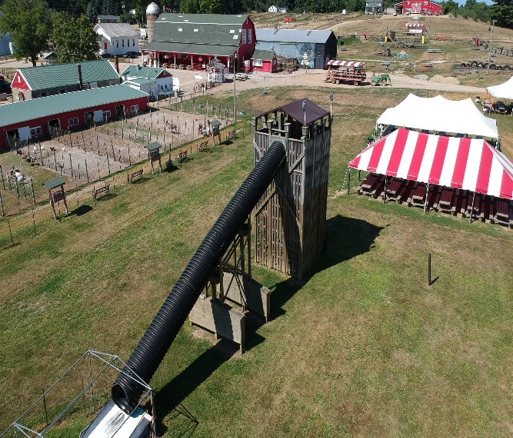
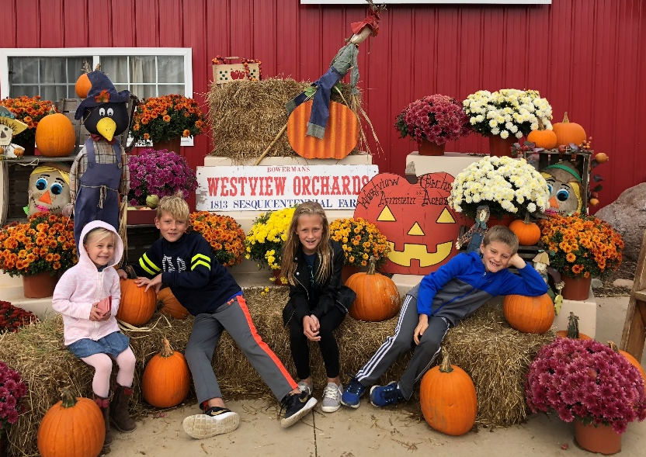
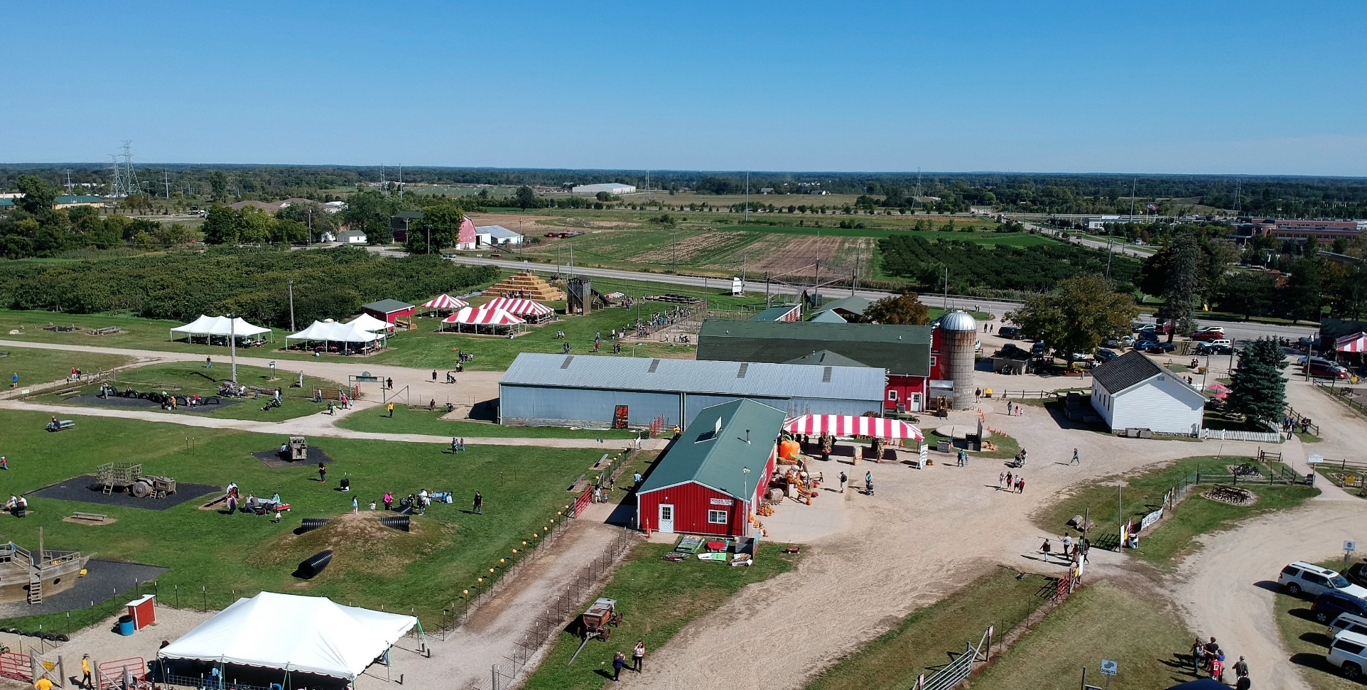
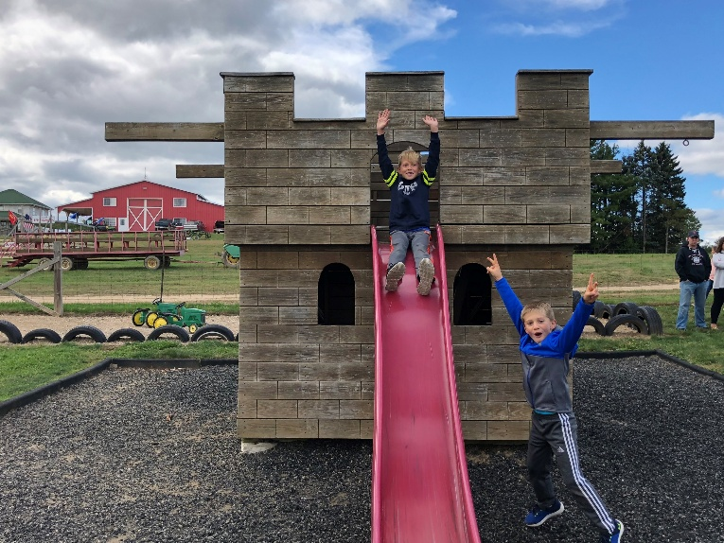
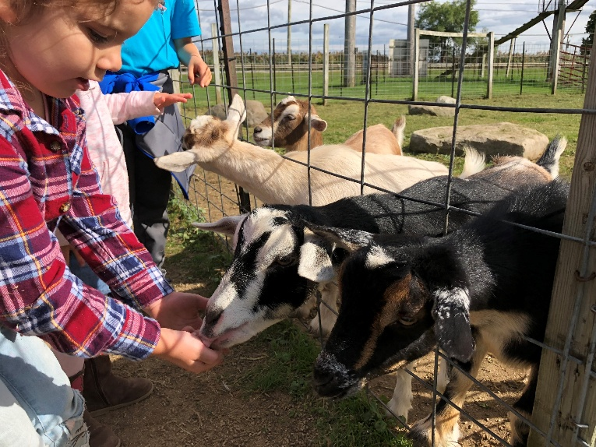
Westview Orchards
Aerial View
Then… Fall Family Fun Weekends

Slide 3
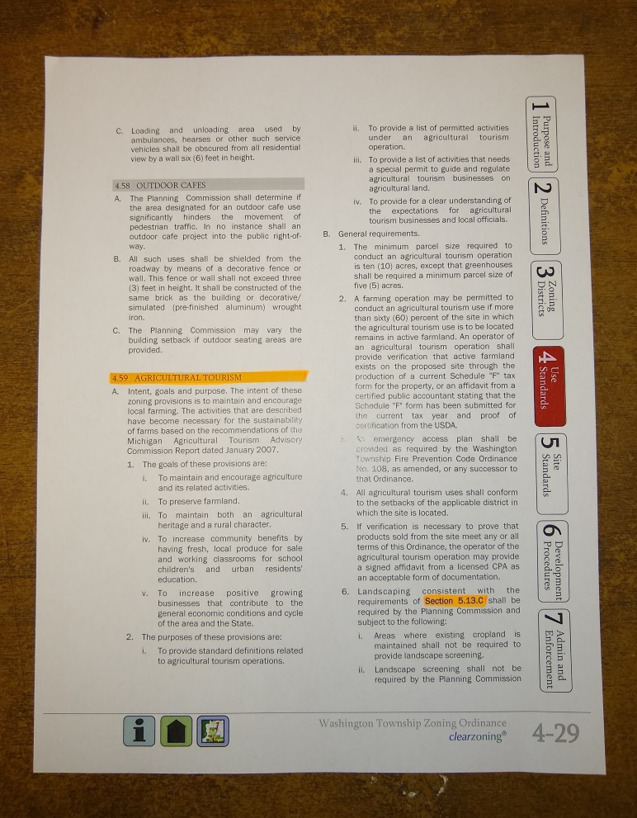
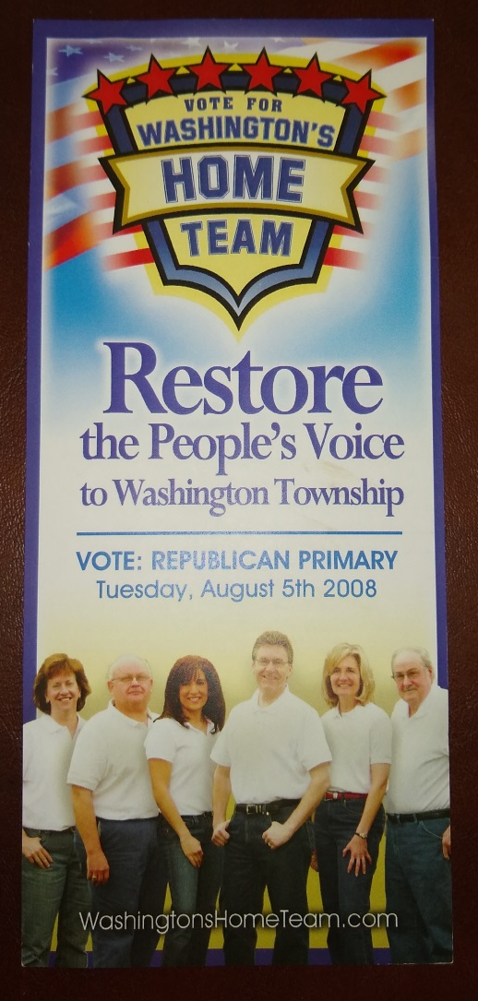
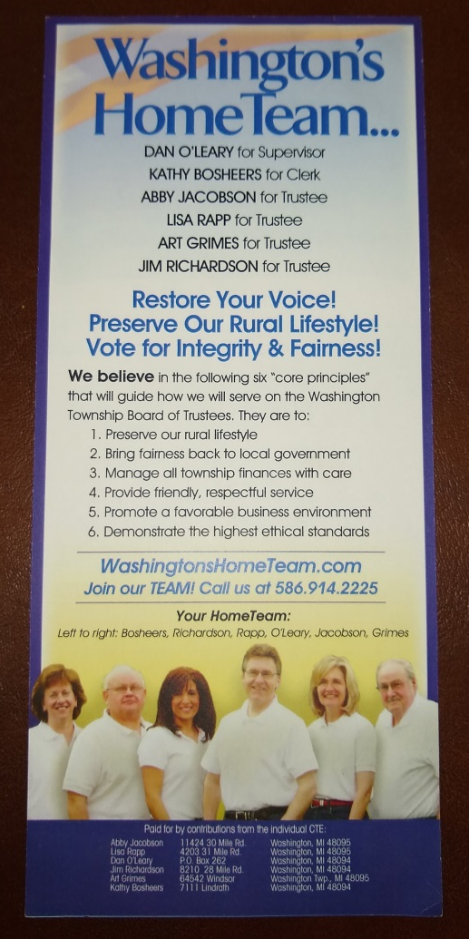
Washington Township
Agritourism Ordinance
“Home Team”

Slide 4
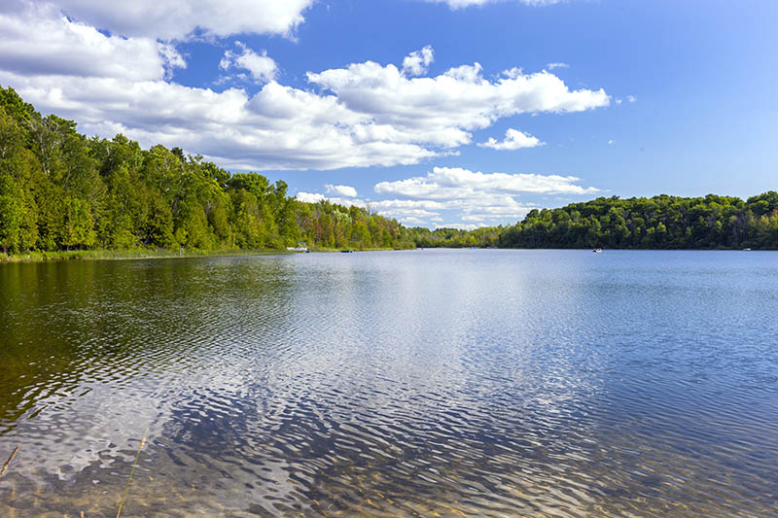
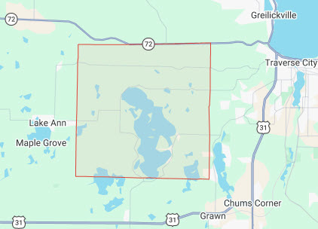
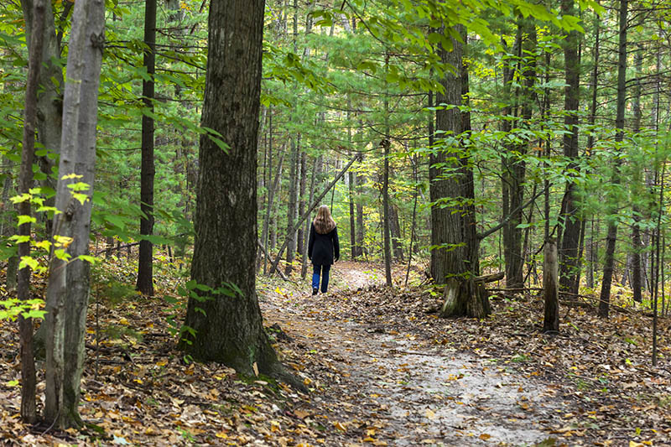
Charter Township of Long Lake

Slide 5

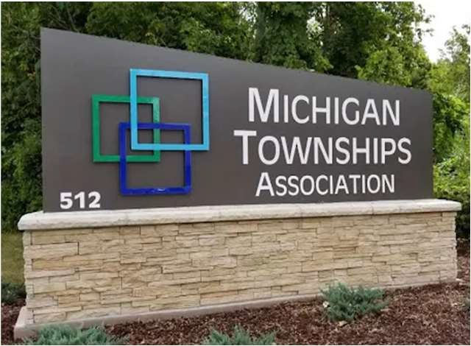



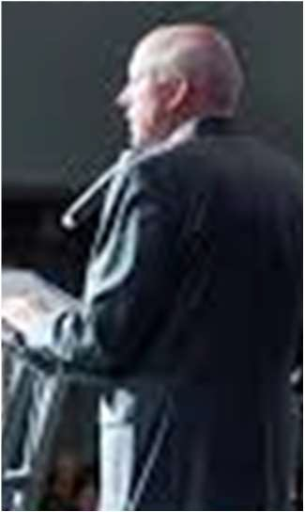

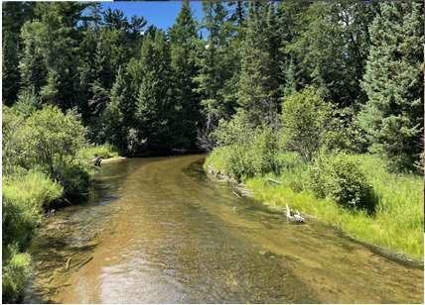



Mansfield Land Use Consultants
Union Township Supervisor (1995-Present)
Board Member and Past President Michigan Township Association (2004-2021)
Board Member Networks Northwest (Regional Council of Government -2014-2020)
Grand Traverse County Rural Fire Board
Past Director and President- Canada Creek Ranch
Chairman, G. T. Metro Fire Department Board of Appeals (2012- present)
Chairman-Grand Traverse County Board of Public Works (1999-2007)
Traverse Area Chamber of Commerce Business Leadership Council (2010-2015)
President of Mansfield Land Use Consultants: Surveyors-Planners-Landscape Architects–Engineers, Traverse City, MI

Slide 6
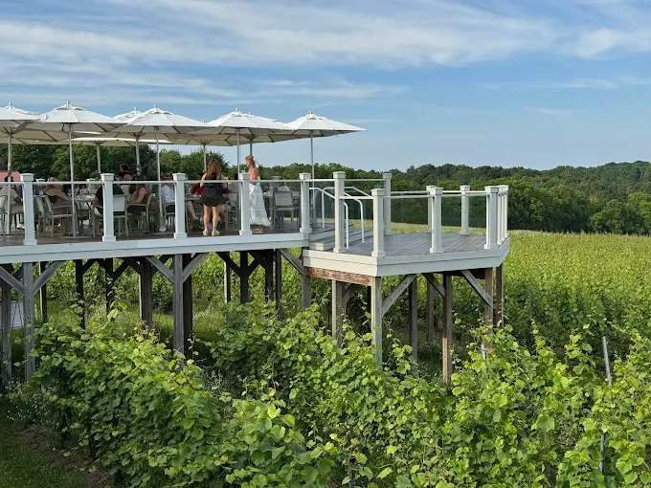
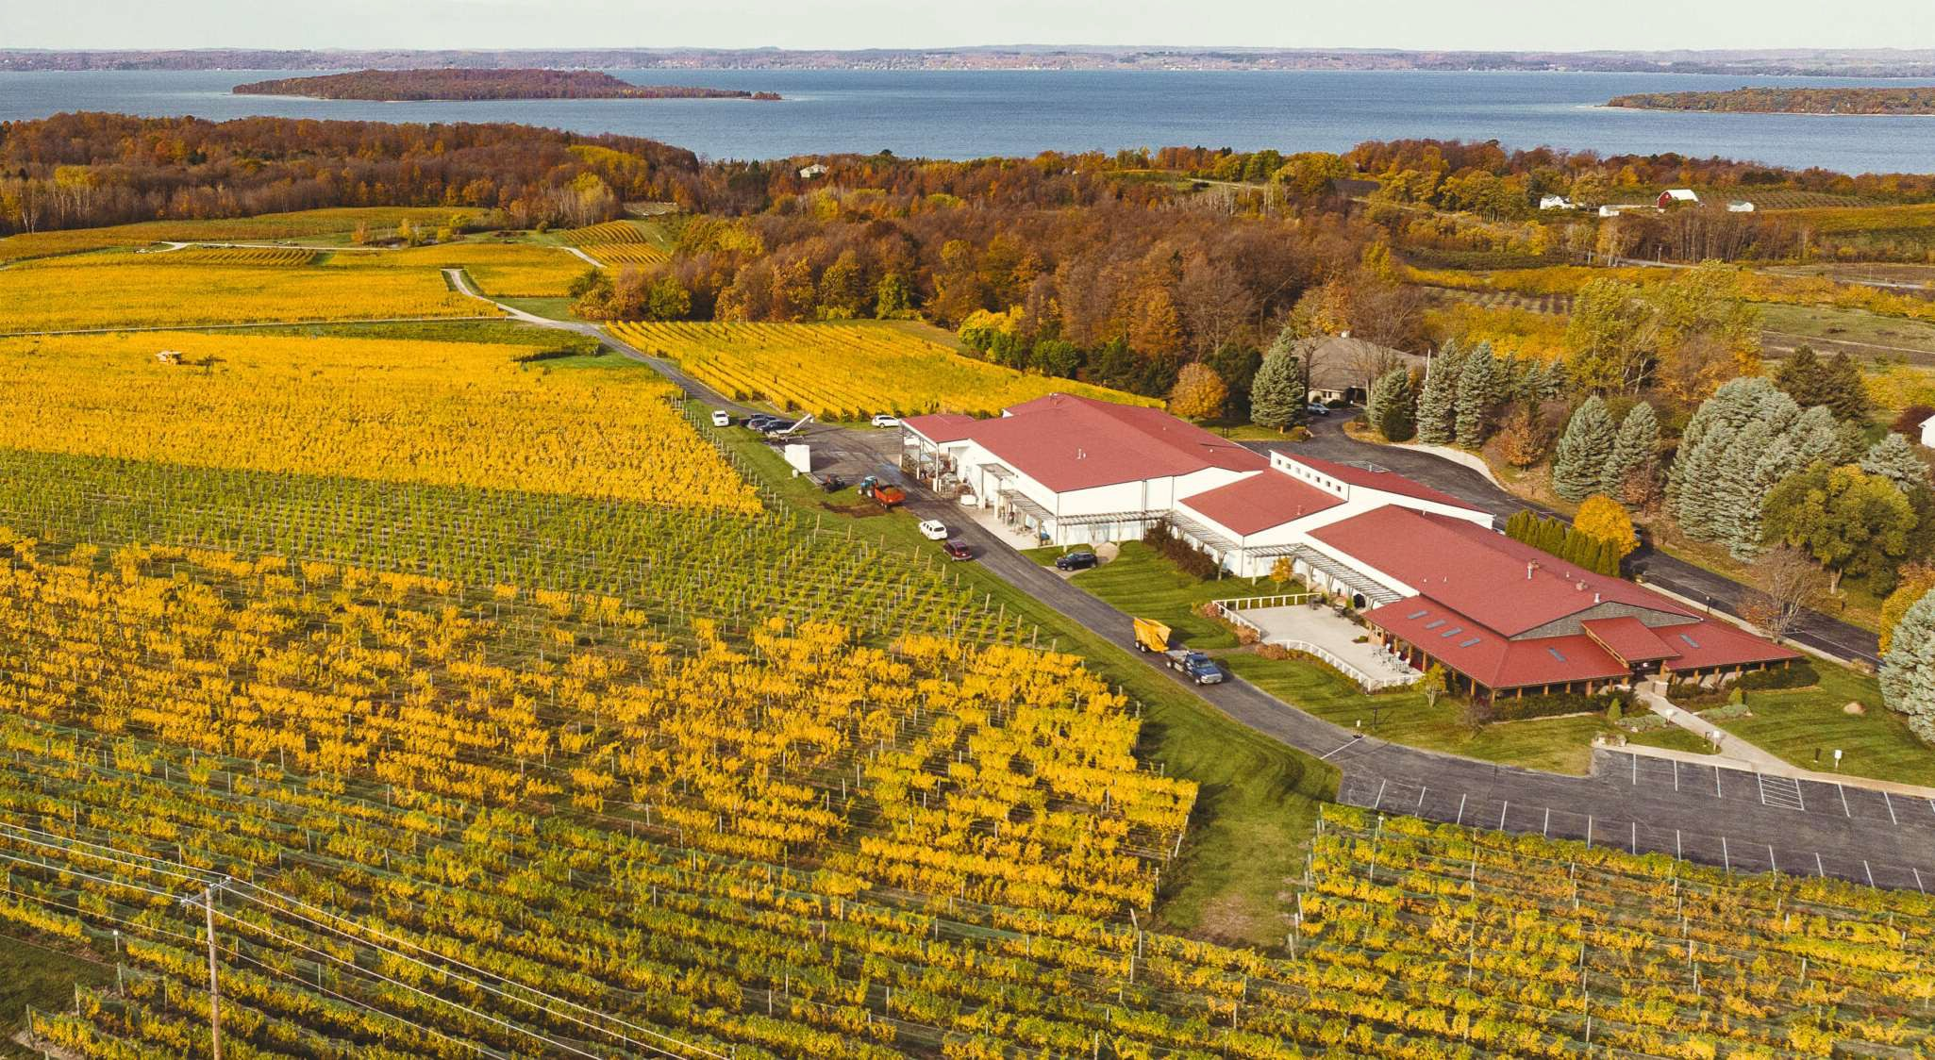
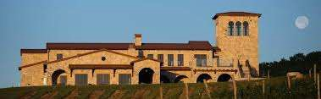
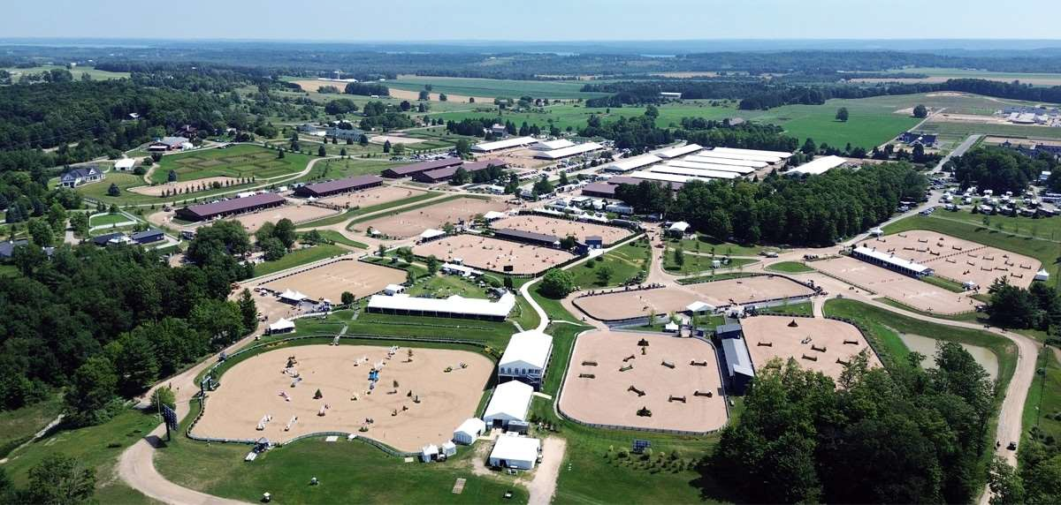
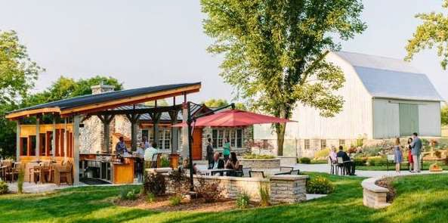
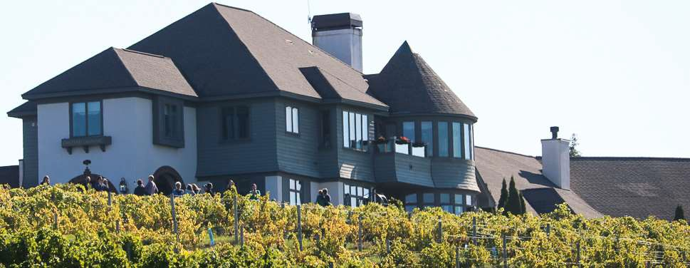
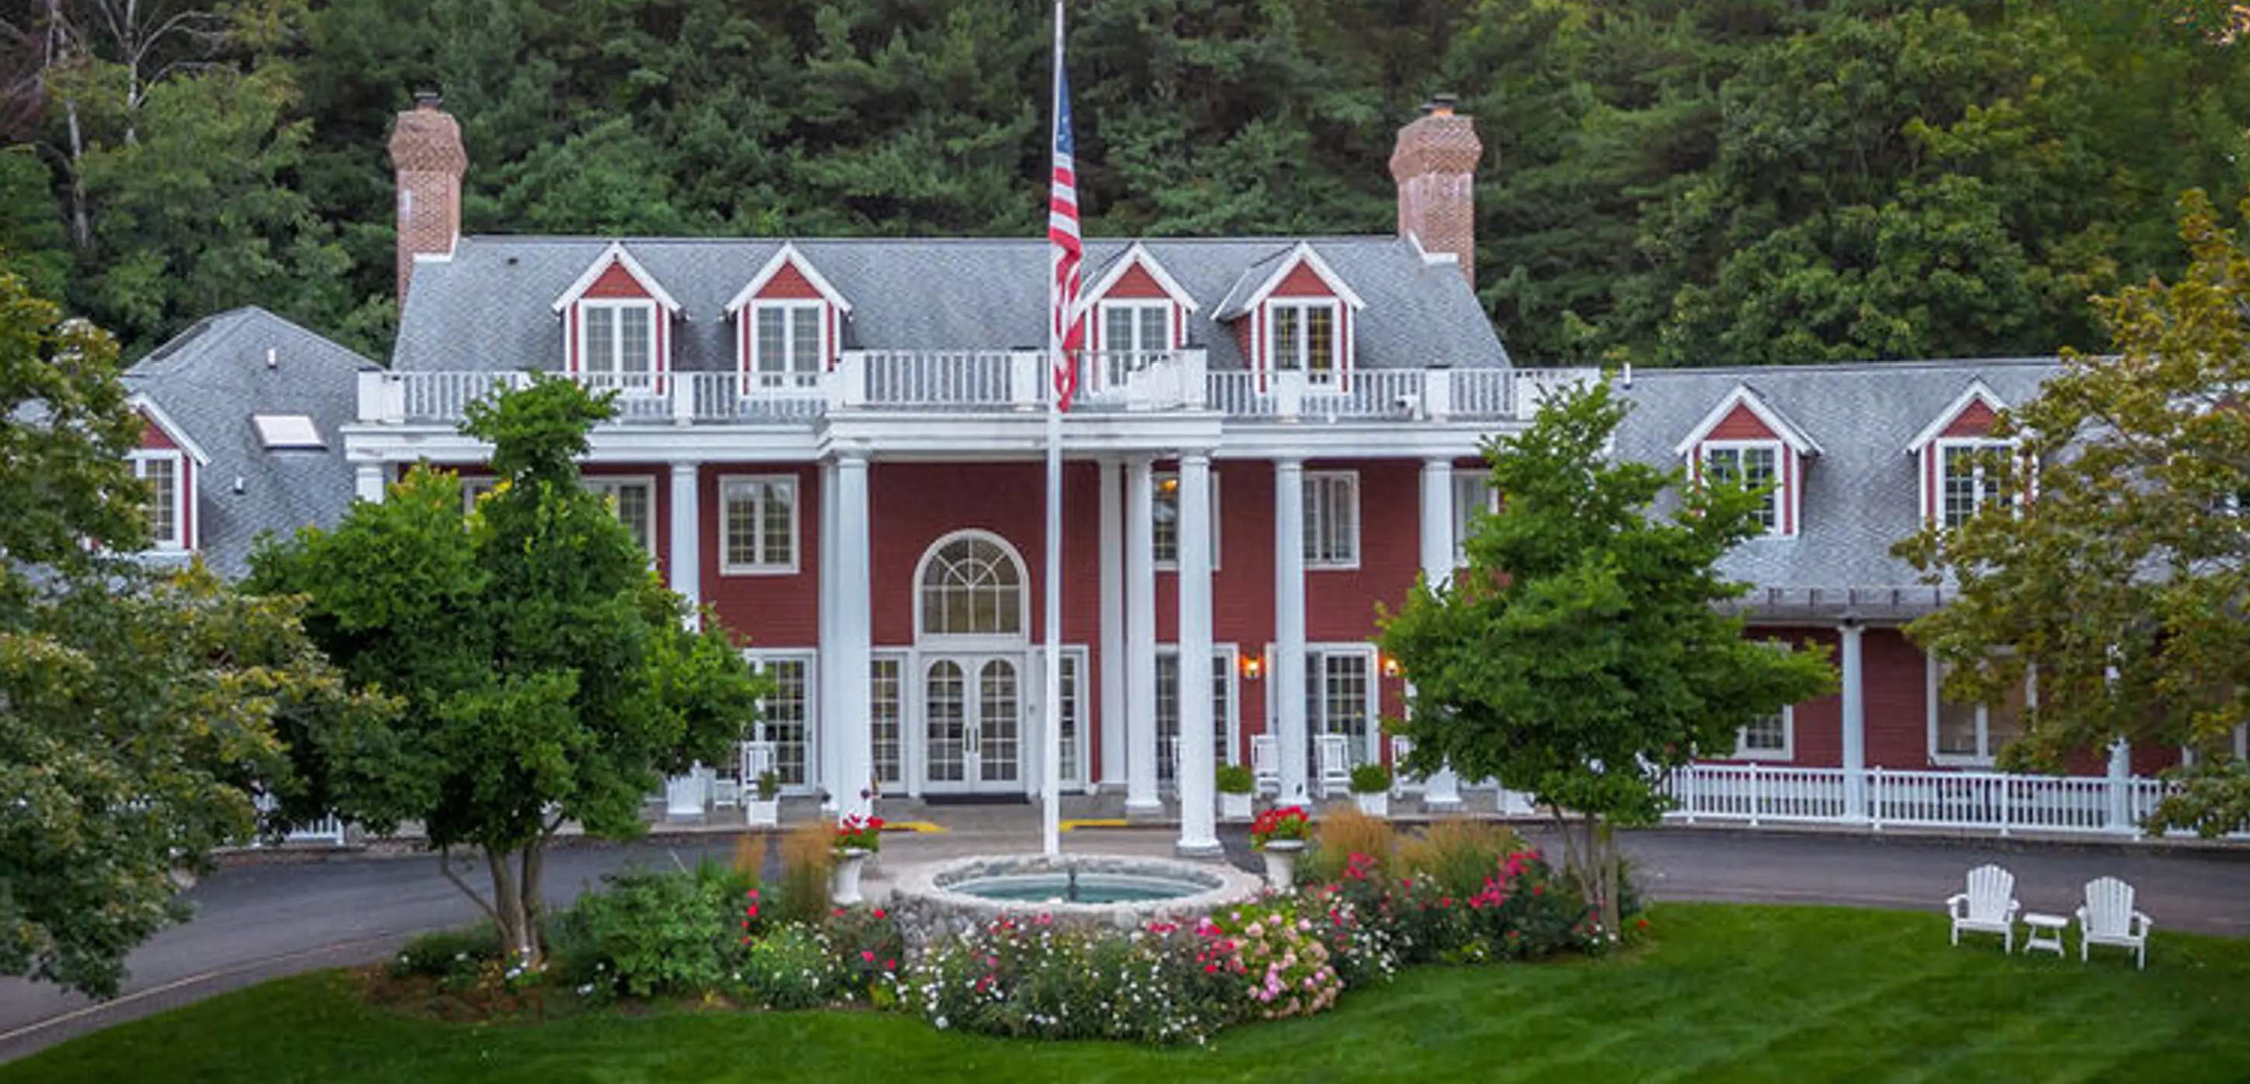
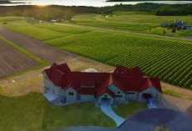
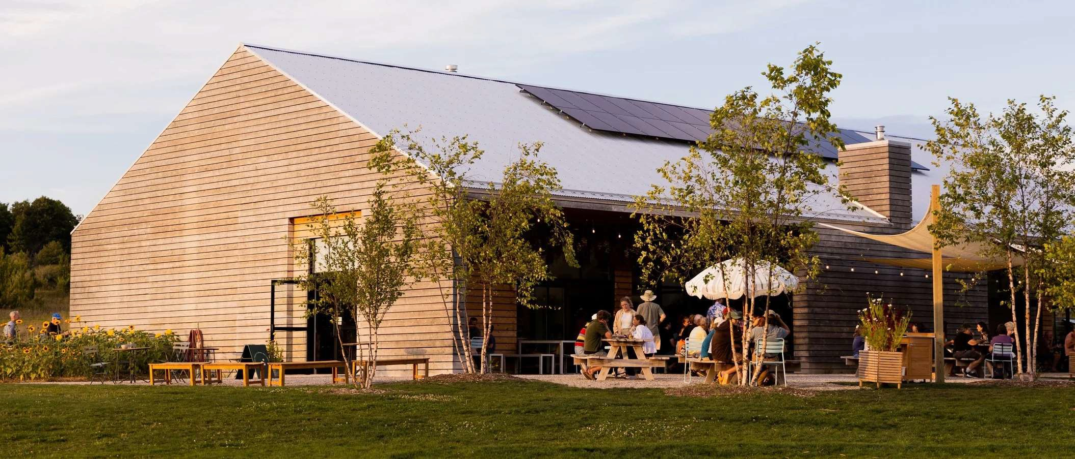
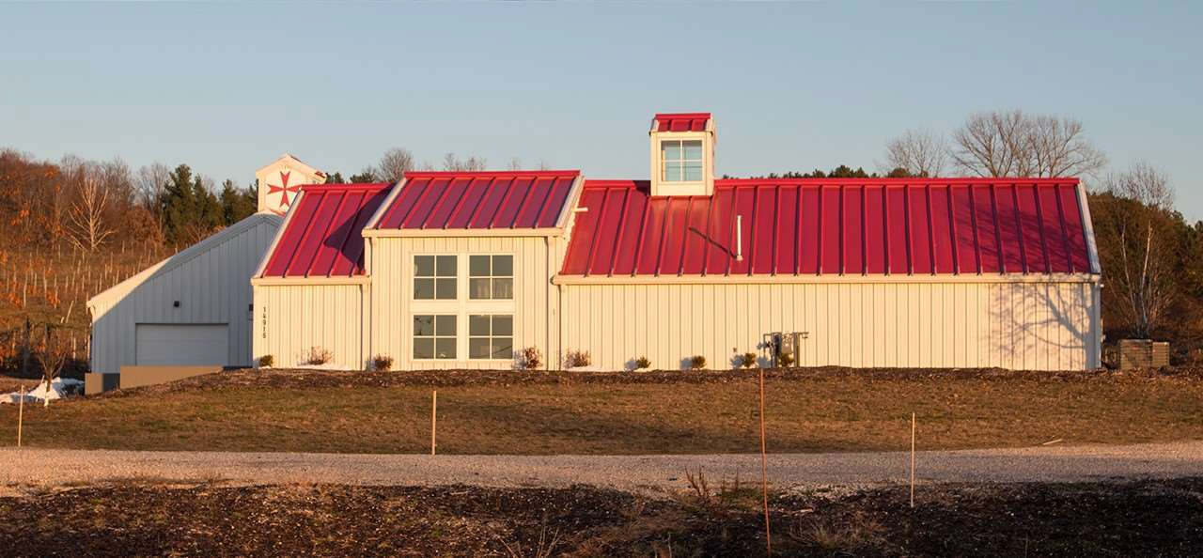
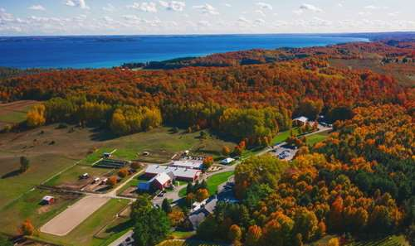
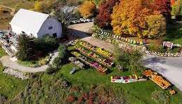
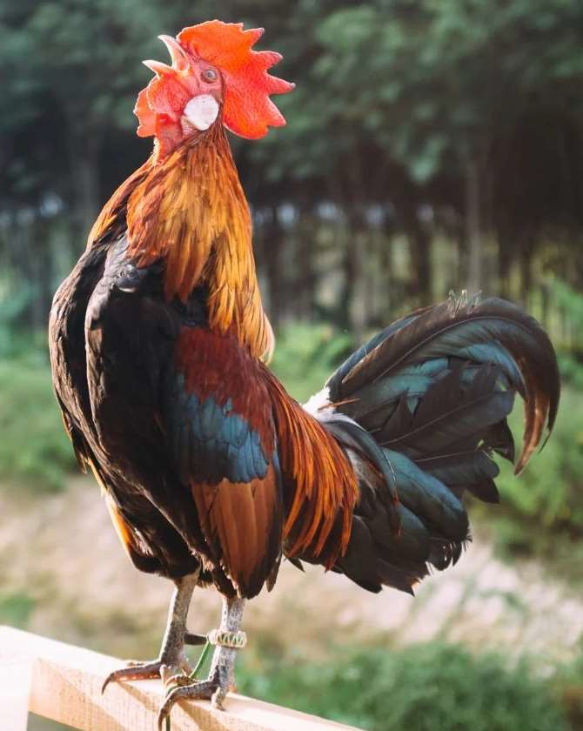
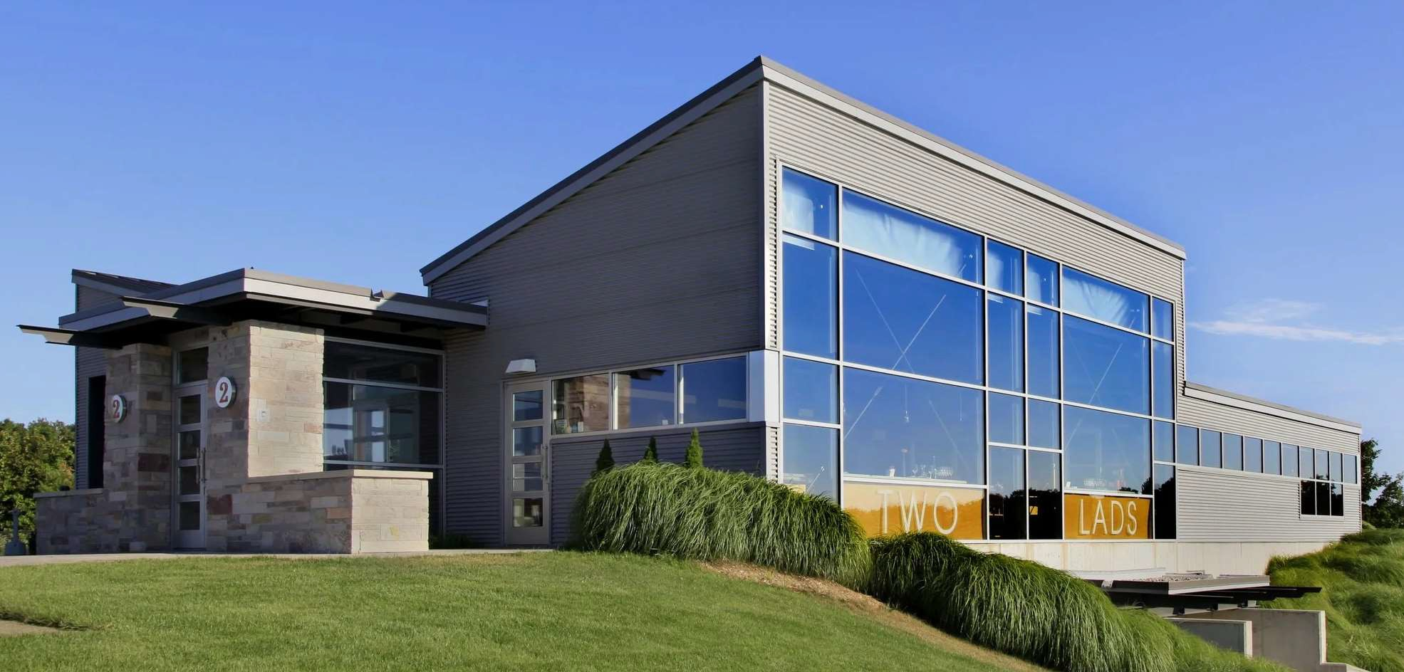

Slide 7
Leelanau Farm Stay Timeline: Began Sept 2020
Public Hearing and Planning Commission
Final Edits
PC Update
Jan 2021
Timbershores Response Completed
Mar 2022
Initial Planning Commission
Nov 2020
Proposed Language
Jan 2021
Public Comment 2023
Community Survey Qs
May-Oct
County PC approval
Nov 2024
2025
Initial HH Request
Sept 2020
MSU Agritourism Presentation
Requested Action
Aug 2021
Farm Stays approved in Cleveland Township May 2022
Text Amendment Application
April 2024
Four Years for Special Use Permit of 4 Campsites
Engaged MSU Resources
Multiple Follow-ups
Feb-May
Ongoing Neighbor Discussions

Slide 8
Farm Stays Fit Leelanau Township’s Master Plan
“Goal: Encourage the retention of prime agricultural lands within the Township in recognition of the agricultural industry’s direct impact on the region’s economy and quality of life.”
…”preserve(s) large agricultural and forested areas”
…”provide supplementary income for local farmers, such as… agritourism activities, consistent with community character.”
“Consider(ing) proposals for lodging…”
Source: Leelanau Township Master Plan 2010
Planning commissions should implement community planning, not personal interests. Is a consensus approach appropriate?
There are opportunity costs in long delays. Striving to revisit SUP in future.
Notes:
Subsection Agricultural Resources
Goal: Encourage the retention of prime agricultural lands within the Township in recognition of the agricultural industry’s direct impact on the region’s economy and quality of life.
Objective #1: Provide for entrepreneurial agricultural and limited rural development that preserves large agricultural and forested areas.
Strategy #1: Ensure that land development codes allow for activities that might reduce costs or provide supplementary income for local farmers, such as wineries, farm stands and agritourism activities, consistent with community character.
Subsection Tourism: Strategies
#2: Develop special use standards for considering proposals for lodging and dining facilities which, by their size, character, architectural design, location, and established need are appropriate for the area and are compatible with adjacent properties.

Slide 9
Questions/Comments

