Slide 1
The Work Before the Welcome
nine
Eight
Traits of Enduring Agritourism Ventures
Richard Anderson · Co-Founder, Iron Fish Distillery
Michigan Agritourism Summit · May 14, 2026
Richard Anderson · Michigan Agritourism Summit · May 14, 2026

Slide 2
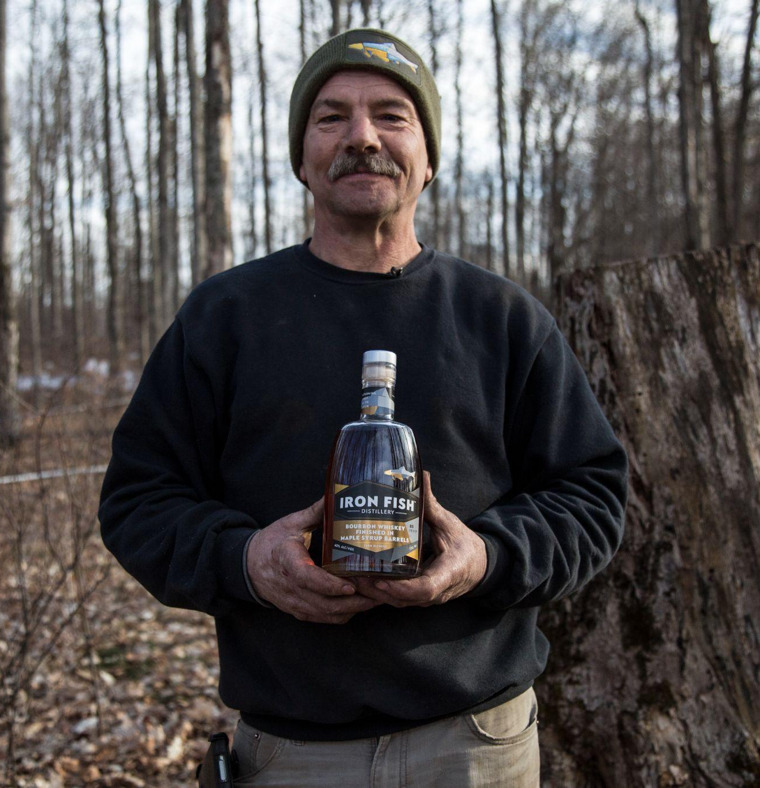
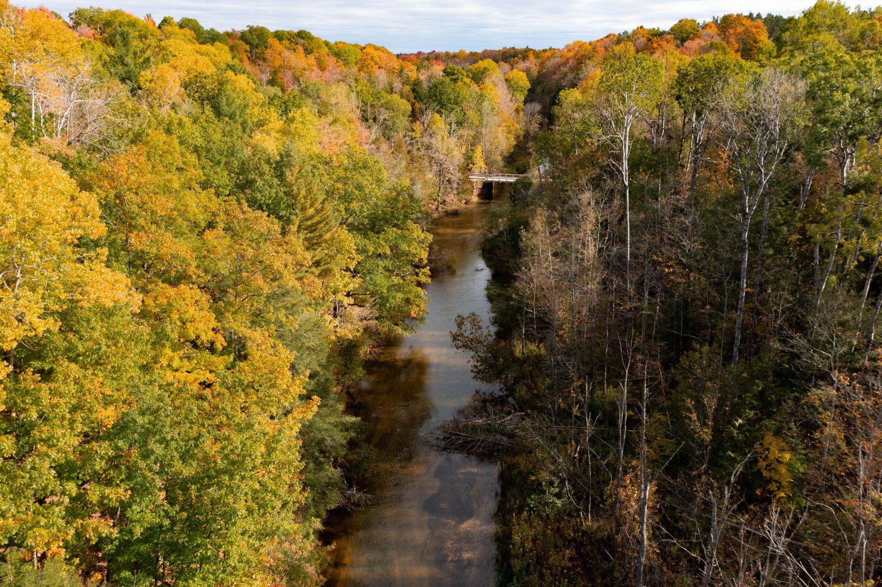
A Neighbor on the Betsie River
Richard Anderson · Michigan Agritourism Summit · May 14, 2026

Slide 3
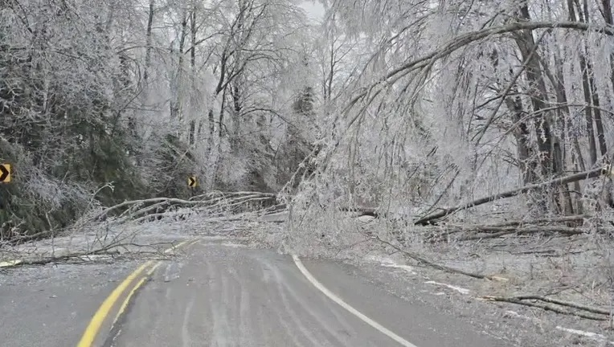
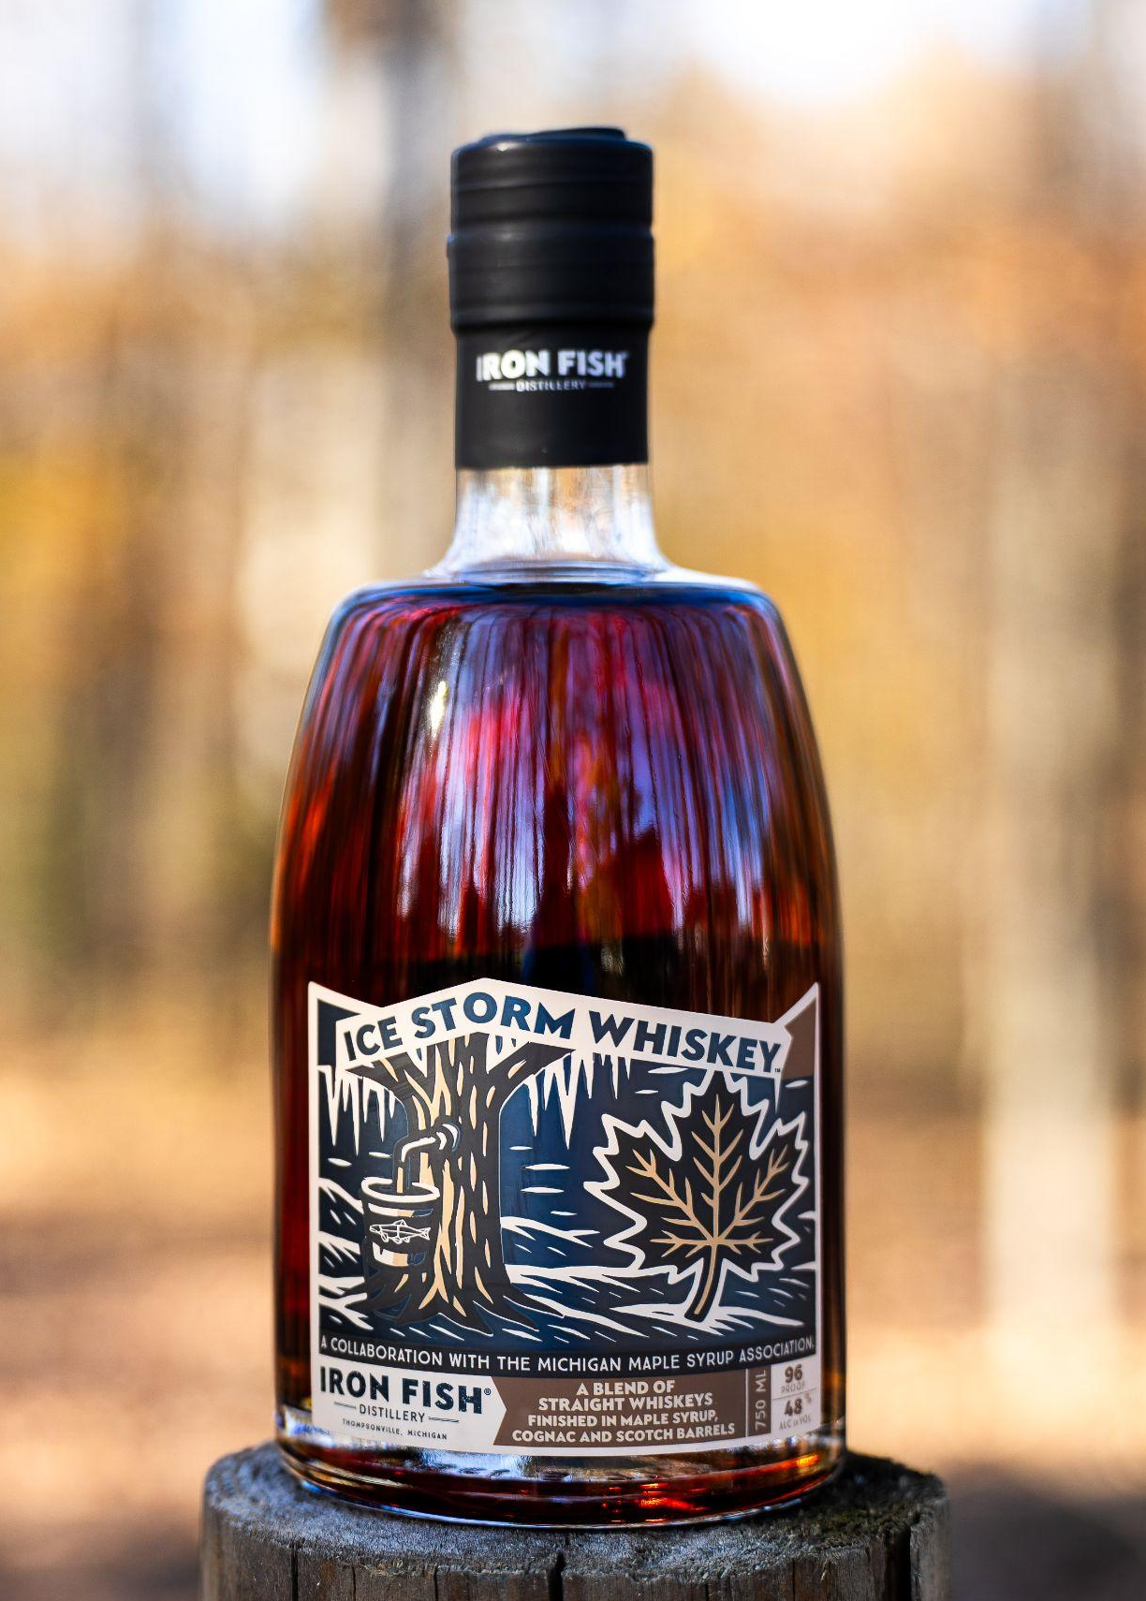
Spring 2025: A Once-in-a-Century Storm
Richard Anderson · Michigan Agritourism Summit · May 14, 2026

Slide 4
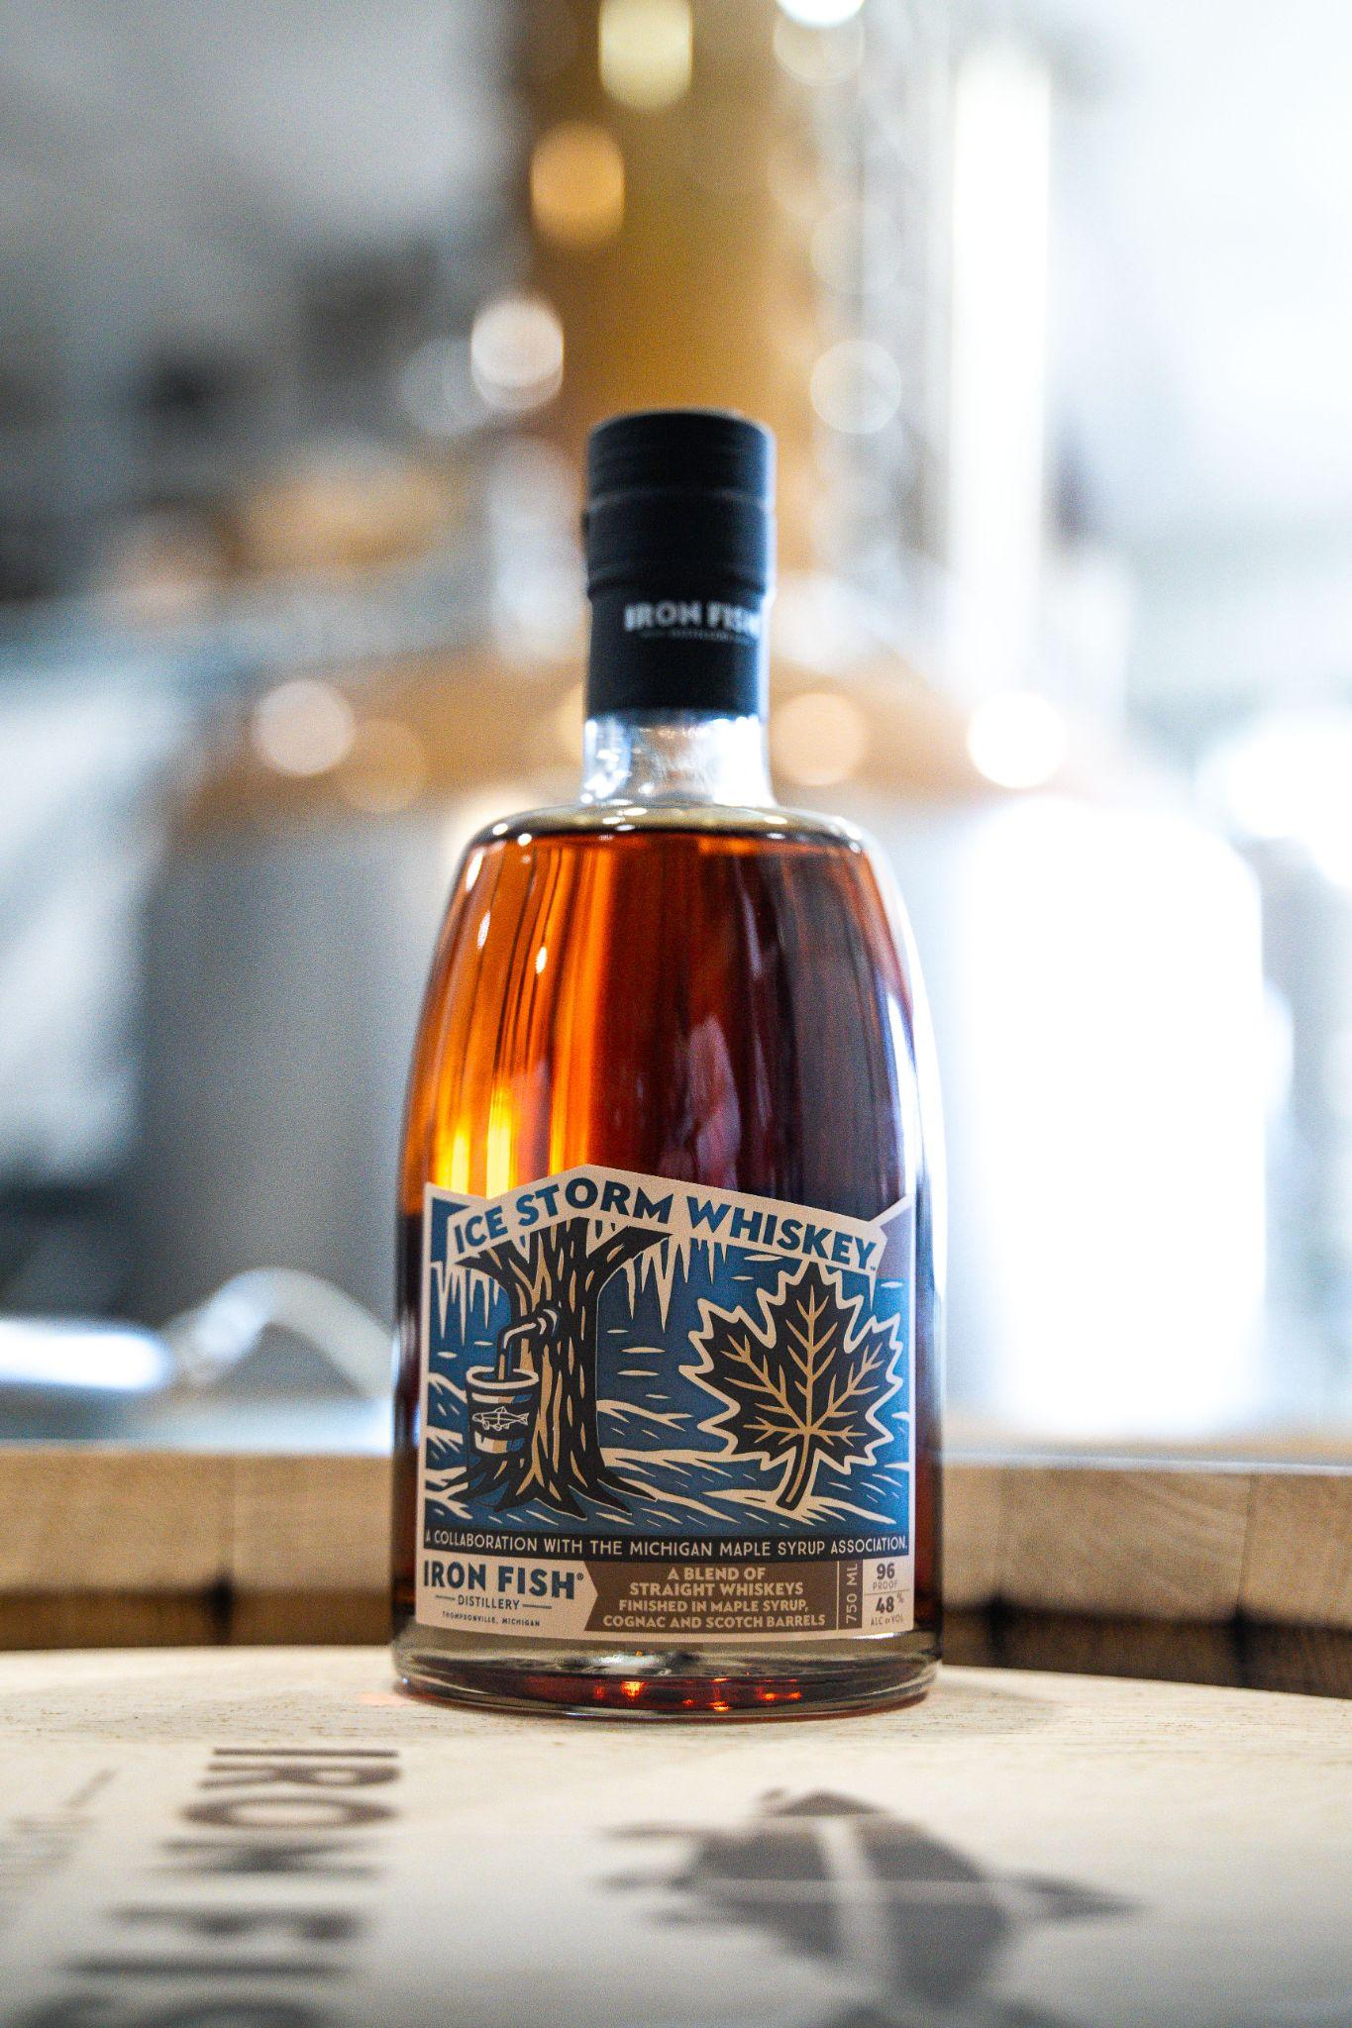
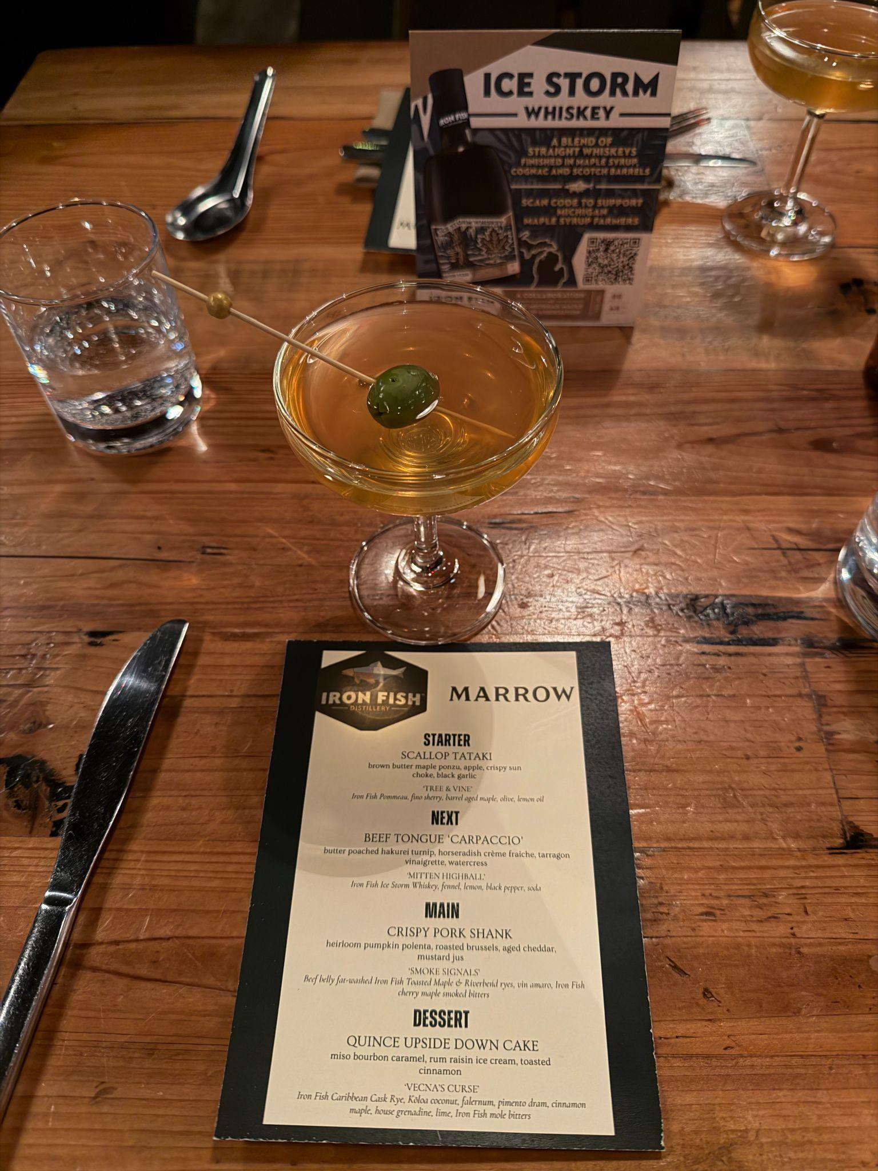
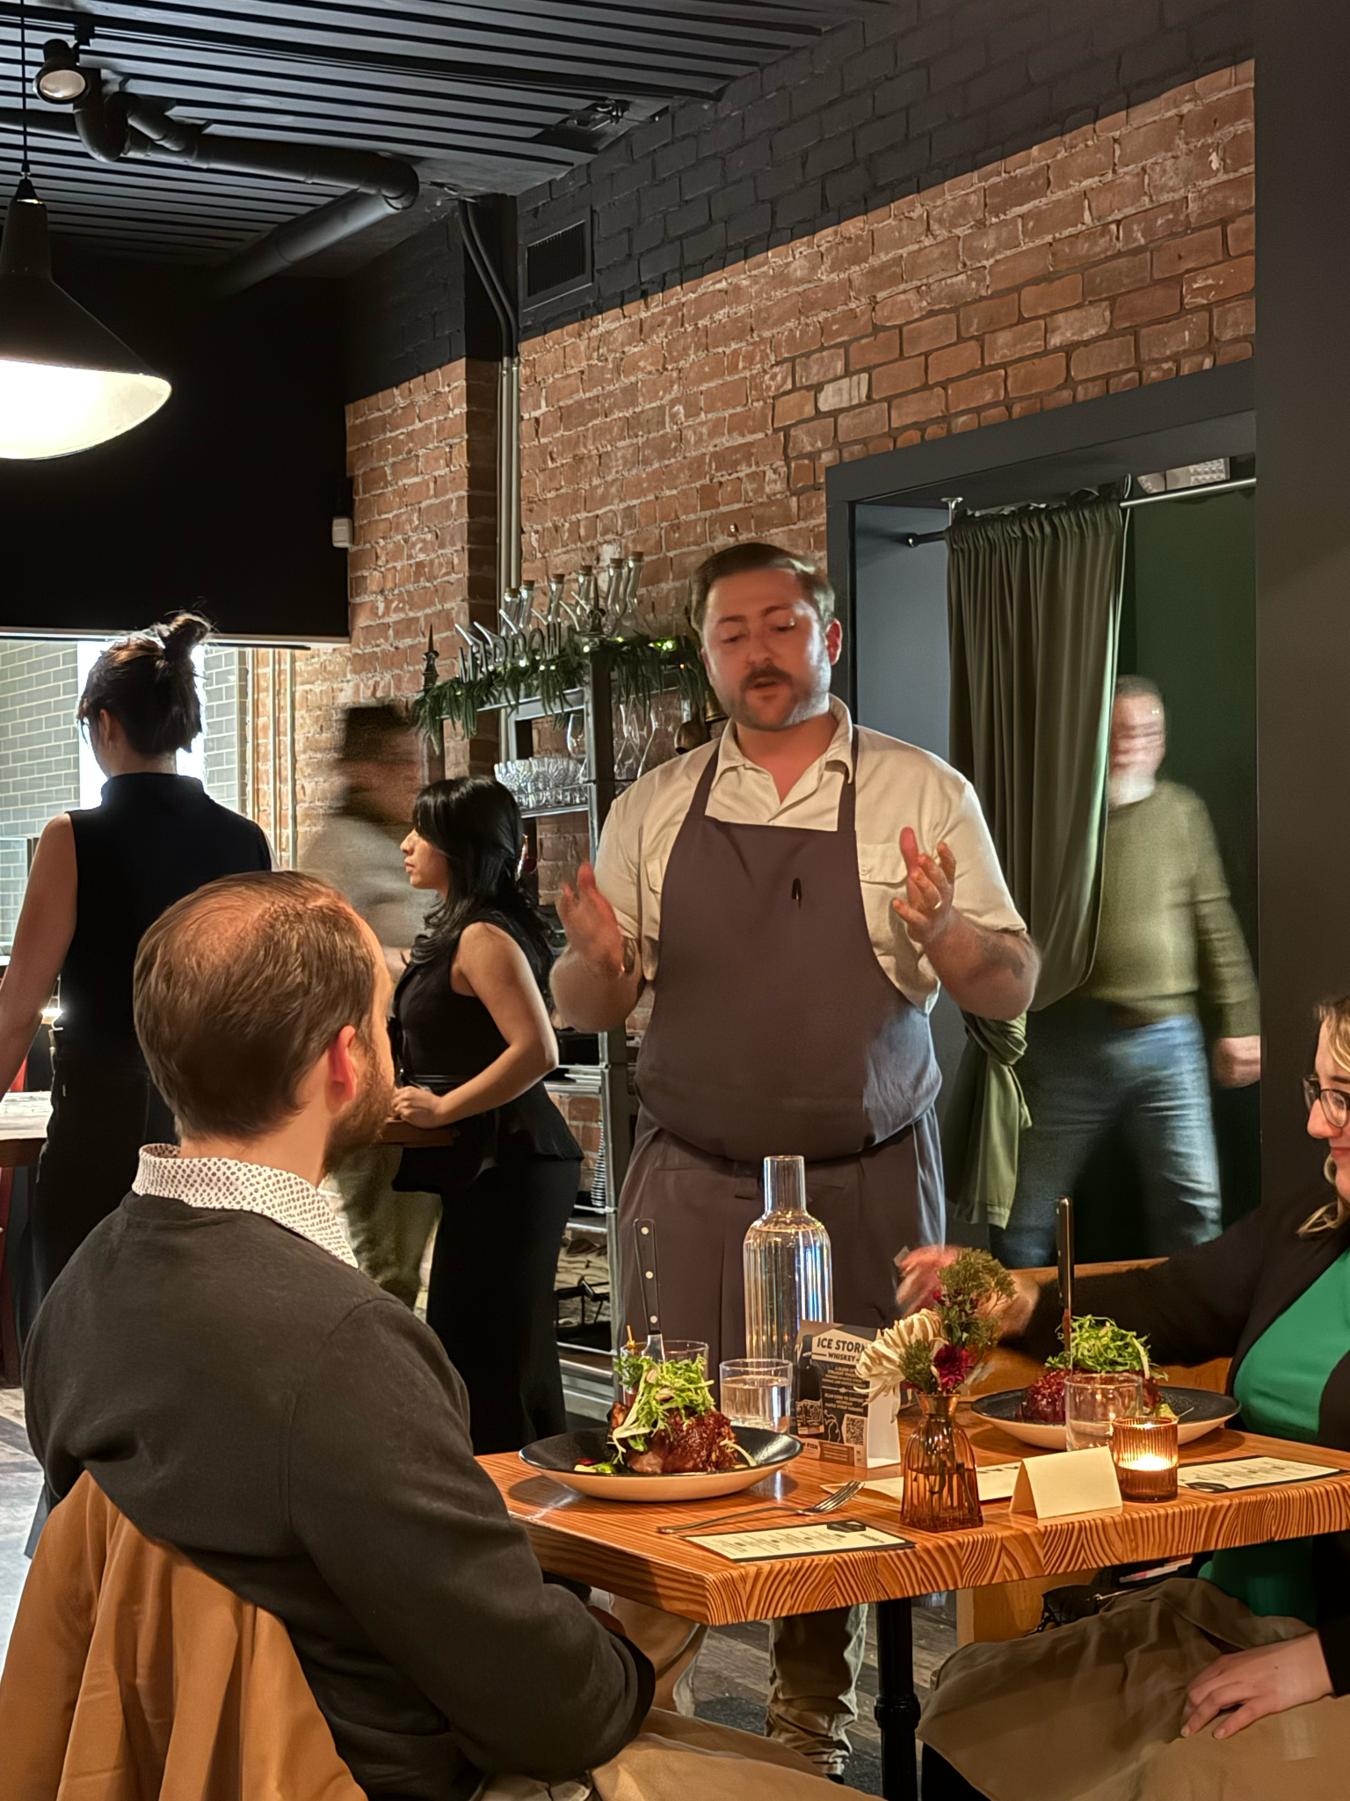

The Response Nobody Orchestrated
Richard Anderson · Michigan Agritourism Summit · May 14, 2026

Slide 5
Nine Traits of Enduring Agritourism Ventures
1. They meet a hunger, not just a market.
6. They practice hospitality as meaning, not method.
2. They are rooted in place — genuinely, not decoratively.
7. They know who they are before they grow.
3. They grow through intentional relationships.
8. They turn coherence into trust — and trust into affinity.
4. Those relationships become networks.
9. They give back to the ecosystem that sustains them.
5. They build capability patiently.
Richard Anderson · Michigan Agritourism Summit · May 14, 2026

Slide 6
Trait 1
They meet a hunger, not just a market.
When modern life feels empty of meaning, people seek what commercial life cannot manufacture
They will drive hours and pay a premium for contact with something real — grown, tended, rooted
Enterprises that understand this aren’t competing on features. They’re answering a deeper question: where can I feel something real?
Richard Anderson · Michigan Agritourism Summit · May 14, 2026

Slide 7
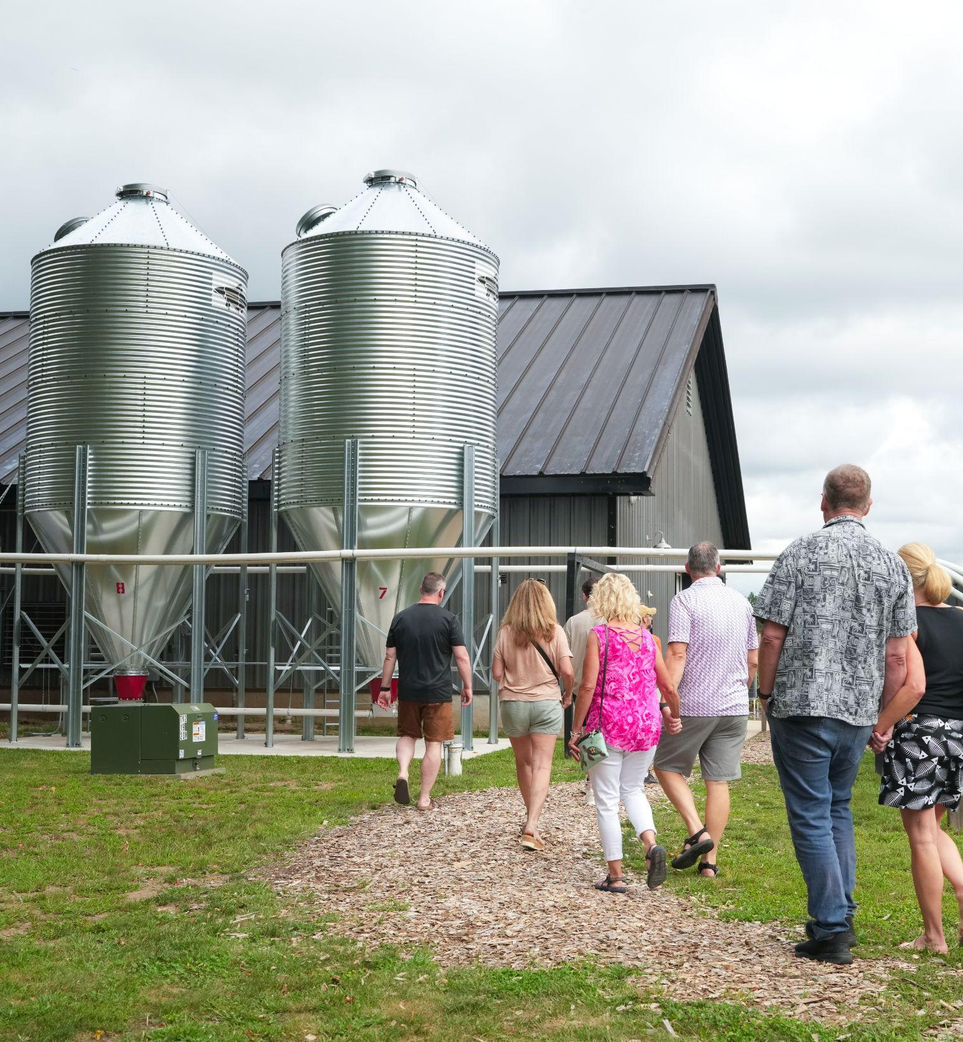
Trait 2
Rooted in place — genuinely, not decoratively.
Drawing genuinely from place requires upstream work that isn’t obvious
[ Image: Someone on a tour in a field of rye at Iron Fish Distillery — grain bags, barrels, distillery floor ]
Visitors know the difference between a place that’s lived-in and one that’s dressed up
The working landscape — unpolished, in-process — is often the most powerful asset
Richard Anderson · Michigan Agritourism Summit · May 14, 2026

Slide 8
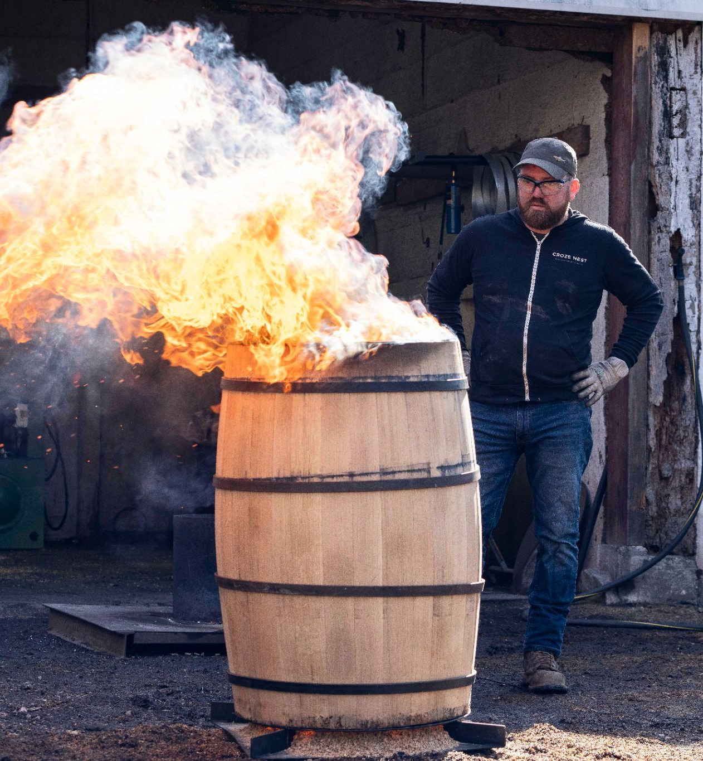
Trait 3
They grow through intentional relationships.
The most powerful relationships begin with a desire to learn from someone else’s craft
[ Image: Griner collaboration — barrel aging, maple syrup, working together ]
Growers become suppliers. Suppliers become collaborators. Collaborators become advocates.
The object of your attention becomes the engine of your brand
Richard Anderson · Michigan Agritourism Summit · May 14, 2026

Slide 9
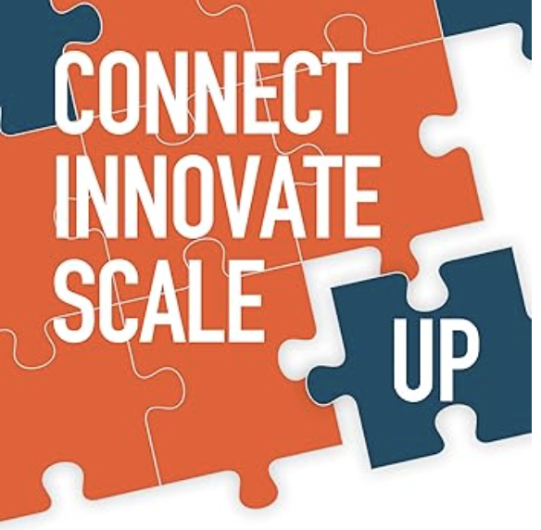
Trait 4
Those relationships become networks.
Networks create change capacity no individual venture can replicate
[ Image: Network activation — map of Michigan / pairing events / community response ]
Density of connection + alignment of values = capacity for emergence
Build your network by becoming worth connecting to
Richard Anderson · Michigan Agritourism Summit · May 14, 2026

Slide 10
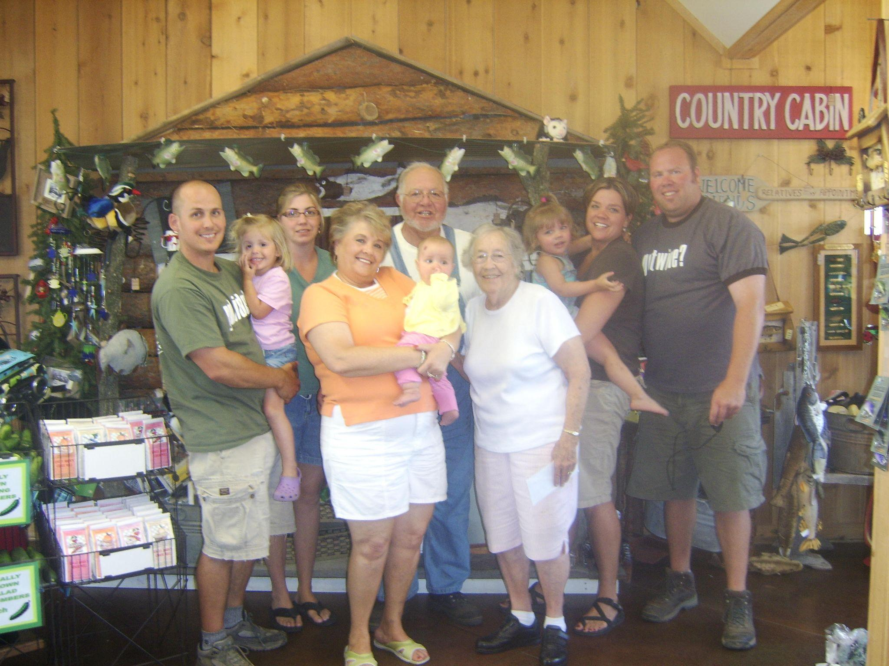
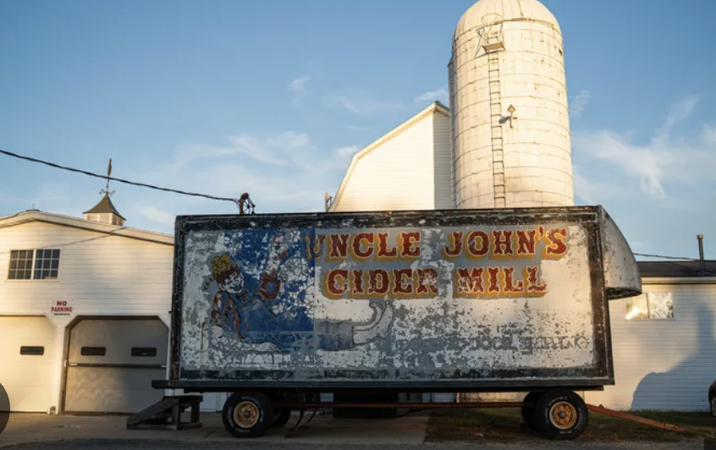
Trait 5
They build capability patiently.
The strongest ventures add depth before volume
[ Image: Uncle John’s Cider Mill — orchard, cider press, barn, five generations ]
Resist the pressure to scale before the enterprise can hold the weight
Don’t confuse momentum with maturity
Richard Anderson · Michigan Agritourism Summit · May 14, 2026

Slide 11
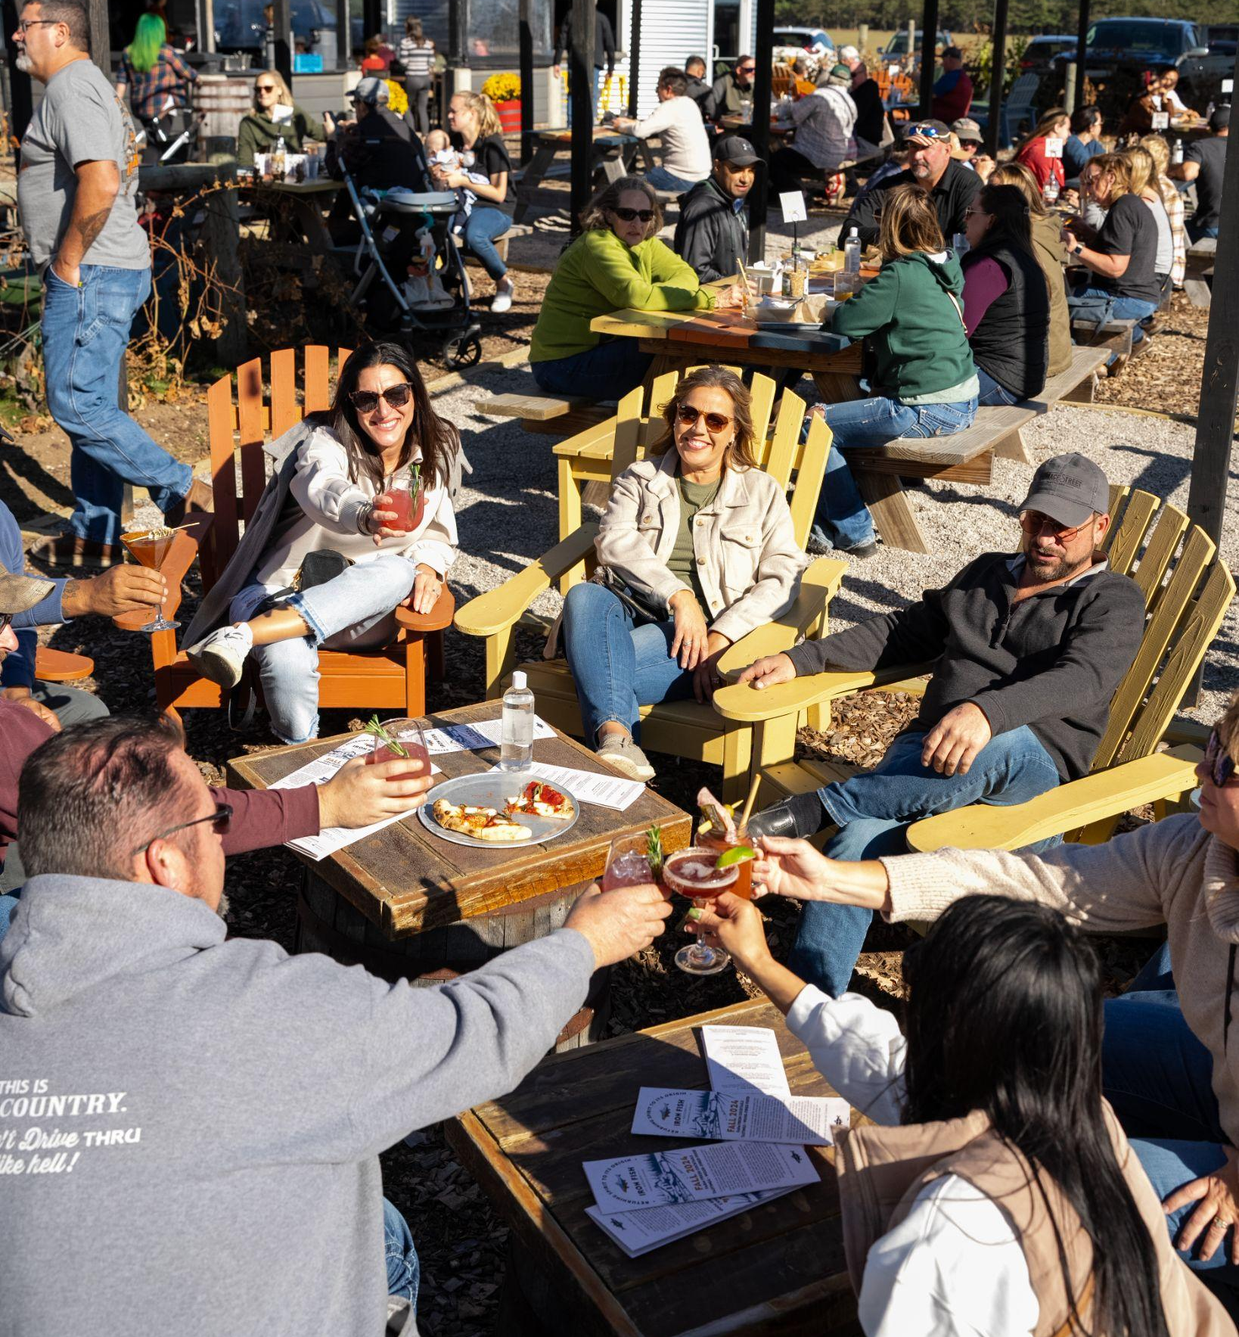
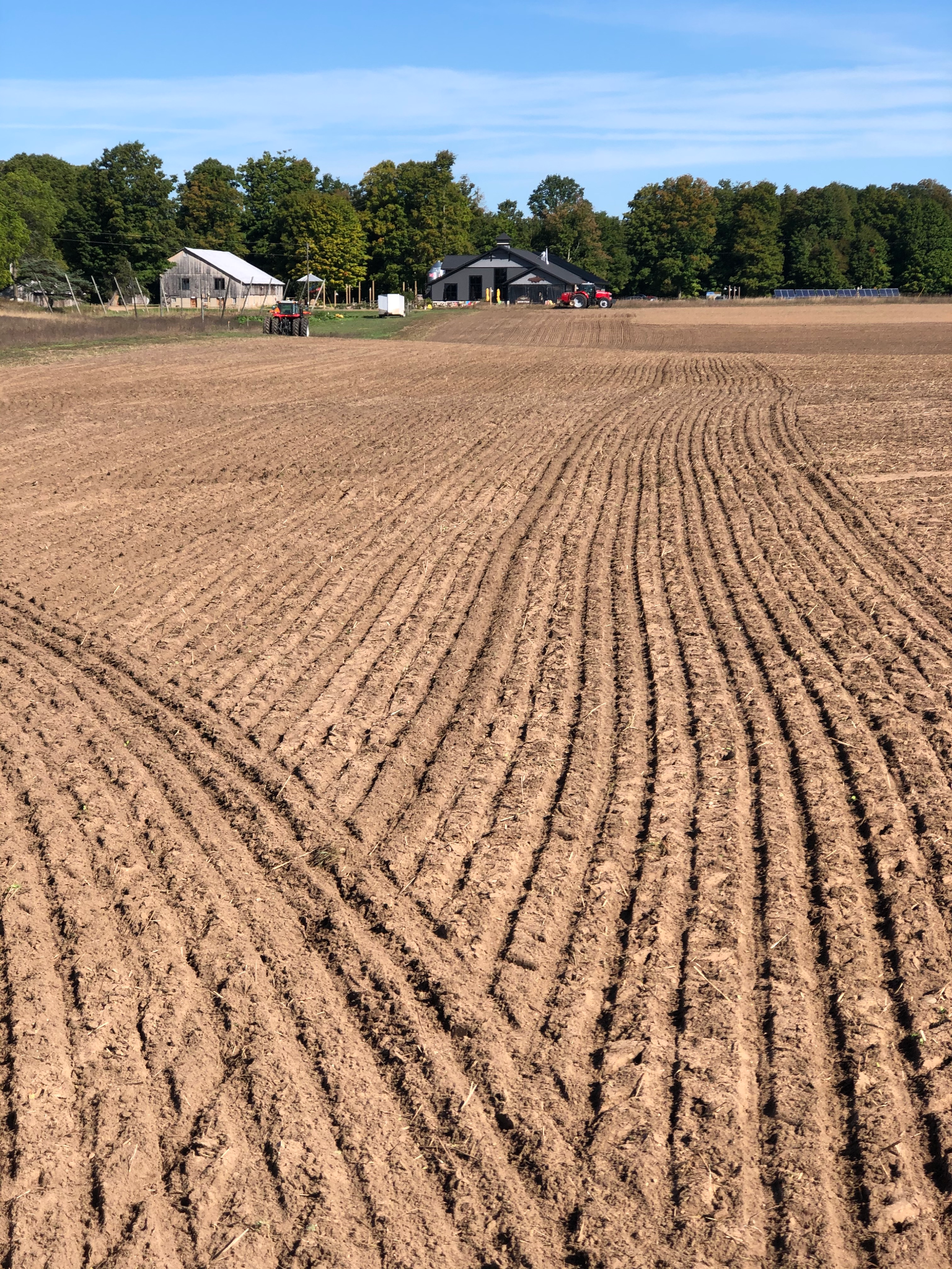
Trait 6
Hospitality as meaning, not method.
Service is technical delivery. Hospitality is how people feel.
[ Image: Iron Fish tour — rye fields, barrel room, team at work ]
The deepest hospitality grows from upstream work
When inside and outside match, visitors feel something they cannot name
Richard Anderson · Michigan Agritourism Summit · May 14, 2026

Slide 12
Trait 7
They know who they are before they grow.
Growth doesn’t transform you. It magnifies you.
Define your identity before revenue, recognition, or feature stories arrive
Identity is the accumulated answer to thousands of small decisions made before anyone was watching
Strategic clarity functions as a gyroscope.
Richard Anderson · Michigan Agritourism Summit · May 14, 2026

Slide 13
Trait 8
Coherence into trust — trust into affinity.
When values are visible in sourcing, staffing, and response to a community in need — people feel it
Trust accumulated over time becomes affinity no marketing budget can manufacture
Affinity isn’t created by marketing. It’s revealed by how you act when it matters.
Work done with care because it mattered — not because anyone was watching.
Richard Anderson · Michigan Agritourism Summit · May 14, 2026

Slide 14
Trait 9
They give back to the ecosystem that sustains them.
Enduring enterprises understand they are downstream of something larger
Obligation runs to the land, the growers, and the living system that makes the work possible
The ventures that endure feel responsible to the system that made them possible
This isn’t altruism. It’s ecology.
Richard Anderson · Michigan Agritourism Summit · May 14, 2026

Slide 15
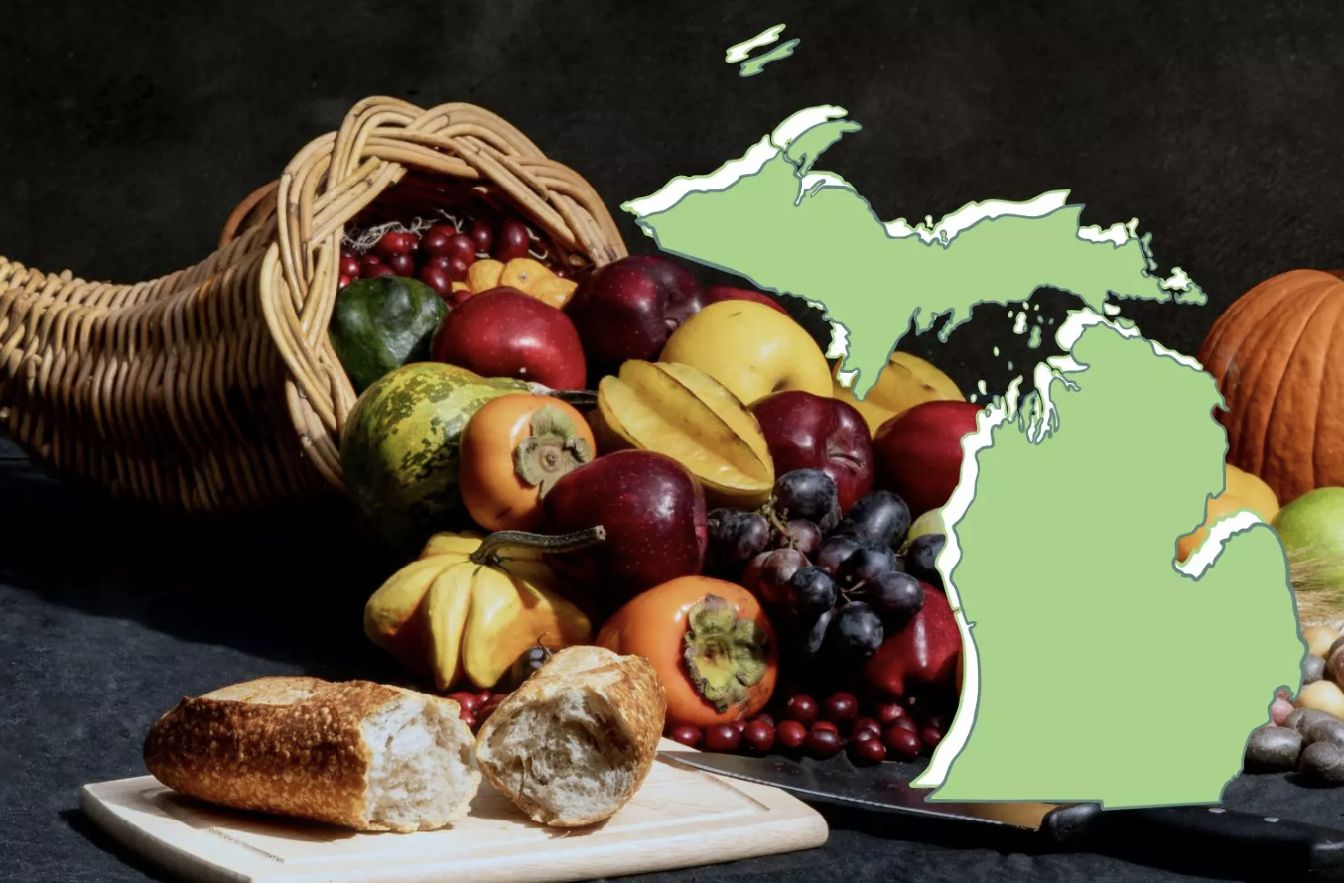
Michigan: Unusual Responsibility
[ Infographic: Michigan Agritourism Economy ]
Source TBD — contact MDARD / MSU Extension
Richard Anderson · Michigan Agritourism Summit · May 14, 2026

Slide 16
[ Image: Uncle John’s Cider Mill — multi-generation Beck family photo ]
The work before the welcome. That’s what endures.
Richard Anderson · Michigan Agritourism Summit · May 14, 2026

Slide 17
The Work Before the Welcome
Enduring agritourism ventures are made of something deeper than the event,
the visitor experience, or the destination marketing.
The upstream work — the work before the welcome — is what endures
Richard Anderson · Michigan Agritourism Summit · May 14, 2026

