Slide 1


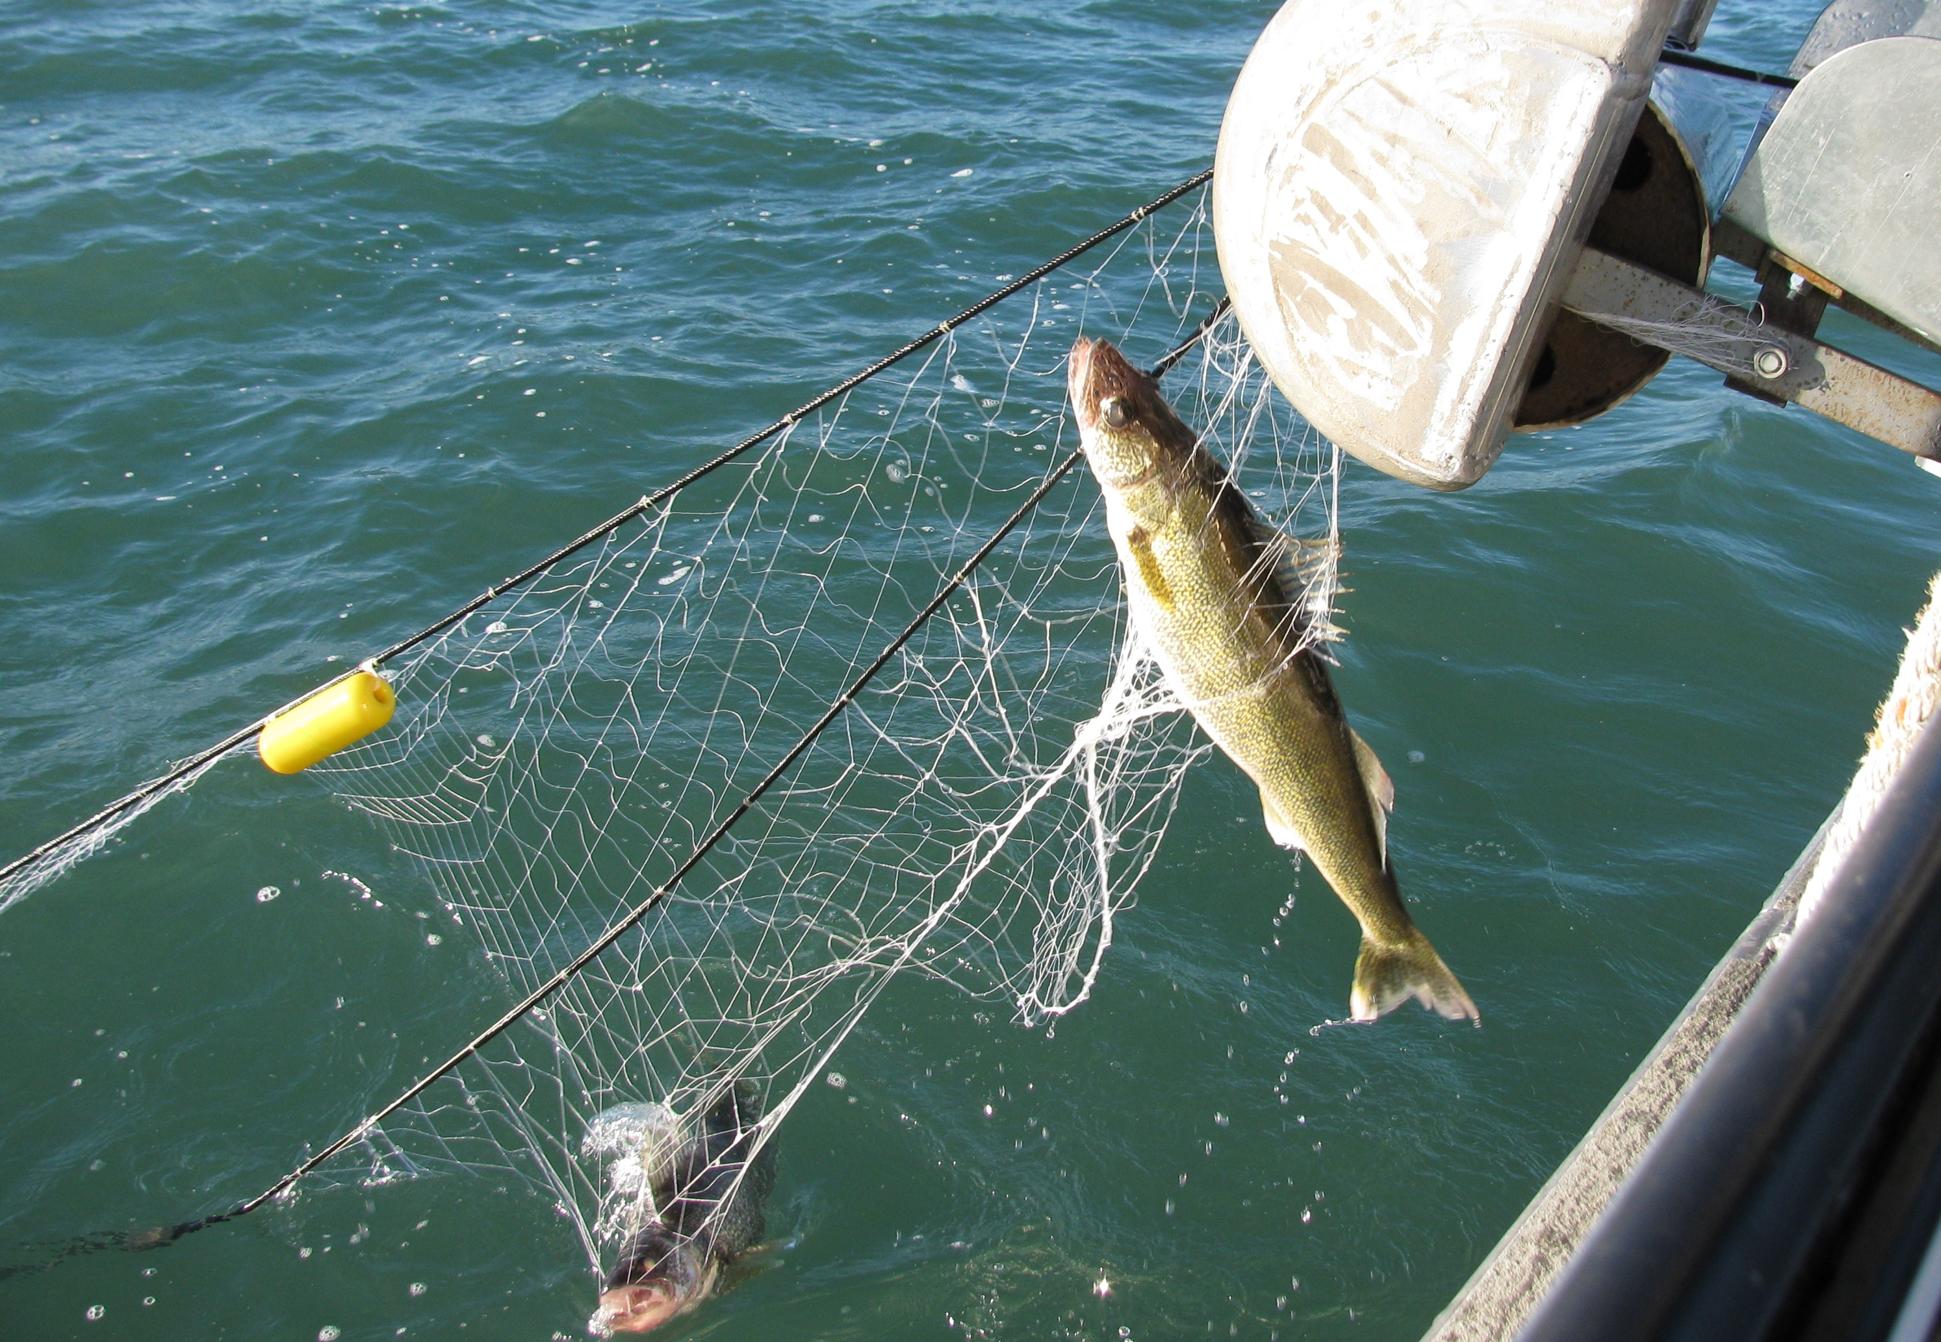
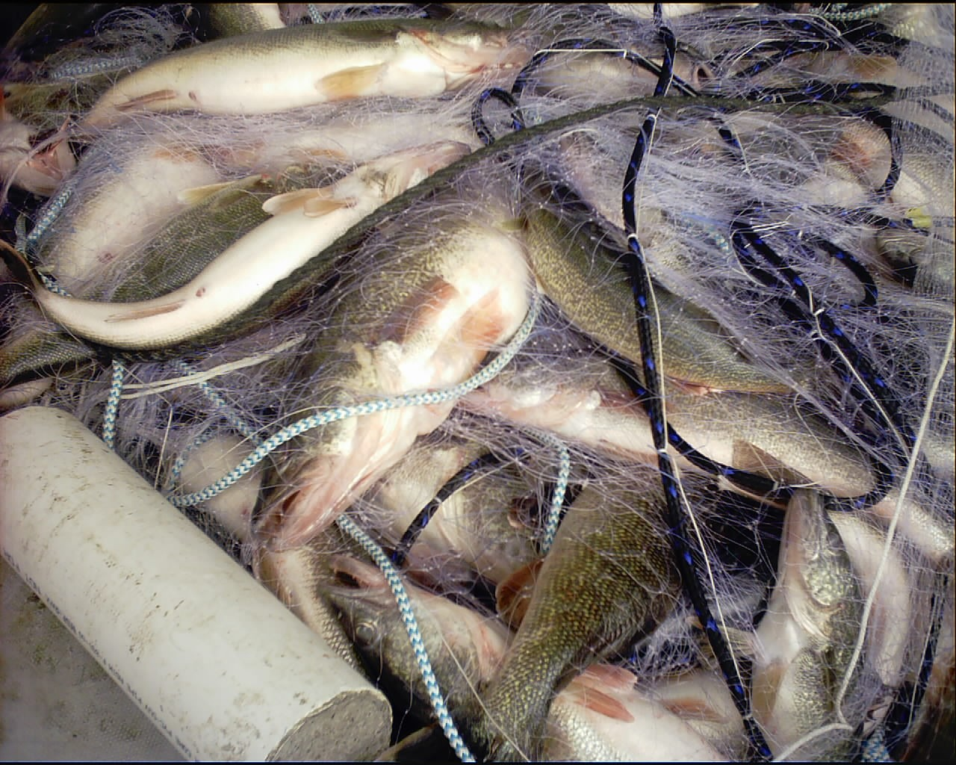
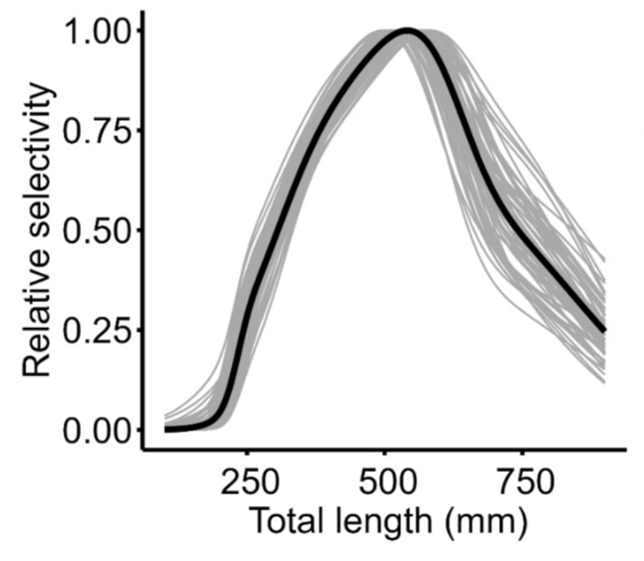











Quantitative Fisheries Center (QFC)
Completed Project Briefing
Indirect Estimation of Contact Selectivity for Gillnets Using Hierarchical Models
Project Lead: | Matt Faust (QFC PhD Student)
Contact info: | matthew.faust@dnr.ohio.gov
QFC Collaborators: | Chris Cahill, Travis Brenden
Funding Agency: | QFC Base Funds
Active Dates: | 2020 – 2025
Caption: Gill-net captured Lake Erie walleye. Credit: Ohio Division of Wildlife
Goal: | Evaluate the feasibility of using a hierarchical modeling framework to account for net-specific deviations in indirect estimation of contact selectivity
Objectives: | Compare selectivity estimates resulting from pooled and hierarchical approaches with data from two standardized experimental gill net configurations Quantify the extent that selectivity parameters for experimental gill nets were spatially correlated using the best fitting models from Objective 1
Management Implications: | Contact selectivity is traditionally estimated by pooling catches among multiple net sets and/or years, which may obscure mask variation in among-set selectivity. Hierarchical models allow such variation to be explicitly accounted for during model estimation and explore possible drivers (e.g. spatial autocorrelation) in among-set contact selectivities
Methods: | Fit pooled and hierarchical contact selectivity models to walleye catch data from two gillnet configurations used on Lake Erie Hierarchical models differed in the assumed underlying selectivity function as well as what parameters were modeled as random effects After identifying best-performing models, spatial autocorrelation in net-specific random effects was assessed
Key Findings: | Hierarchical models were more supported than traditional pooled approaches for both gillnet configurations. Binormal selectivity functions were more supported than other evaluated functions Hierarchical models that accounted for spatial autocorrelation were difficult to estimate, but models that converged has low spatial range suggesting weak autocorrelation
Deliverables: | Faust, M.D., C.L. Cahill, and T.O. Brenden. 2025. Indirect estimation of contact selectivity for gillnets using hierarchical models. Canadian Journal of Fisheries and Aquatic Sciences 82:1-14. Download manuscript
Caption: Example of contact selectivities estimated from walleye gillnet catch data using hierarchical models. Black line is the population-averaged aggregate selectivity. Gray lines are net-specific aggregate selectivities from gillnets deployed over a 5-year period.
QFC Supporting Partners

